Slide 1
Notice of Copyright
This presentation is protected by U.S. and international copyright law.
Reproduction, distribution, display, and use of the presentation without written permission is prohibited.
For information, contact Stephanie Samulski (ssamulski@tileusa.com)
© Tile Council of North America

Slide 2
Thin Tiles

Slide 3

What We’ll Be Covering:
What Is Thin Tile?
How Is It Different?
Thin Tile Standards for Manufacturing and Installation
Why Is Thin Tile Exciting?
Thin Tile Applications: Familiar & New

Slide 4
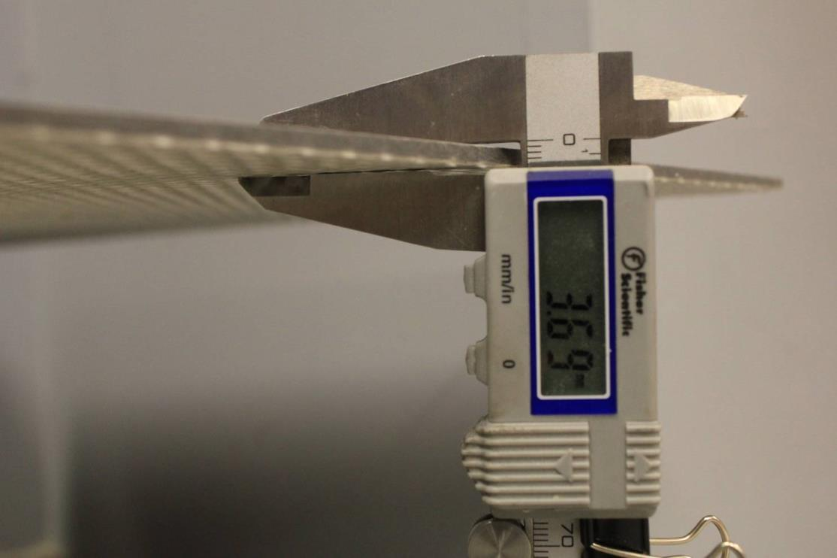
Thin Tiles Range:
~ from 3 mm to 6.0 mm

Slide 5
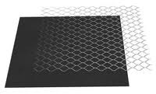

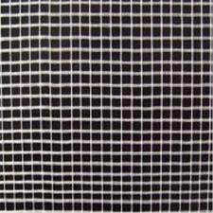
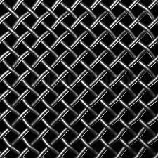
Often Reinforced with Fiberglass, Plastic, or Metal Mesh

Slide 6

Thin Tile Manufacturing Methods
Traditional Dust Pressing
Extrusion
The Lamina® Process
The SACMI Continua® Process

Slide 7
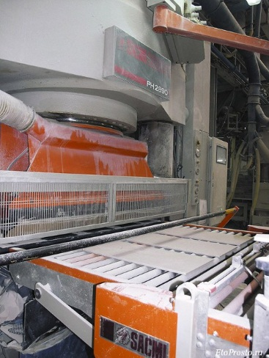
Traditional Dust Pressing
Die cavities are filled with powders and pressed.

Slide 8
Extrusion Process
NO PHOTO AVAILABLE

Slide 9
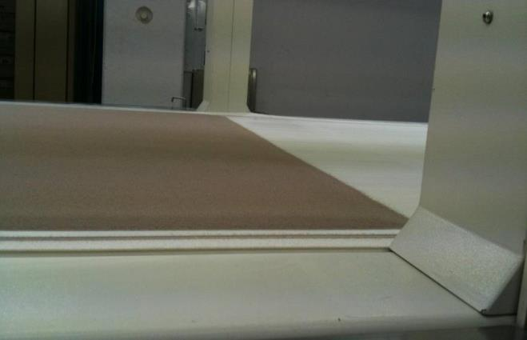
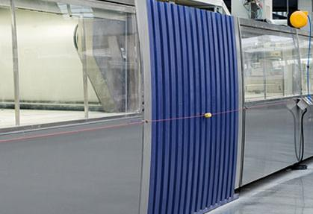
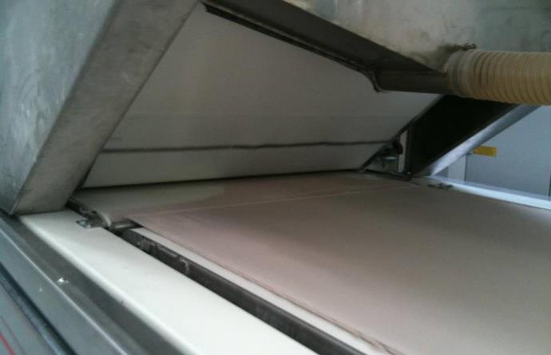
The Lamina® Process
Powders are spread evenly into a pile on the conveyer belt.
Powders are pressed between two flat plates (no die cavity); edges are trimmed later.
The pile of powders is fed between two belts into the press.

Slide 10
The SACMI Continua® Process
Powders are distributed in exact die dimensions and are pre-compacted using rollers.
Pre-compacted powders are placed in die for final compaction in a traditional press.

Slide 11
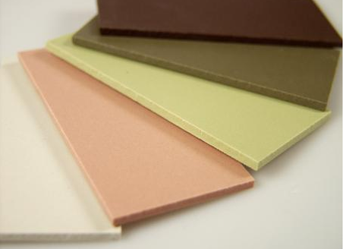
How Is Thin Tile Different?

Slide 12

It’s Different
Different properties & characteristics
Important differences in performance
and the way it needs to be installed

Slide 13

It’s Different
Reduced thickness means:
  Lower breaking strength
  Increased edge sensitivity
  Flexibility: a new consideration
  Higher coverage requirement
  Tighter lippage requirement
  Greater sensitivity to point loading

Slide 14
It’s Different
Large surface areas mean:
  Current dimensional analyses do not apply
  Sampling procedures need to be reconsidered
  Flatter substrate and floor prep needed
  Job site handling is changed
  Shipping is changed
  Greater mortar thickness
  Breakage is big money

Slide 15
It’s Different
Reinforcing on some products means:
  Need to develop requirements such as bond strength to the tile and bondability to thin-set
  What happens when tile cracks
  Alkali sensitivity of the mesh and adhesive
  Metal film reactivity to the mortar
  Water absorption of mesh
  Freeze/thaw effect
  VOCs

Slide 16

Product standards
& installation standards:
Establish performance (quality) requirements
Provide a mechanism for communicating differences (vs. traditional tile) and clarify how user expectations should be different
Communicate differences in installation

Slide 17


Under
Construction
  ANSI A137.3 American National Standard Specifications for Thin Porcelain Tile and Thin Porcelain Tile Panels
  ANSI A108.19 Installation of Thin Porcelain Tile and Thin Porcelain Tile Panels by the Thin Bed Method with Latex-Portland Cement Mortar

Slide 18


Sneak peek into the exciting world of standards development…
Even giving it a name can be a challenge
Why not just call it “thin tile” ?

Slide 19

What Should the
Thin Tile Standard
Be Based On?
Method of Manufacture?
Area of Use?
A Little Bit of Both!!
  Different tables based on marketplace understanding and expectation

Slide 20
We’ve Been Here Before:
Standards for traditional ceramic (A137.1) and glass (A137.2) are separate; both take a hybrid approach:
  Pressed and extruded ceramic tiles – different criteria based on method of manufacture, same area of use
  Cast, fused, and low-temperature-coated – different criteria based on method of manufacture, same area of use

Slide 21
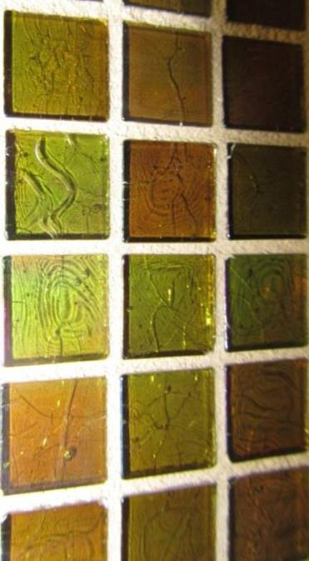
We’ve Been Here Before:
Special needs/market expectations for glass necessitated a unique standard:
  Defects vs. expected characteristics (ex: bubbles)
  Translucency/opacity
  Quantity of recycled content

Slide 22
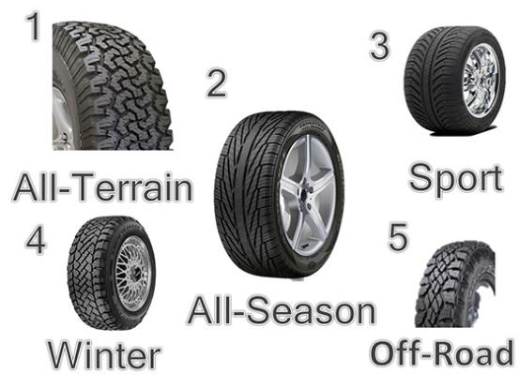
Many Things in Life
Vary in This Way
Tires: standards regulate differing levels of performance
Hospitality: Different criteria for different price levels – one star hotel versus 5 star hotel

Slide 23
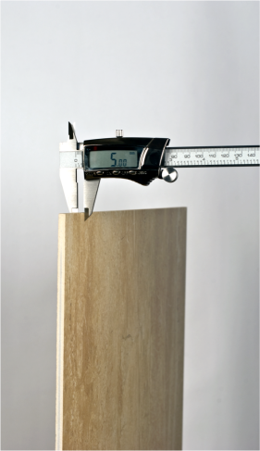
Likely to Be Included in A137.3
Definition:
  Thickness: 0.236 inches (6.0mm)
  or less
  Thin Porcelain Tiles ≤ 1 square meter
  Thin Porcelain Tile Panels > 1 square meter

Slide 24
Likely to Be Included in A137.3
Water Absorption
  Non-reinforced: 0.5% or less
  Reinforced: 0.5% or less (reinforcing removed) AND 1.0% or less (with reinforcing attached)

Slide 25
Likely to Be Included in A137.3
Breaking strength considerations:
  How low can we go? How to account for flexibility?
  Does not break into pieces like traditional tile; audible “crack” observed but tile still intact (especially for reinforced)
  Can a point loading test be used? If so, what modifications are needed?
  Three point bending test? (good for evaluating flexibility)

Slide 26
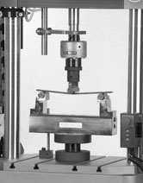
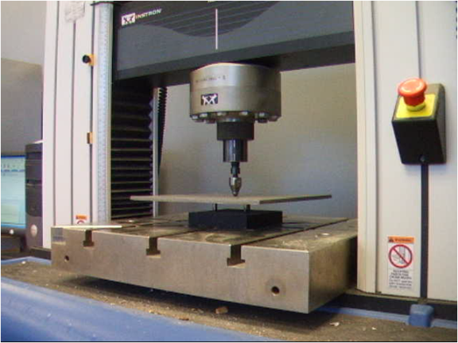
Three Point Bending
Tile supported by end beams
Modulus of Rupture (MOR)
Breaking strength of glass tile (ANSI A137.2) and traditional tile (ISO standard)
Point Loading
Tile supported by 3 pegs
Used to determine breaking strength (ANSI A137.1)

Slide 27
Likely to Be Included in A137.3
Installed performance considerations:
Unique setting procedures and materials
May help determine application suitability and suitable substrates
(Not included in A137.1 or A137.2)

Slide 28
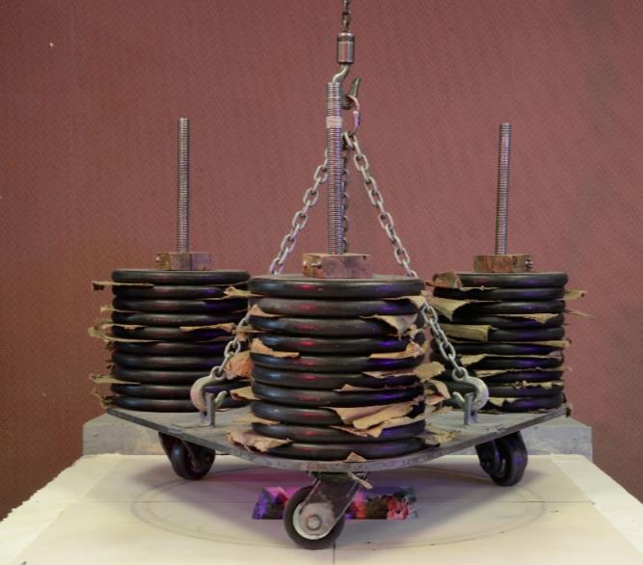
Likely to Be Included in A137.3
Robinson Floor Test:
Increasing weight and wheel hardness; test to failure
Industry accepted; well understood and lots of data with traditional tile
Does installation performance change if different materials are used (membranes, etc.)?

Slide 29

Likely to Be Included
in A137.3
Impact Resistance:
Inherently, thinner materials are more susceptible to damage from impact (less material to absorb stresses associated with impact).
Commonly, materials are reinforced to add impact resistance:
  This alters impact behavior so traditional tile tests (coefficient of restitution) no longer apply.
Impact near grout joints from carts and dollies
Impact in the middle from falling objects, high heels, etc.

Slide 30
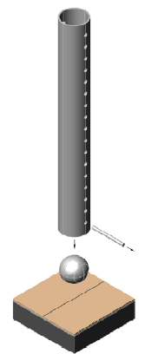
Impact Resistance Tests…
Weighted sphere dropped onto tile face from a predetermined height
Samples checked for visible damage:
  Cracks
  material loss
  edge crushing

Slide 31
Impact Resistance Tests…
For edge impact, borrow pendulum test from dinnerware industry?
Repeated impacts from a swinging arm of a pendulum
Force required to cause fracture, chip, etc.

Slide 32
Likely to Be Included in A137.3
Dimensional Tolerances
Evaluation of Edge Length Is Extremely Important:
  Very small grout joints are common, which makes edge length consistency very important.
  Very large tiles means fewer grout joints and fewer places to accommodate sizing inconsistencies.

Slide 33

Likely to be included in A137.3 Dimensional Tolerances
A New Method Is Needed to Evaluate Edge Length Because of Existing Lab Equipment:
  Typically under 5 ft.
  Relies on tile rigidity: tile rests on its corners; thin tiles would sag

Slide 34
Likely to Be Included in A137.3 Dimensional Tolerances
Warpage
  Affects lippage in traditional tile, and minimizing lippage is even more critical for thin tile . . . but how does warpage affect lippage with thin tile?
  Is it relevant for inherently flexible product?
Wedging (Corner Squareness)
Thickness

Slide 35

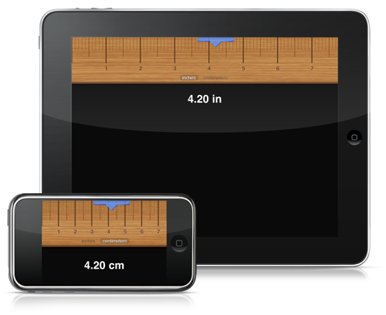
Measurement Methods Under Consideration
Place tiles on a flat plane?
Measure them vertically?
Coordinate measuring machine (CMM)?
Lasers?

Slide 36
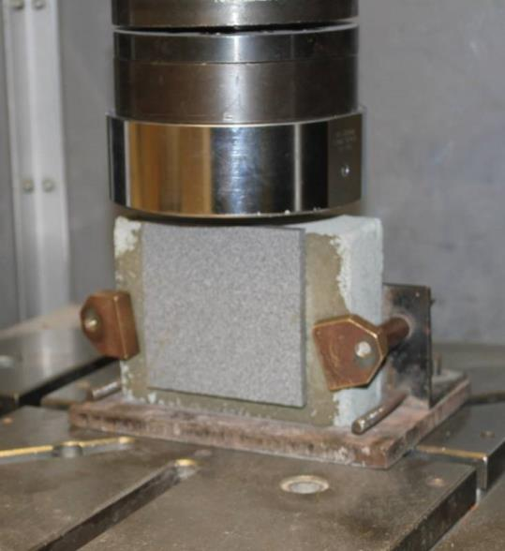
Likely to Be Included in A137.3:
Bond Strength Test
Force required to break bond:
  between tile and substrate
  between reinforcing and tile?
  effect of moisture?
Bonding to fiberglass/metal reinforcing?
Non-reinforced thin tiles with flat backs

Slide 37
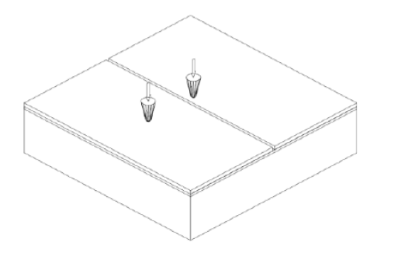
Likely to Be Included
in A137.3:
Point Load Test?
How will tile perform where thin-set voids exist?
Will thick mortar, tile flexibility, or “spongy” materials (like membranes) increase cracking?
Does reinforcing help a lot? help a little? Hurt?
Use membrane test?
  Probe loaded until tile cracks
  Test tile center or edge?

Slide 38
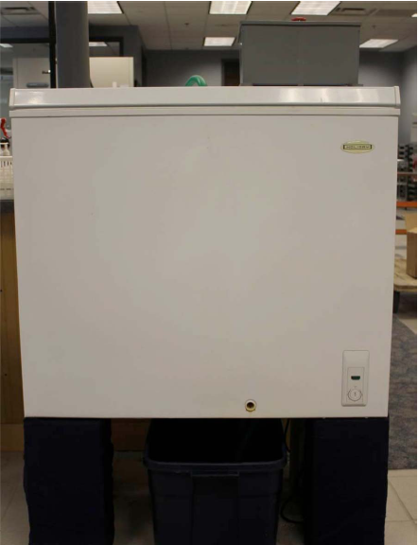
Likely to Be Included in A137.3:
Freeze/Thaw Testing?
Important to evaluate this if thin tiles will be used outside
  Thin profile may be attractive for decks/balconies
Effect of water trapped between reinforcing and ceramic body?
Does existing test method work?
  Recently increased from 15 to 300 freeze/thaw cycles

Slide 39
Likely to Be Included in A137.3?
Other Performance Characteristics Evaluated for Traditional Tiles:
  Abrasion resistance
  Chemical resistance
  Stain resistance
  Crazing resistance
  Thermal shock
  Shade variation
  Color uniformity
  DCOF

Slide 40

Thin Tile Installation:
A Moving Target?
Lack of product standard makes development of installation standards or guidelines difficult

Slide 41

Thin Tile Installation
The trade is essentially unregulated, so installation practices vary widely and are difficult to control …yet thin tile requires special precautions and procedures for all aspects of handling and installation

Slide 42
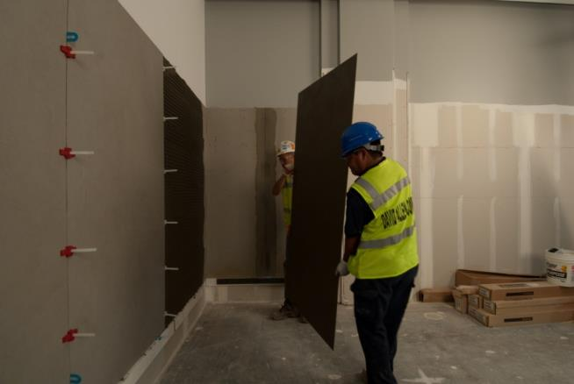
Likely to Be Included in A108.19
Modified version of A108.5
Limited scope
  Interior
  Thin-bed
  Cementitious mortars

Slide 43
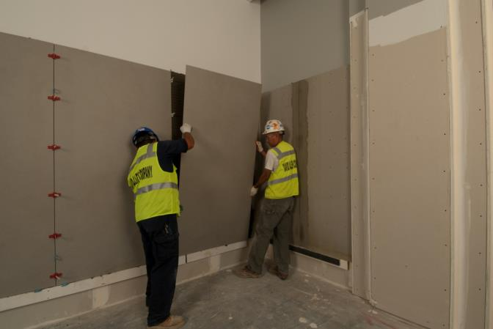
Likely to Be Included in A108.19
Select substrates
  Floors: concrete, mortar bed over concrete
  Walls: concrete, CMU, drywall, backer boards
Tile over tile? Who determines soundness of existing tile?

Slide 44
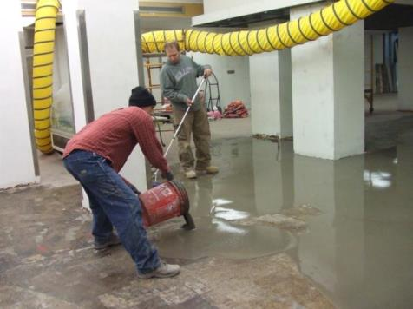
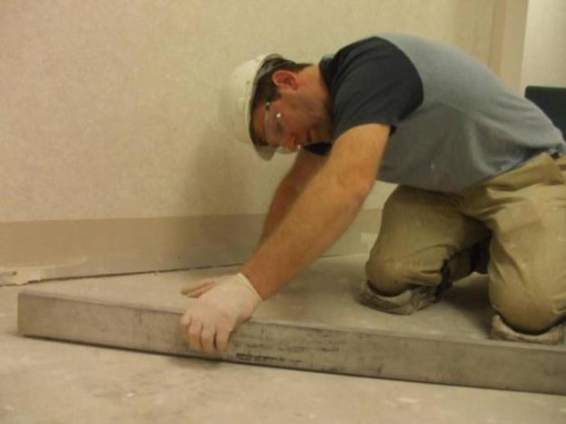
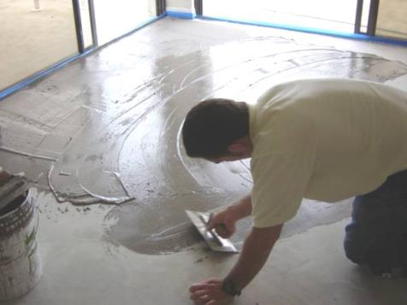
Likely to Be Included in A108.19
Required substrate flatness:
  1/8” in 10 feet
  1/16” in 1’
Substrate prep required, like VCT flooring

Slide 45
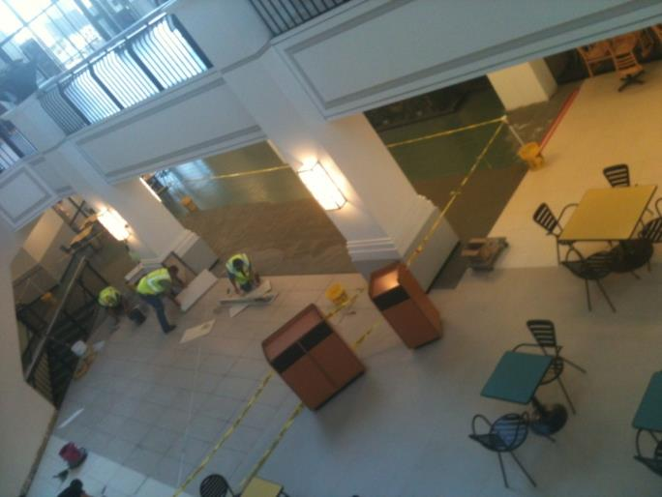
Likely to Be Included in A108.19?
Jobsite Requirements
  Clear pathways
  Elevator, buck hoist, or boom lift may be needed
  Emphasis on restriction of traffic and impact

Slide 46
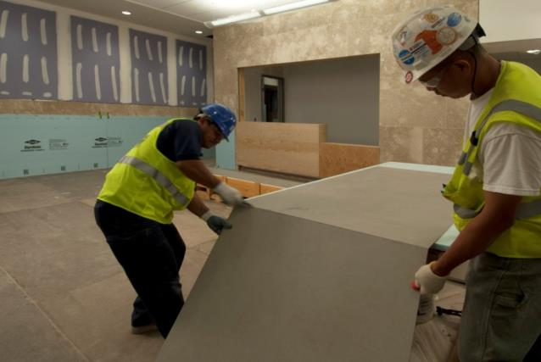
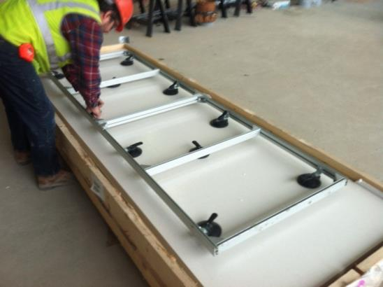
Likely to Be Included in A108.19?
Handling large pieces:
  Rack with suction cups?
  2 people? 4 people?
  Specialized tools for cutting and transporting?
  Dedicated workstation?

Slide 47
Likely to Be Included in A108.19
Unpacking/handling:
  How to ensure material isn’t damaged since cracks are often not obvious
  Documentation
  Necessary equipment and procedure for moving crates around jobsite
    Long arms on forklift
    Keep large pieces vertical when carrying

Slide 48
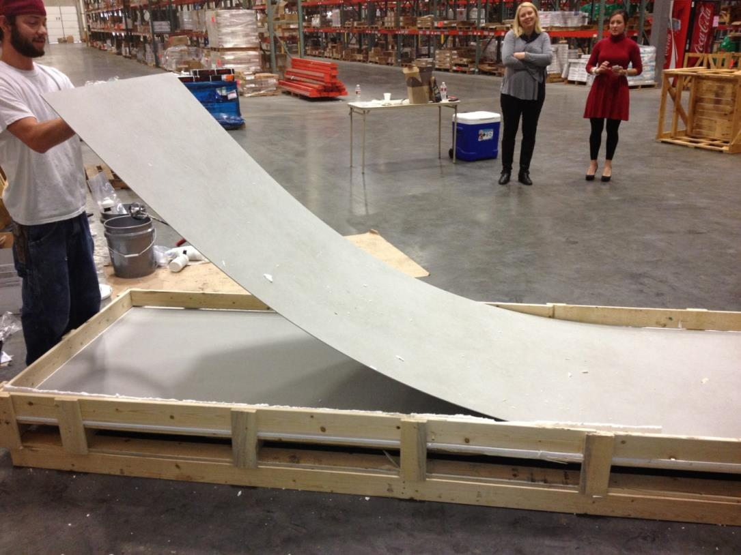
Here’s What NOT to Do

Slide 49
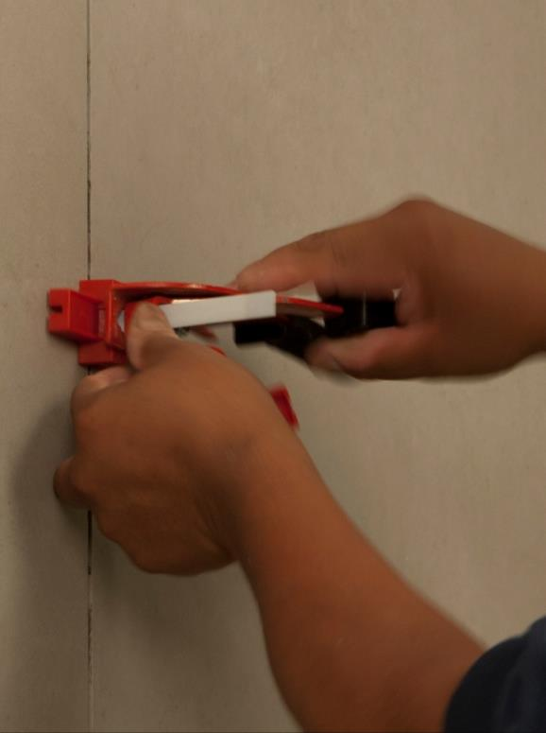
Likely to Be Included in A108.19
Use of leveling system?
Lippage tolerances being discussed: 1/64” to 1/16”
  With a 3 mm tile, 1 mm is 1/3 the tile’s thickness
  Is edge fracture more likely?

Slide 50
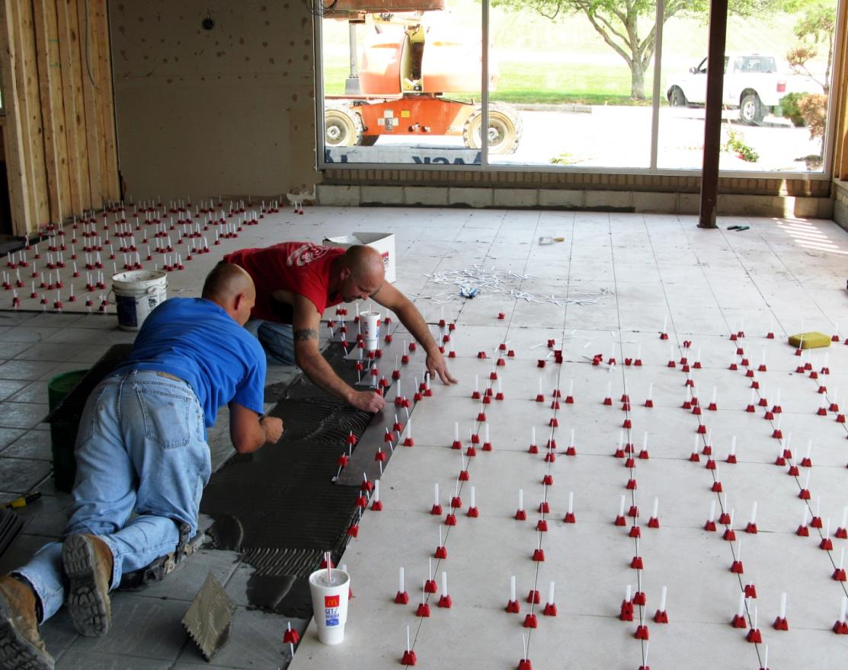
Look Easy?

Slide 51
Likely to Be Included in A108.19
Finished installation flatness?
Is ¼” in 10’ reasonable or are “waves” created during installation?

Slide 52
Likely to Be Included in A108.19
Do existing standards for grout joint width apply?
Existing standards aim at wider grout joints to accommodate facial dimensions and warpage
But ... Some feel edges are more susceptible to impact with wider joints

Slide 53
Likely to Be Included in A108.19
Will facial dimensions and warpage be tight enough for the desired “credit card” joints?
OR
Will dimensions and warpage HAVE TO be tight enough for “credit card” joints needed to minimize impact?

Slide 54
Likely to Be Included in A108.19
Either way…full grout joints are imperative to minimize impact

Slide 55
Likely to Be Included in A108.19: Movement Joints
By existing standards, if large sizes are used, almost every joint would need to be a movement joint, especially for wet and sun exposed areas
Tile edge performance with soft filler unknown
Can control joints in concrete be relocated to nearest joint?

Slide 56
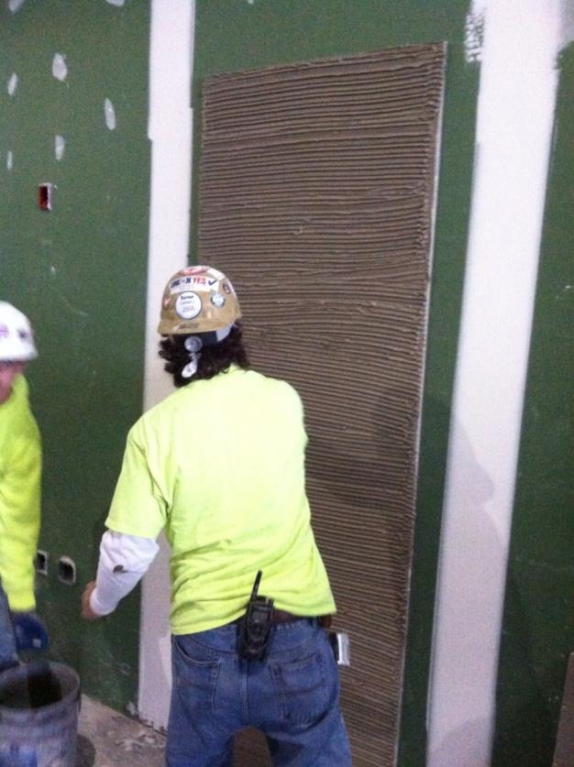
Likely to Be Included in A108.19
Coverage
  How much is enough?
  How to get coverage on edges without trapping air?
  How to check, especially for large, thin sizes?

Slide 57
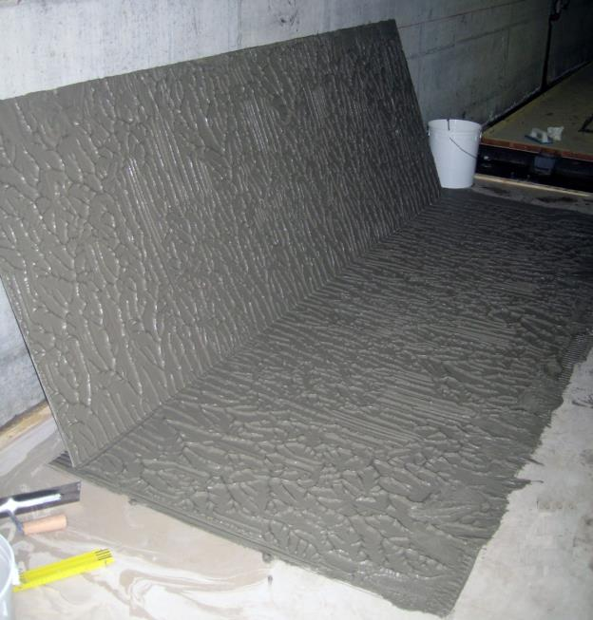
Likely to Be Included in A108.19
Embedding the Tile
  Walk on it?
  Vibrate?
  Thinner thin-set?

Slide 58
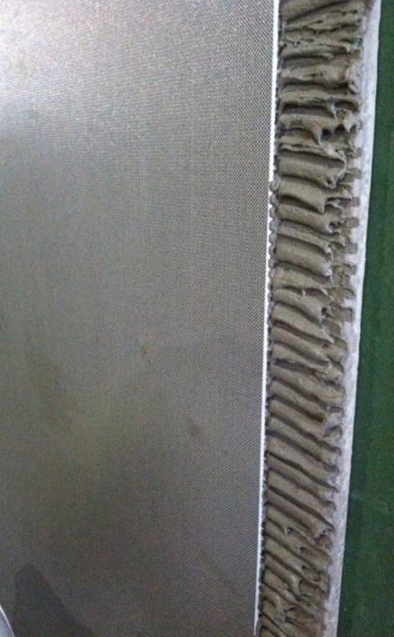
Likely to Be Included in A108.19
Varying Opinions on Application Thickness
  3/8” needed for workability?
  Susceptibility to thin-set shrinkage?

Slide 59

Likely to Be Included in A108.19
Mortar Cure Time
  Are rapid sets needed? Realistic?

Slide 60
Likely to Be Included in A108.19
With all of these challenges and questions, it seems likely that contractor and installer qualifications and certifications will be required

Slide 61

Industry Collaboration
Thin Tile Standards
Where your voice can be heard in the development of standards

Slide 62
Thin Tile Opportunities
The following slides present and explain many thin tile opportunities
In the absence of established consensus standards, seek guidance from manufacturers and qualified installation professionals

Slide 63
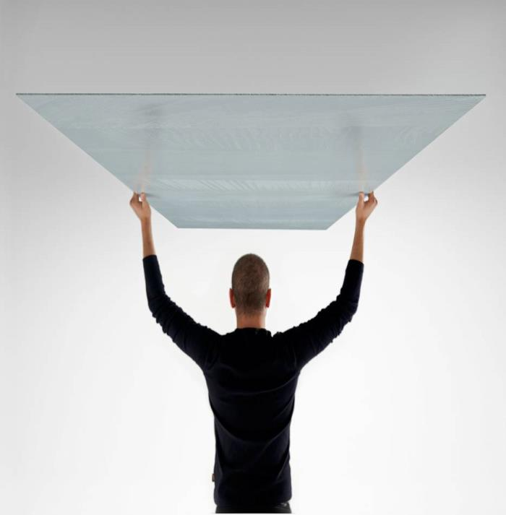
Why Is Thin Tile Exciting?
Thin Tile Over Tile: Renovations Are Cleaner, Faster, and More Time- and Cost-Efficient
Lower Environmental Impact
Versatile Design Profile
Flexibility

Slide 64
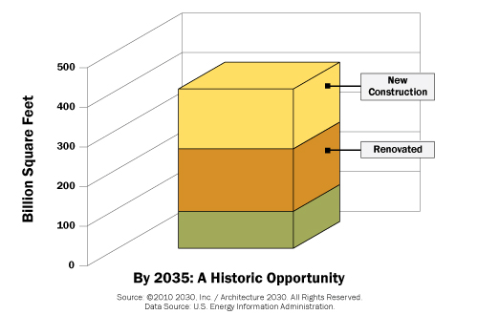
What’s So Great About
Thin Tile Over Tile?
One Word: RENOVATION
According to Architecture 2030:
Every year, approximately 5 billion square feet.
By the year 2035, approximately three-quarters (75%) of the built environment will be either new or renovated.

Slide 65

Hotels Must Renovate Frequently:
Thin Tile Over Tile Can Help
In the Age of Expedia, Hotels.com, Priceline, Trip Advisor, etc. Word of Bad Experiences Travels Quickly
Guests’ Expectations Are High
Sluggish Economy = More Competition
Typical Renovation Cycles Are Between 6-12 years, but Some Hotels Renovate as Often as Every 3-5 Years

Slide 66
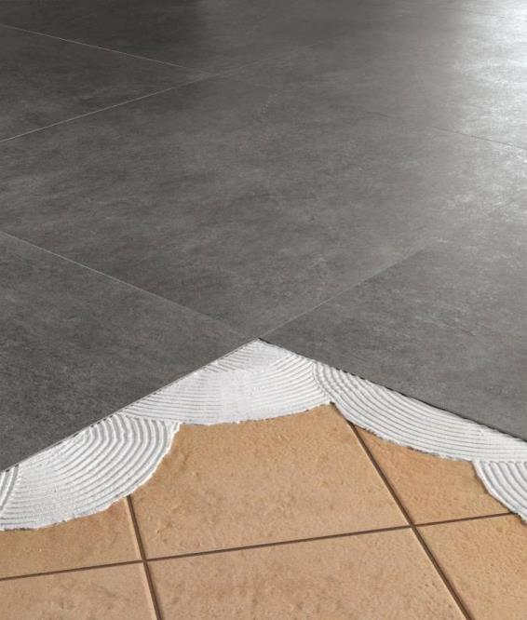
Thin Tile Over Tile:
Time & Cost Savings
Hotel Renovation Project:
Update Guest Bathrooms
Number of Rooms: 540
Number of Floors: 22
95%+ Occupancy Rate Year-Round
1/8” Thin Tile
3’ x 10’ Panels Cut to Size
Thin Tile-Over-Tile Installation
Total Installation Time: 30 Days
Typical Installation Time with Traditional Demolition and Installation? TWO YEARS

Slide 67

Thin Tile over Tile:
Client Satisfaction Is Key
In the Hospitality, Medical & Dental, & Apartment Rental Sectors:
Noise is a Liability
Dust is Verboten
Time is Money in Terms of Project $ Spent as Well as Revenue Lost on Unoccupied Units

Slide 68
Environmental Impact:
Thin Tile vs. Traditional Tile
50%
LOWER
SHIPPING
WEIGHT
LESS
RAW
MATERIAL
LESS ENERGY USED TO PRODUCE
LESS ENERGY USED TO TRANSPORT

Slide 69
Lower Environmental Impact
LESS ENERGY USED TO PRODUCE
LESS ENERGY USED TO TRANSPORT
REDUCED CARBON EMISSIONS
GREATER SUSTAINABILITY

Slide 70
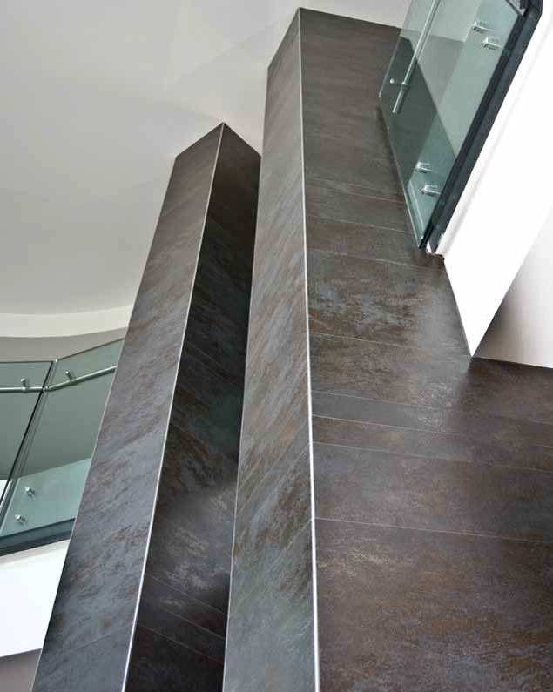
Versatile Design Profile
Large Panels Are Still Lightweight
Easier to Install at High Elevations than Other Large-Format Wall Cladding
Hotel: Modena, Italy
Panel size: 1 m x 3 m
Thickness: 3 mm

Slide 71

Versatile Design Profile
Faux Finishes on Large Thin Tile Panels: The Look of Genuine Marble or Stone Tile without the Weight or Cost
Panel size: 5 ft. x10 ft.
Thickness: 6 mm

Slide 72
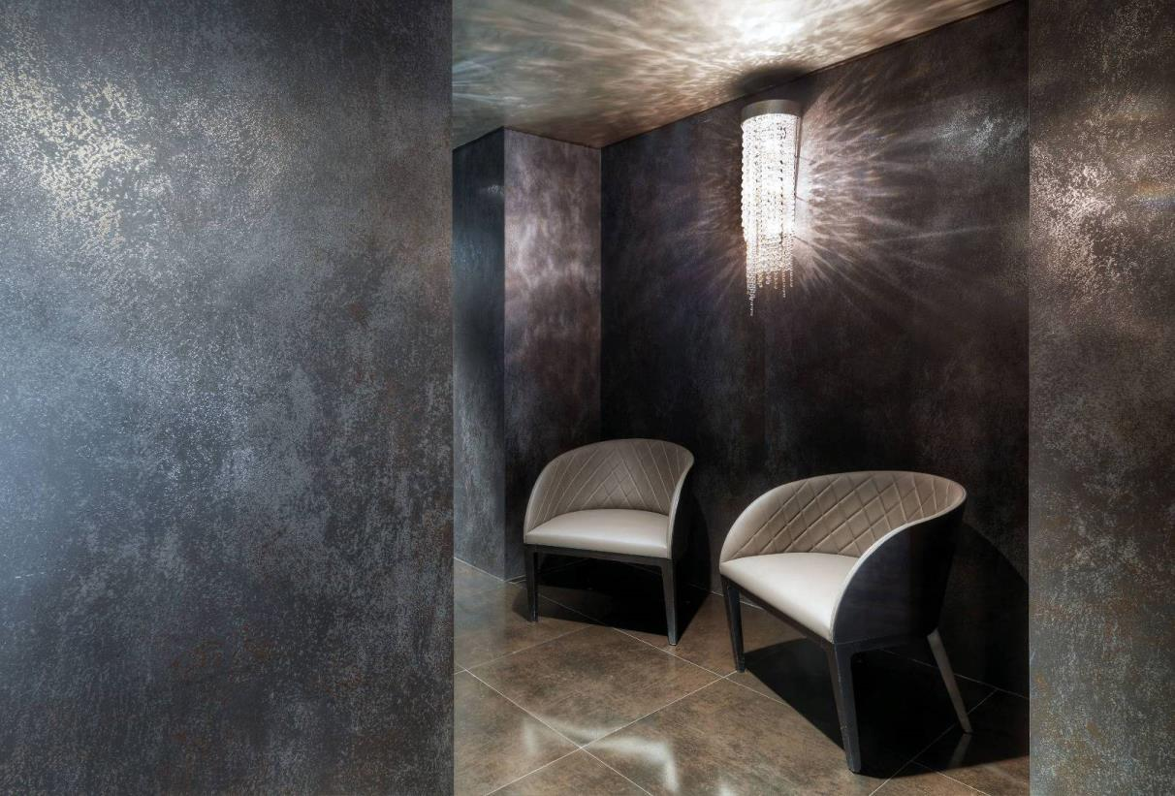
Versatile Design Profile:
Uniform, Sleek Appearance
Luxury Hotel, Rome
Panel Size: 1 m x 3 m
Thickness: 3.5 mm

Slide 73
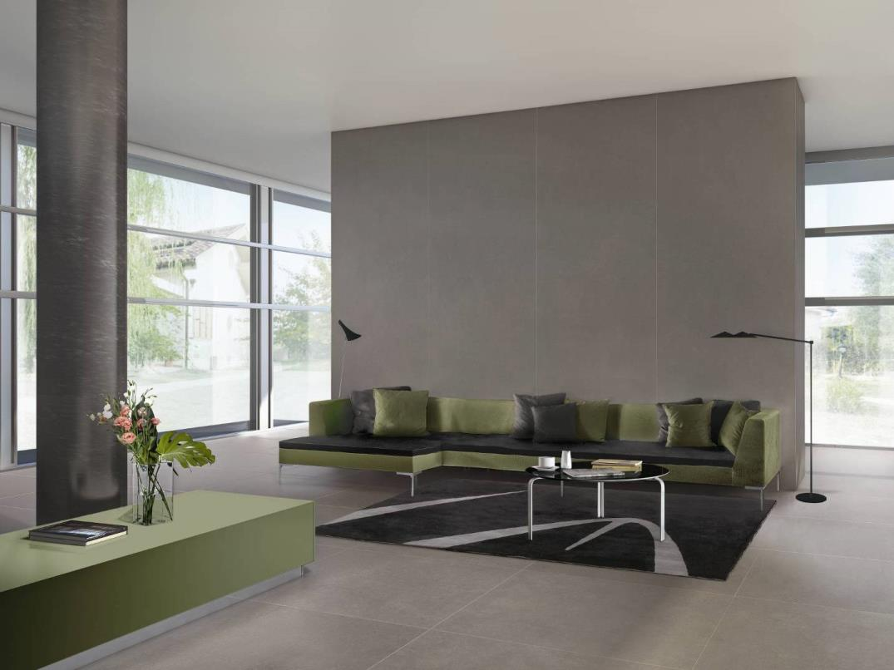
Versatile Design Profile:
Dramatic Elements
Panel size: 1 m x 3 m
Thickness: 3 mm

Slide 74


New options for
surfaces
More flexible than traditional tile
Reinforcement increases flexibility
CURVED
Panel Size: 1 m x 3 m
Thickness: 3 mm

Slide 75

Thin Tile: It Bends!
Tunnel Autostradale, Bologna-Firenze

Slide 76
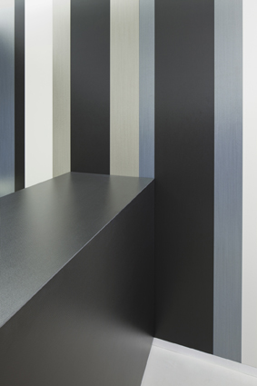
Thin Tile Applications:
Familiar and New Markets
Walls
Floors
Countertops
Furniture
Photovoltaic Panels
Pleasure Boats

Slide 77
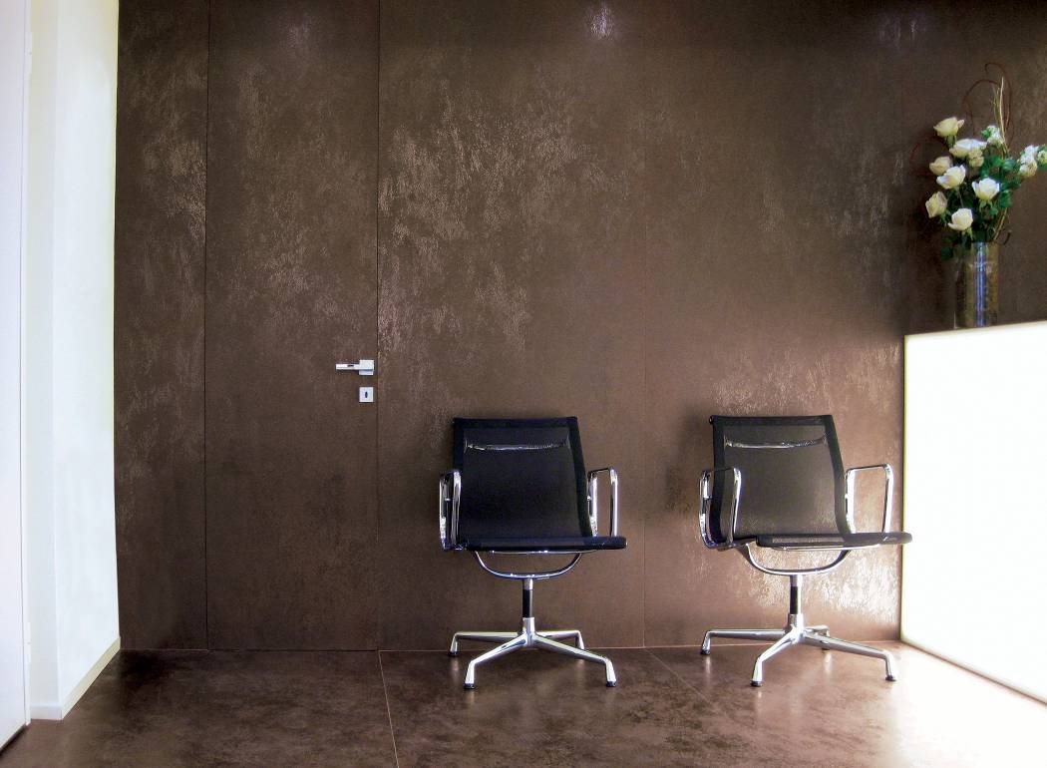
Familiar Thin Tile Applications:
Walls
Panel size: 1 m x 3 m
Thickness: 3 mm

Slide 78
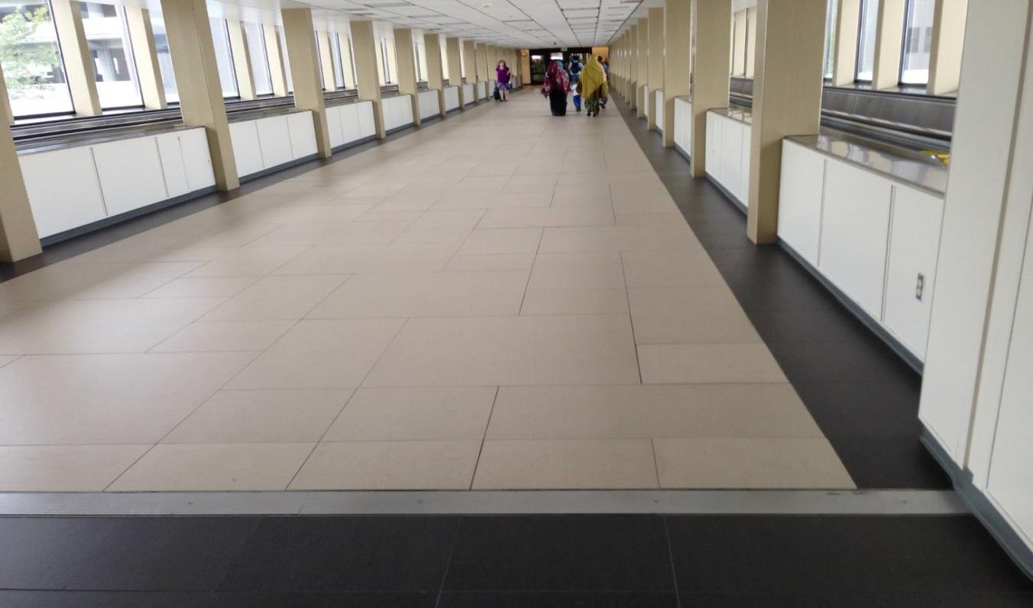
Familiar Thin Tile Applications:
Floors
Airport installation
Thickness: 3 mm

Slide 79
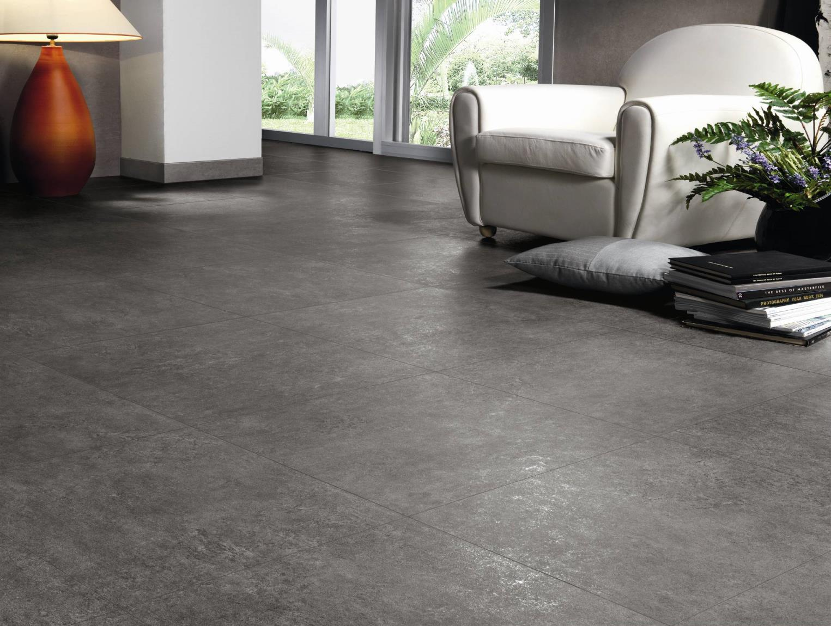
Panel size: 1 m x 1 m
Thickness: 3.5 mm

Slide 80
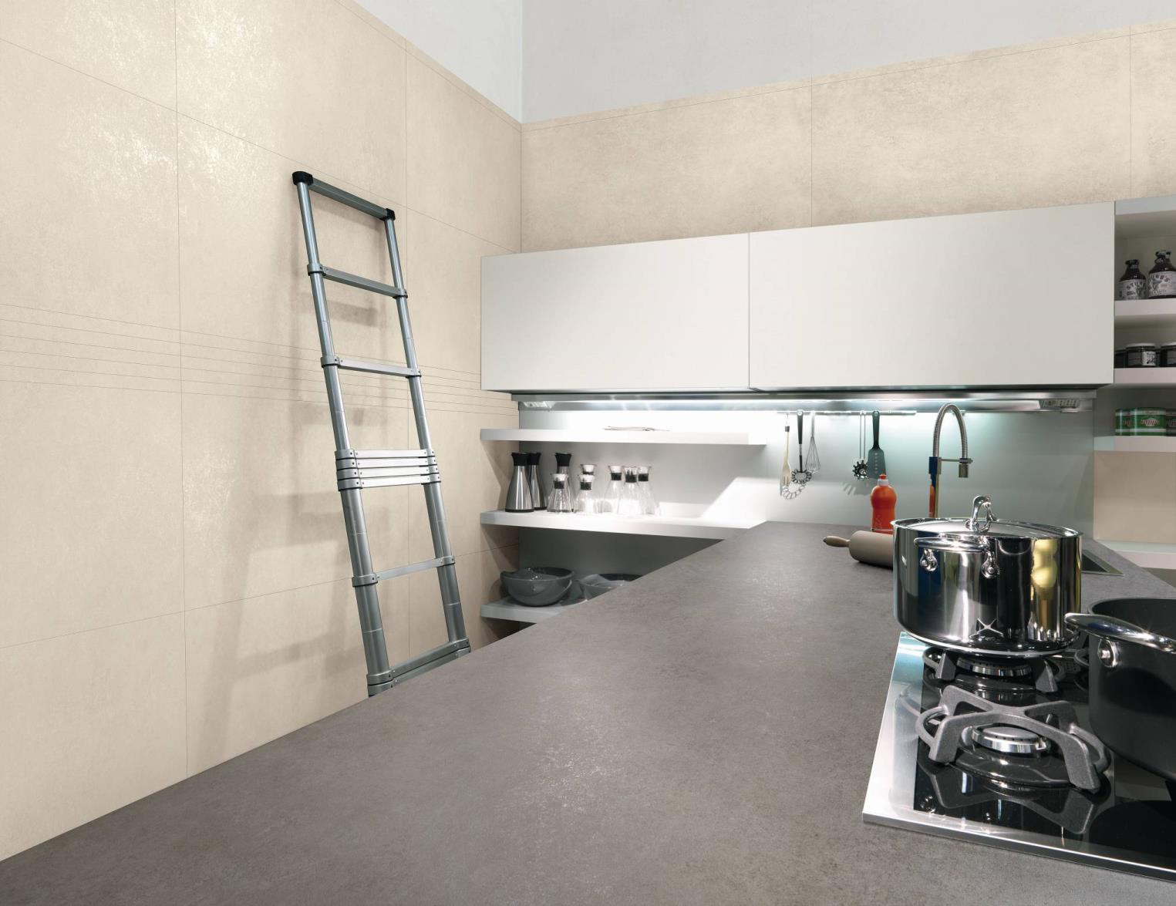
New Thin Tile Applications:
Countertops
Panel size: 1 m x 3 m
Thickness: 3 mm

Slide 81
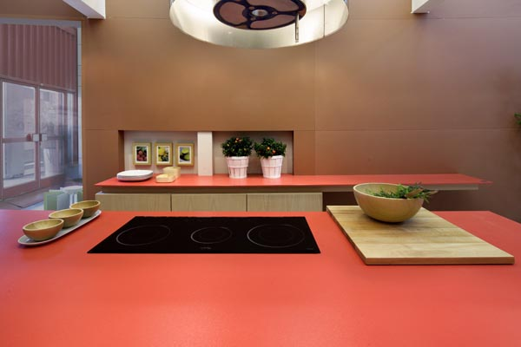
Panel Size: 3 ft. x 10 ft.
Thickness: 3 mm

Slide 82
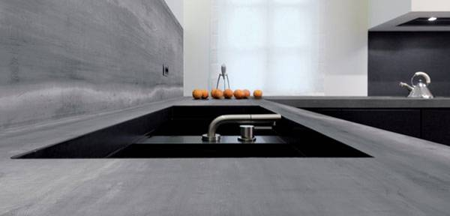
Panel size: 5 ft. x 10 ft.
Thickness: 6 mm

Slide 83

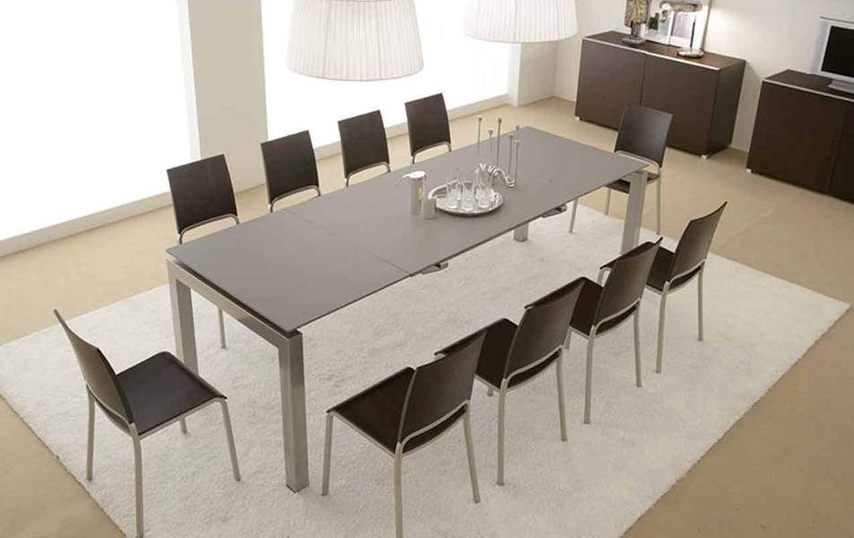
New Thin Tile Applications:
Furniture
Panel Size: 1 m x 3 m
Thickness: 3 mm
Panel Size: 1 m x 3 m
Thickness: 3.5 mm

Slide 84

Panel Size: 1 m x 3 m
Thickness: 5.7 mm

Slide 85

Panel Size: custom
Thickness: 3 mm

Slide 86
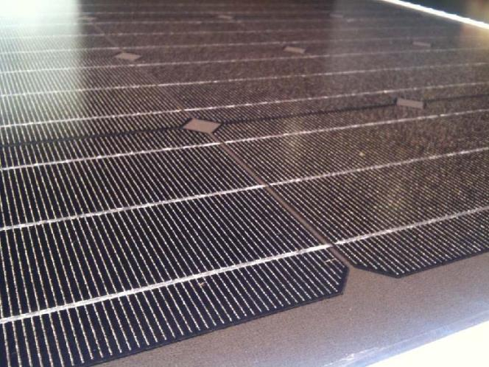
New Thin Tile Applications:
Photovoltaic Panels
Smooth Integration with External Cladding and Ventilated Façades
Façades Can Conserve & Generate Energy
Attractive Way to House Solar Power Sources

Slide 87
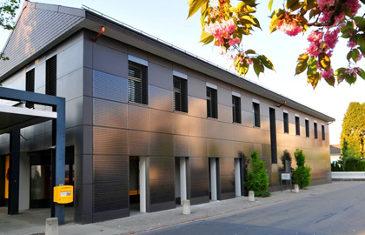
Building Retrofitted with Ventilated Façade and Integrated Photovoltaic Thin Tile Panels
(Aadorf, Switzerland)

Slide 88

Photovoltaic Thin Tile Panels Integrated Seamlessly into Exterior Cladding

Slide 89


New Thin Tile Applications:
Pleasure Boat Interiors
Thin Tile Panels Are Lightweight Enough to Cover Surfaces in a Pleasure Boat!
Panel Size: 1 m x 3 m
Thickness: 3.5 mm

Slide 90

3 mm thin tile on all surfaces*
*except window, upholstery, pillows, food, telephone, and appliances

Slide 91
In Conclusion ...
Many product properties will be uniquely determined for thin tiles
Criteria for the installation of thin tiles will necessarily differ from the criteria for traditional thickness tiles
Although thin tile presents some challenges, and it will take work to implement new standards, the new applications and markets are worth the effort

