Slide 1

Notice of Copyright
This presentation is protected by U.S. and international copyright law.
Reproduction, distribution, display, and use of the presentation
without written permission is prohibited.
© Tile Council of North America
For information, contact Stephanie Samulski (ssamulski@tileusa.com)

Slide 2

standards. Science. education. Advocacy.
Update on Critical Industry Issues
Eric Astrachan, Executive Director

Slide 3

Sign up to receive email notifications from TCNA!

Slide 4

What We’ll Cover
2014 Market Update
Changes to ANSI and the Handbook
Overview of other standards under development
Micro updates on sustainability, COF, thin tile, water absorption standards, & installer certification

Slide 5

2014
INDUSTRY
UPDATE

Slide 6
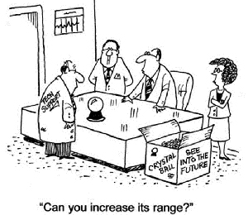
U.S. Ceramic Tile
Consumption through 2Q 2014
Total YTD: 1.1%
(vs. 2Q 2013 YTD)
U.S. $ Value: 3.8%
from 2Q 2013 YTD
Estimated 2014 Total: 2.2% from 2013
Notes:
Through 2Q 2014, U.S. tile consumption was 1.21 billion sq. ft. (112.3 million sq. m.), down 1.1% vs. 2Q 2013 YTD.
Extrapolating from the available year-to-date data, 2014 U.S. ceramic tile consumption would be 2.42 billion sq. ft., down 2.2% from 2013 (2.48 billion sq. ft.) and the first year-over-year decline in consumption since 2009.
The value of U.S. tile consumption through 2Q 2014 YTD was $1.42 billion, up 3.8% from 2Q 2013 YTD.

Slide 7
U.S. Imports through August 2014 YTD
(in sq. ft.)
% of Total
Italy……… 35.1%
China……. 25.1%
Mexico…...17.1%
Total $ Value/Sq. Ft.
$0.07 vs. August 2013 YTD
Total Imports:
3.0% vs. August 2013 YTD
% of Total:
Mexico…… 30.7%
China……... 28.7%
Italy……….. 18.0%
68.4% of U.S. Consumption
14% vs. historic high (2006)
(in $ value)
Notes:
Through Aug. 2014, 1.13 billion sq. ft. of ceramic tile arrived in the U.S., a 3.0% decrease from Aug. 2013 YTD.
Mexico was the top exporter to the U.S. through Aug. 2014 (in sq. ft.) with a 30.7% share of U.S. imports. China and Italy were the next largest exporters of tile to the U.S. (in sq. ft.), comprising 28.7% and 18.0%, respectively.
Although imports still represent the majority of U.S. ceramic tile consumption (68.4% through 2Q 2014), import penetration has fallen significantly since 2006, when imports comprised a record 82.4% of U.S. consumption.

Slide 8

Domestic Shipments: 2Q 2014 YTD vs 2Q 2013
Total Sq. Ft.: 382 million
0.7%
Total $ Value: $558 million
2.2%
$ Value/Sq. Ft.: $1.46
$0.04
Source: U.S. Census Bureau & TCNA
Notes:
2Q 2014 YTD domestic shipments totaled 382 million sq. ft., down 0.7% from 2Q 2013 YTD.
2Q 2014 YTD domestic shipments in $ value were at $558 million, up 2.2% vs. 2Q 2013 YTD.
The $ value/sq. ft. of domestically-produced tile rose from $1.42 through 2Q 2013 to $1.46 (2Q 2014 YTD).
Through 2Q 2014, U.S. exports were at 17.5 million sq. ft. (1.6 million sq. m.), down 19.1% vs. 2Q 2013 YTD. The vast majority of these exports were to Canada (60.0%) and Mexico (19.0%).

Slide 9
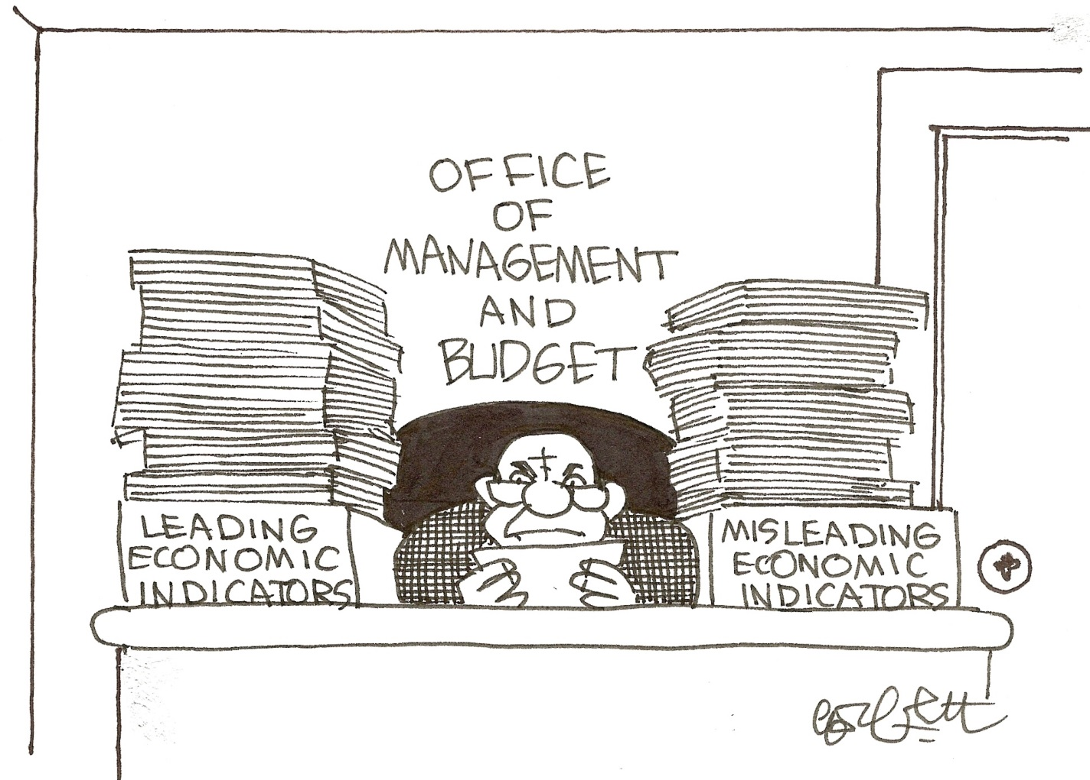

Slide 10


GDP: 4.6%
New Housing Starts:
8.00%
New Home Sales: 33.0%
Construction Spending:
5.0%

Slide 11


Unemployment: 1.3%
Mortgage Rates:
0.33%
Foreclosures: 9.1%
Notes:
30-year fixed mortgage rates were at 4.16% as of Sept. 2014, down from 4.49% in Sept. 2013. Although mortgage rates have risen considerably since their all-time low of 3.35% in Dec. 2012, the current rate is still historically very low.
As of Aug. 2014, new home starts were at an annual rate of 956,000 units, up 8.0% vs. Aug. 2013. New home starts have increased 4 years in a row and are on pace to increase again in 2014.
U.S. GDP increased at an annual rate of 4.6% in 2Q 2014 and has increased for 12 of the last 13 quarters
The U.S. unemployment rate was at 5.9% as of Sept. 2014, down from 7.2% in Sept. 2013 and the lowest rate since July 2008.

Slide 12




Consumption Should Be
Instead, It’s
WHY?! Nobody Knows.
What Do We Know? Not Much.
Tile Sales Are Expected to Decline Slightly

Slide 13


Slide 14
ANSI Standards Update

Slide 15

Stuff you probably already know about ANSI ASC A108…
Committee develops “voluntary” standards according to ANSI rules: Committee balance, consensus process, etc…

Slide 16

Stuff you probably already know about ANSI ASC A108…
57 voting members: manufacturers, labor, distributors, importers, etc…
TCNA is the Secretariat and a representative of labor is Chairman

Slide 17
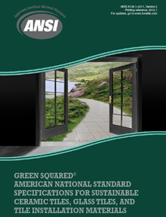
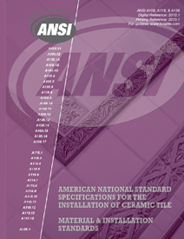
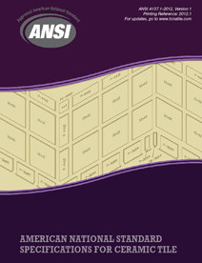
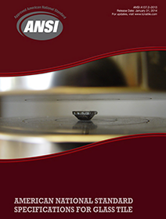
The result…
Lippage allowances . . . . . . . . . . . . . . . . . . . . . . A108 (installation)
Warpage allowance for rectified tile . . . . . . . . . . A137.1 (tile)
Opacity . . . . . . . . . . . . . . . . . . . . . . . . . . . . . . . . A137.2 (glass tile)
Bond strength (mortars, membranes, etc.) . . . . . A118 (installation materials)
Recycled content . . . . . . . . . . . . . . . . . . . . . . . . . A138.1 (sustainability)

Slide 18
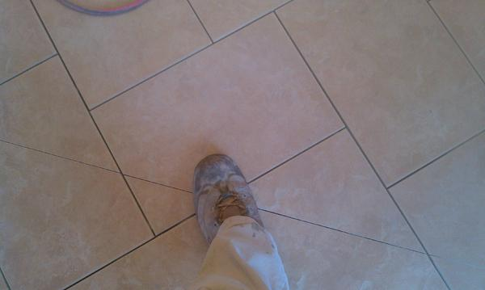
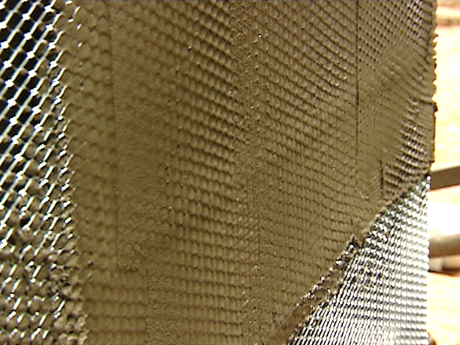
ANSI work in progress
Proposal to “officially” allow saw-tooth movement joints
  very important to some designers
  reqiured evaluation of sealant performance
Proposal to allow use of metal lath varieties not specifically named, with evaluation report from accredited evaluator
  To allow for newer, suitable products contractors use
Both in balloting stage, expected to pass in 2015

Slide 19
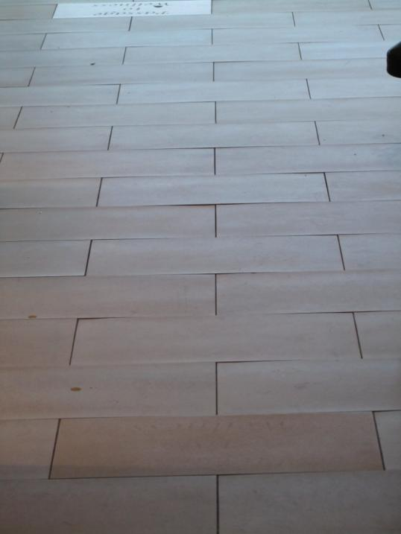
ANSI work in progress
  Possible expansion of recent “max. 1/3 offset” standard for large tiles set in running bond pattern
    Warpage is accentuated in 50% offset pattern because highest and lowest tile points are adjacent
    50% offset prohibited for tiles 15” on any side unless otherwise allowed by tile manufacturer
      Prohibits adjacent high/low points

Slide 20
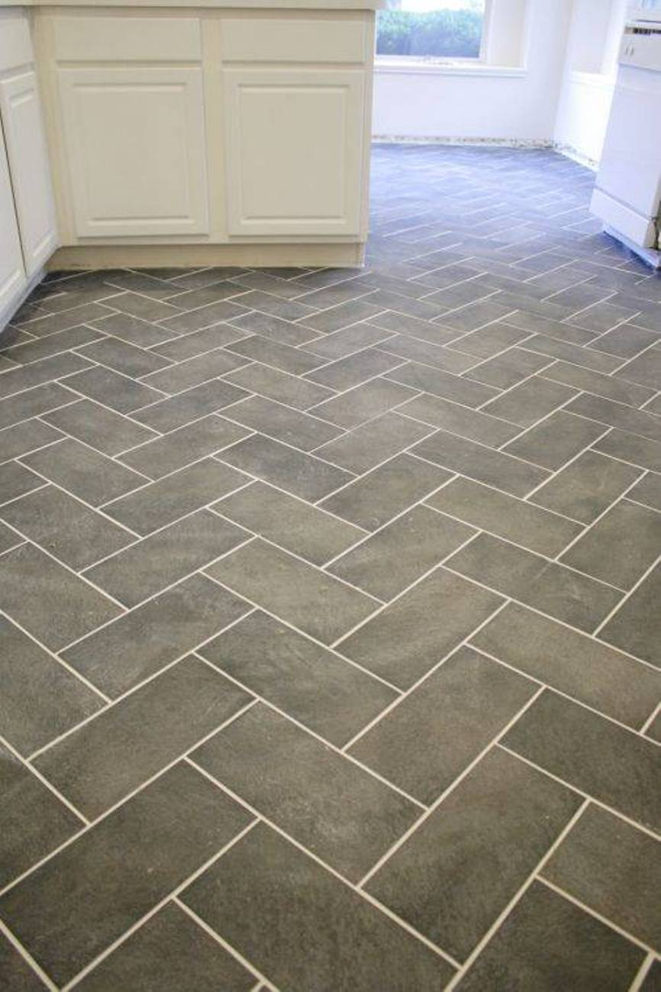
ANSI work in progress
  Possible expansion of recent “max. 1/3 offset” standard for large tiles set in running bond pattern
  Same issue can present itself with other patterns: basketweave, herringbone, chevron
  Limiting lippage due to warpage = limiting complaints, managing expectations
  Stay tuned… beginning stages

Slide 21
Changes to the
2015 TCNA Handbook

Slide 22
Medium Bed Mortar
Dry set Mortar for
Large and Heavy Tile (LHT mortar)
“Medium bed” brought confusion: specs asking for tile to be set by “the medium bed method”
Nice idea: the best of both worlds
  Fast (single step) and light installation AND fix substrate flatness issues, create slopes to drains, and transition between floor heights
TOO BAD IT DOESN’T WORK!!!!

Slide 23

Take it from this guy….
Lack of a standard further contributes to confusion
In the interim, a change to the Handbook should help

Slide 24
Medium Bed Mortar
Dry set Mortar for
Large and Heavy Tile (LHT mortar)
Addresses
  incorrect specifications for tile to be set by a “medium bed method”
  incorrect specifications for mortar to be used to fix substrates that aren’t flat
  incorrect specifications for mortar to be used to form slope to drain, transitions in floor heights

Slide 25
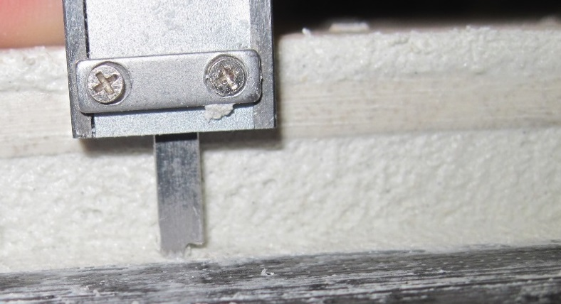
Dry Set Mortar for Large and Heavy Tile (LHT Mortar), formerly Medium Bed Mortar
Similarities
  for thin-set installations
  minimize slump/thicker bond coat, useful for larger tiles
  declared by manufacturer; no ANSI or ISO standards
    must meet requirements of ANSI A118.1, A118.4, A118.11, or A118.15 or ISO C1 or C2

Slide 26
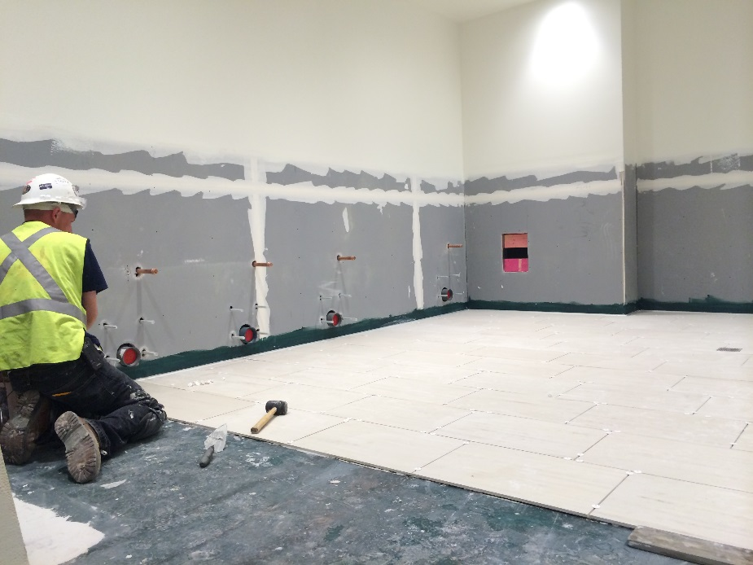
Dry Set Mortar for Large and Heavy Tile (LHT Mortar), formerly Medium Bed Mortar
Improved/added info:
  bond coat 3/32” to 1/2” thick after tile is embedded (previously ¾”)
  for heavy tiles: 5 lb/square foot or heavier
  for ungauged tiles
  for large tiles, as required to achieve coverage requirements if/when there is warpage that creates larger void between tile and substrate

Slide 27

Dry Set Mortar for Large and Heavy Tile (LHT Mortar), formerly Medium Bed Mortar
“Note to specifier” section
  not for truing or leveling substrates or the work of others
    exceeds “the limitations of the mortar”
  a product, not an installation method
  Specs that reference a “medium bed method” or call for mortar to level, flatten, or fill substrates or to create slopes or transitions between finish floor heights “do not conform to tile industry standards or norms.”

Slide 28

Changes to Environmental
Classifications
  Res1/Com1: dry
  Res2/Com2: limited water exposure
  Res3/Com3: wet
  Res4/Com4: high humidity, heavy moisture
  Res5/Com5: high temp (125°F or higher)
  Res6/Com6: exterior
Handbook “Environmental Classifications” describe levels of moisture and heat exposure
Classifications assigned to methods to relay suitability under typical conditions

Slide 29
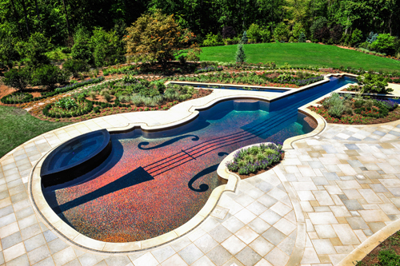
Changes to Environmental Classifications
Now: Environmental Exposure Classifications to avoid confusion with sustainability considerations
Res7 and Com7 categories added for submerged installations: pools, fountains, water features
Because not all mortars and grouts are suitable for submerged applications

Slide 30
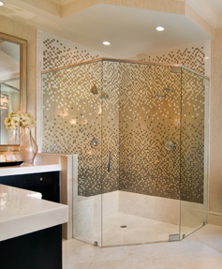
New Methods for
Curbless Showers
based on existing B421 and B422 shower methods
full waterproofing up walls

Slide 31
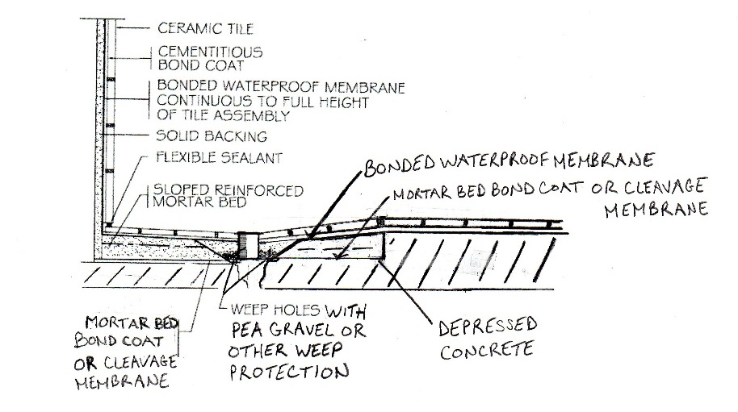
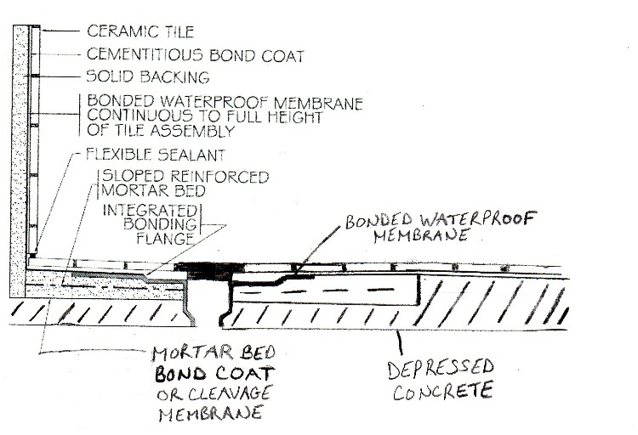
B421 Curbless
traditional drain version
B422 Curbless
integrated bonding flange version

Slide 32
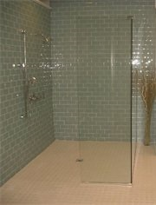
Design/Specification
Considerations for
“Zero-Entry” or Curbless Showers
  Depressed slab prevents added floor height at entryway (what occurs when contractors are asked to create curbless showers w/o depressed slab)
  Refer to ADA for compliance; curbless methods do not inherently comply

Slide 33

Shower Water and Splash Water “often difficult to contain within a curbless shower”
Floor and wall waterproofing required outside the immediate shower area, at least one foot beyond high point of the floor
Secondary drain may be required outside shower area
High point of floor must be outside the shower area, beyond shower door/curtain; location of high point is critical when secondary drain not included
Additional waterproofing outside shower area may be needed

Slide 34
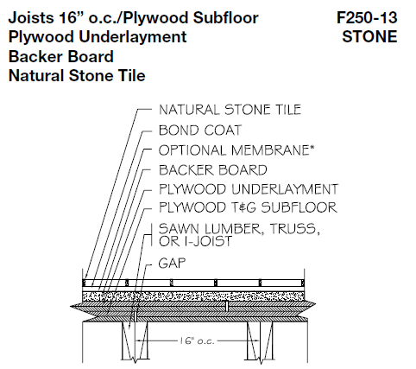
Change to Deflection Limitation in
Stone Methods over Wood Substrate
deflection = bending
maximum allowable floor member live load and concentrated load deflection shall not exceed L/360 L/720
Applies to 3 methods
Consensus resolution to stone industry discussions

Slide 35

Field and Installation Requirements Guide
Natural Stone Tile Installation Over Frame Construction
Strongbacks, bridging, or other load-sharing members may be required within a wood framed system to reduce differential deflection between adjacent framing members.
Without load-sharing members, deflection may differ significantly between adjoining members. Accordingly, for framed construction, an L/720 requirement has been specified… L/360 accepted for concrete/masonry substrates.

Slide 36

For more info…
(Muehlbauer, not Schwab)

Slide 37
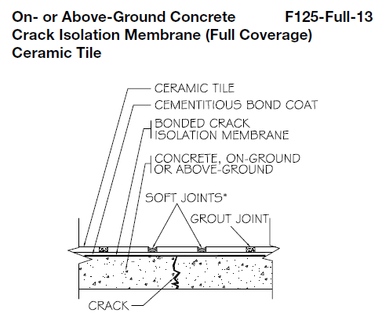
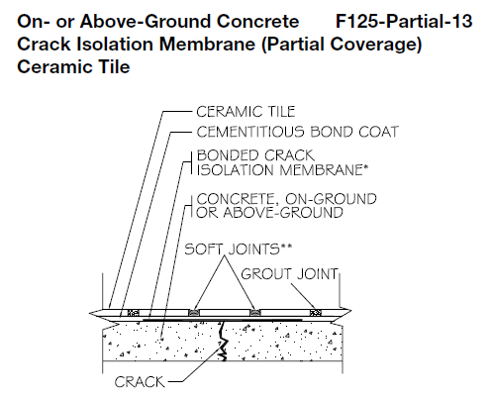
Crack Isolation
F125-Full v. F125-Partial
Requirements section modified to address problems of unclear specs/bidding issues
Same language added under “Materials”
Requirements
• Specifier to identify areas of coverage (partial or full). Unless full coverage is clearly specified, installing contractor’s responsibility is limited to partial coverage.

Slide 38

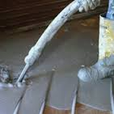
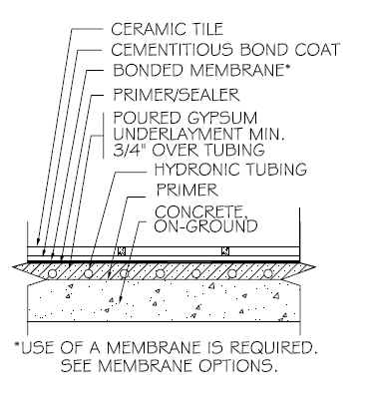
6 New Radiant Heat Methods for Natural Stone Tile
Based on ceramic tile methods, adapted as all other stone methods are
  Small joints, unsanded grout may be necessary
  Service rating dependent on the stone used
RH111/RH111A: poured gypsum underlayment encapsulating hydronic tubing (membrane required)

Slide 39
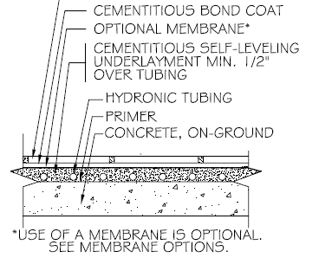
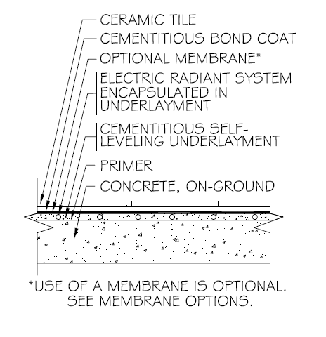
6 New Radiant Heat Methods for Natural Stone Tile
RH112/RH221A: cementitious self-leveler encapsulating hydronic tubing (membrane optional)
RH116/RH116A: electric heat system encapsulated in cementitious self-leveler (membrane optional)
New methods provide a means of specifying popular and successful use of stone tile with heat

Slide 40
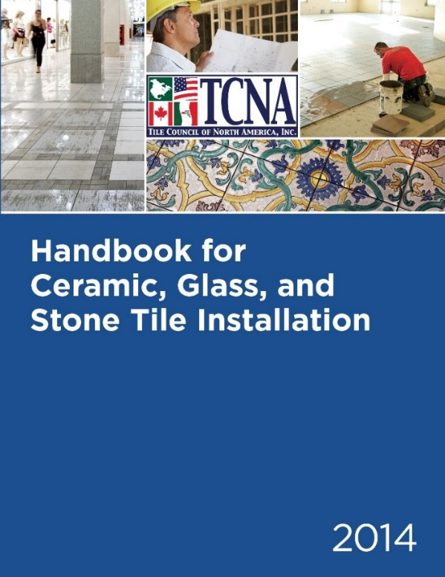
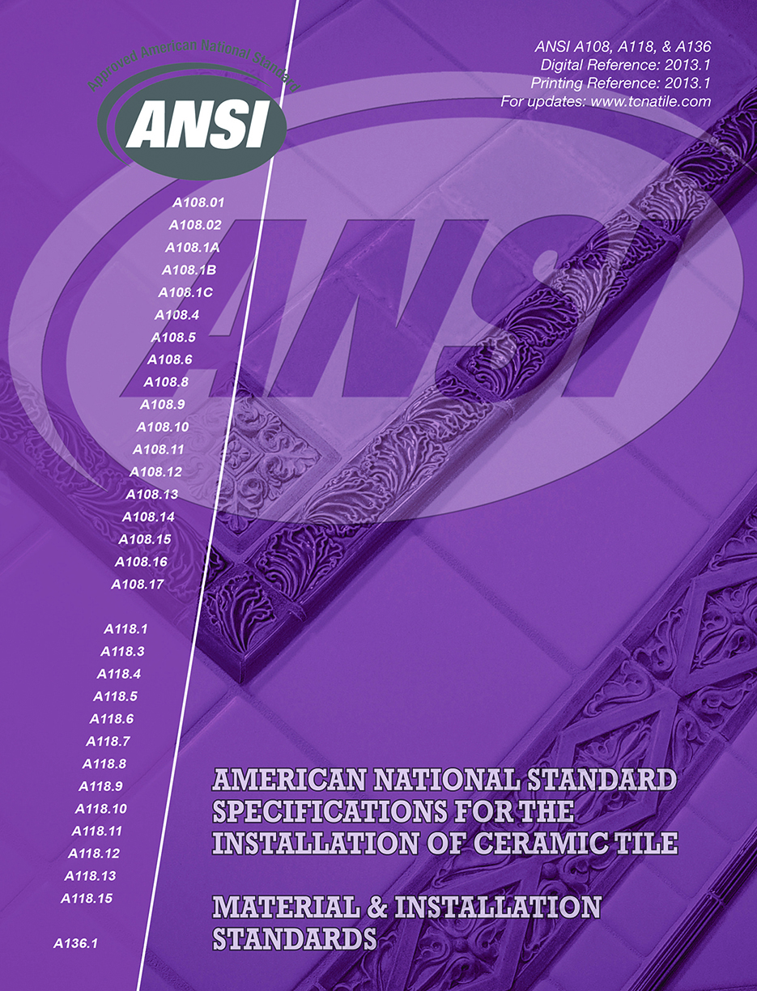
We’ve Just Covered Familiar TCNA Territory

Slide 41



What Has TCNA Done for You Lately?

Slide 42

First, a Pop Quiz:
How Is TCNA Funded?

Slide 43
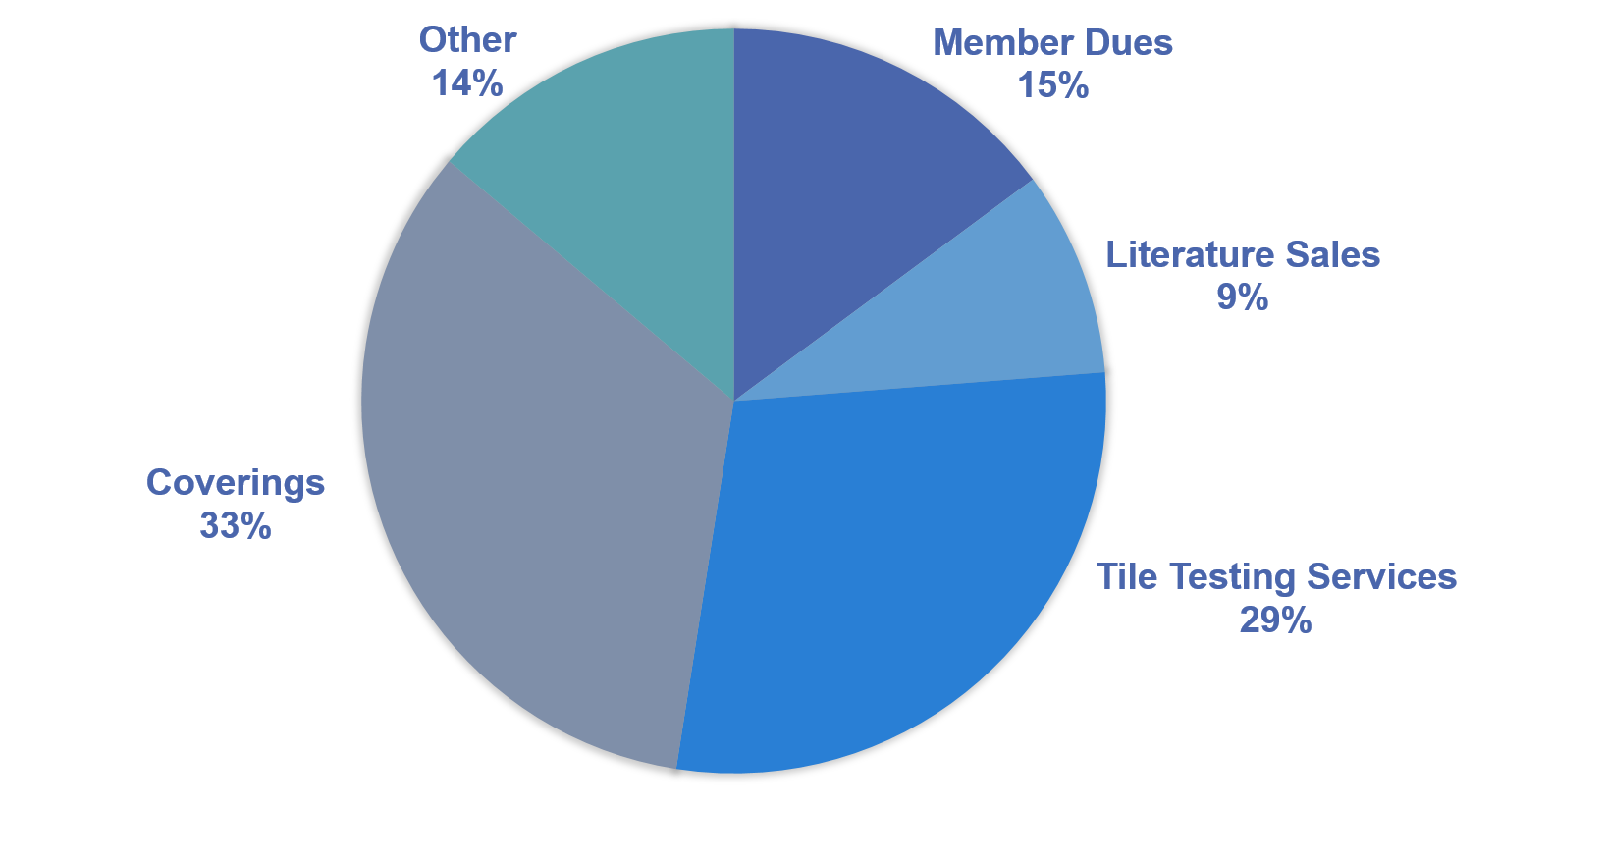
TCNA’s Diverse Funding

Slide 44

TCNA’s Work Impacts All Industry Segments
(not just manufacturers)
Distributors
Tile installers and contractors
Architects and designers
General contractors
Specifiers

Slide 45




STANDARDS
SCIENCE
EDUCATION
ADVOCACY

Slide 46
Standards

Slide 47

Tile Industry Standards
Product standards establish a benchmark for product performance
Installation standards establish guidelines for the end result, sometimes the technique by which that is achieved
Standards for testing protocols and testing materials establish consistency, so valid evaluations and comparisons can be made

Slide 48

Tile Industry Standards
TCNA primarily engages in research and development of product standards, testing protocols, and testing materials
  In many cases TCNA staffers chair the Committees
Standards should relate to the actual product function, consumer expectations
  Example: antibacterial efficacy
Where function and/or expectations are different, standards should be different
  Example: glass tile vs. quarry tile

Slide 49
TCNA Standards work
ANSI ◊ NMX ◊ ASTM ◊ MMSA ◊ NTCA ◊ ISO ◊ NSF ◊ SCS ◊ UL USGBC ◊ ICC/IgCC ◊ NIBS ◊ Green Globes ◊ GSA ◊ ASHRAE

Slide 50

ASTM International
(formerly: American Society for Testing and Materials)
Developer/publisher of globally recognized consensus-based standardized test methods for virtually every industry
More than 30,000 individual members
    Anyone can participate
90% consensus requirement = stringent standards
  Commonly referenced in U.S. construction specifications, regulations, and codes

Slide 51
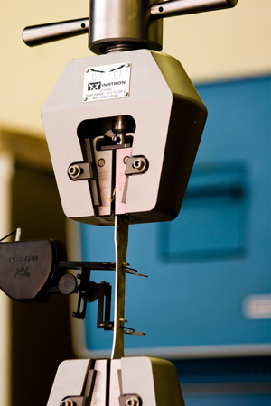
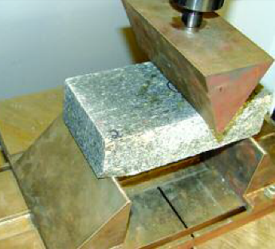



TCNA and ASTM International
C21—Ceramic Whitewares and Related Products
C18—Dimension Stone
E60—Sustainability
F13—Pedestrian/Walkway Safety and Footwear
COTCO—Regulatory Committee for ASTM Committees

Slide 52
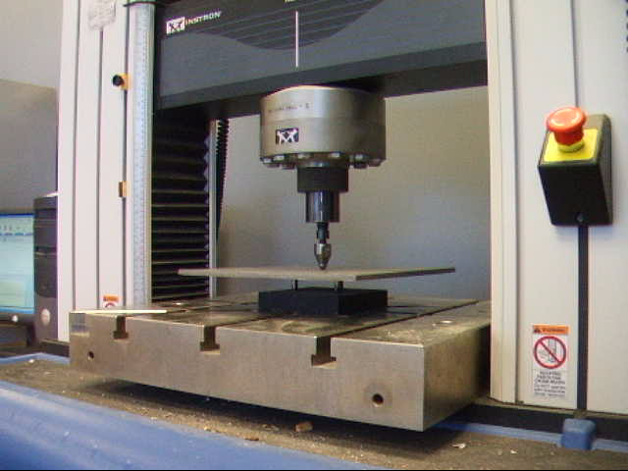
ASTM C21: Ceramic Whitewares
Most tile quality/performance tests in the ANSI A137.1 tile standard are ASTM tests: breaking strength, warpage, etc.
Tests regularly reviewed, revised
  Improved, changed manufacturing methods
  New products, new data, new test equipment
  Safety improvements
Currently under review: water absorption, surface abrasion, and the Robinson Floor Test

Slide 53
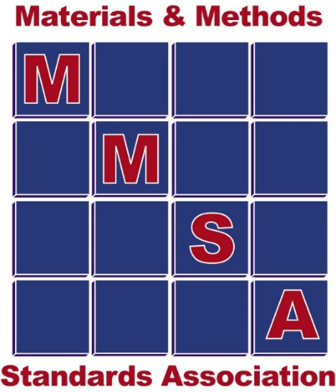
Materials & Methods Standards Association
Tile industry professionals collaborating to develop and revise methods and standards for installation materials (thin-set, grout, etc.)
Often the first stop on the journey to generic consensus standards for installation products
Often, manufacturers conduct in-house testing in preliminary stages as an affordable way to do a lot of testing during the test R&D stage

Slide 54

TCNA and MMSA
Fresh set of eyes and hands to replicate test methods and data in round robin testing
Research expertise
In progress standards
  Large and Heavy Tile Mortars
  Uncoupling Membranes

Slide 55

NTCA Technical Committee
NTCA Methods and Standards
Collaboration where standards/lack of standards impacts contractors
Origin of curbless shower methods, original stone methods
Harmonization of NTCA reference manual where possible and a forum for TCNA to understand contractor impact, perspective
Development of much needed documentation of shared jobsite issues, especially while waiting for formal standards, e.g., EQ studs

Slide 56


International Standards Organization
World’s largest developer of voluntary international standards
Over 19,500 international standards
Almost every industry has an ISO Committee
165 member countries; one vote each

Slide 57
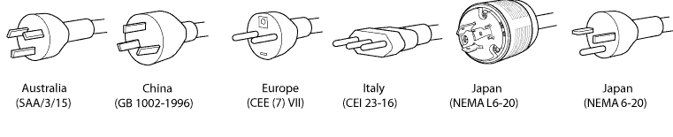
TCNA and ISO
Establish compatibility where possible, helpful, and more efficient to do so for producers and consumers
  Example: U.S. vs. European outlets
Where there must be differences, international standards provide a benchmark and common language for product quality
68% of tile sold in the U.S. is imported
  What is expected and how is that measured?

Slide 58
International vs. Domestic Standards
International standards widely perceived as superior, due to global participation, but are often (not always) “watered-down” compromises
De facto lowest common denominator
Domestic standards are more relevant/reflective of their marketplace, and are usually more stringent in countries like the U.S.
Domestic standards take precedence in the U.S.
International standards are valuable, should coexist with domestic standards without conflicting

Slide 59
TCNA and ISO: How?
The ANSI Committee doubles as the Technical Advisory Group (TAG) to ISO and determines the U.S. position on international standards developed through ISO
  How to vote
  Revisions/objections
  New standards needed
This is how U.S. interests are heard, included

Slide 60
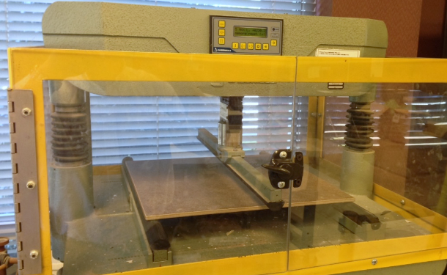
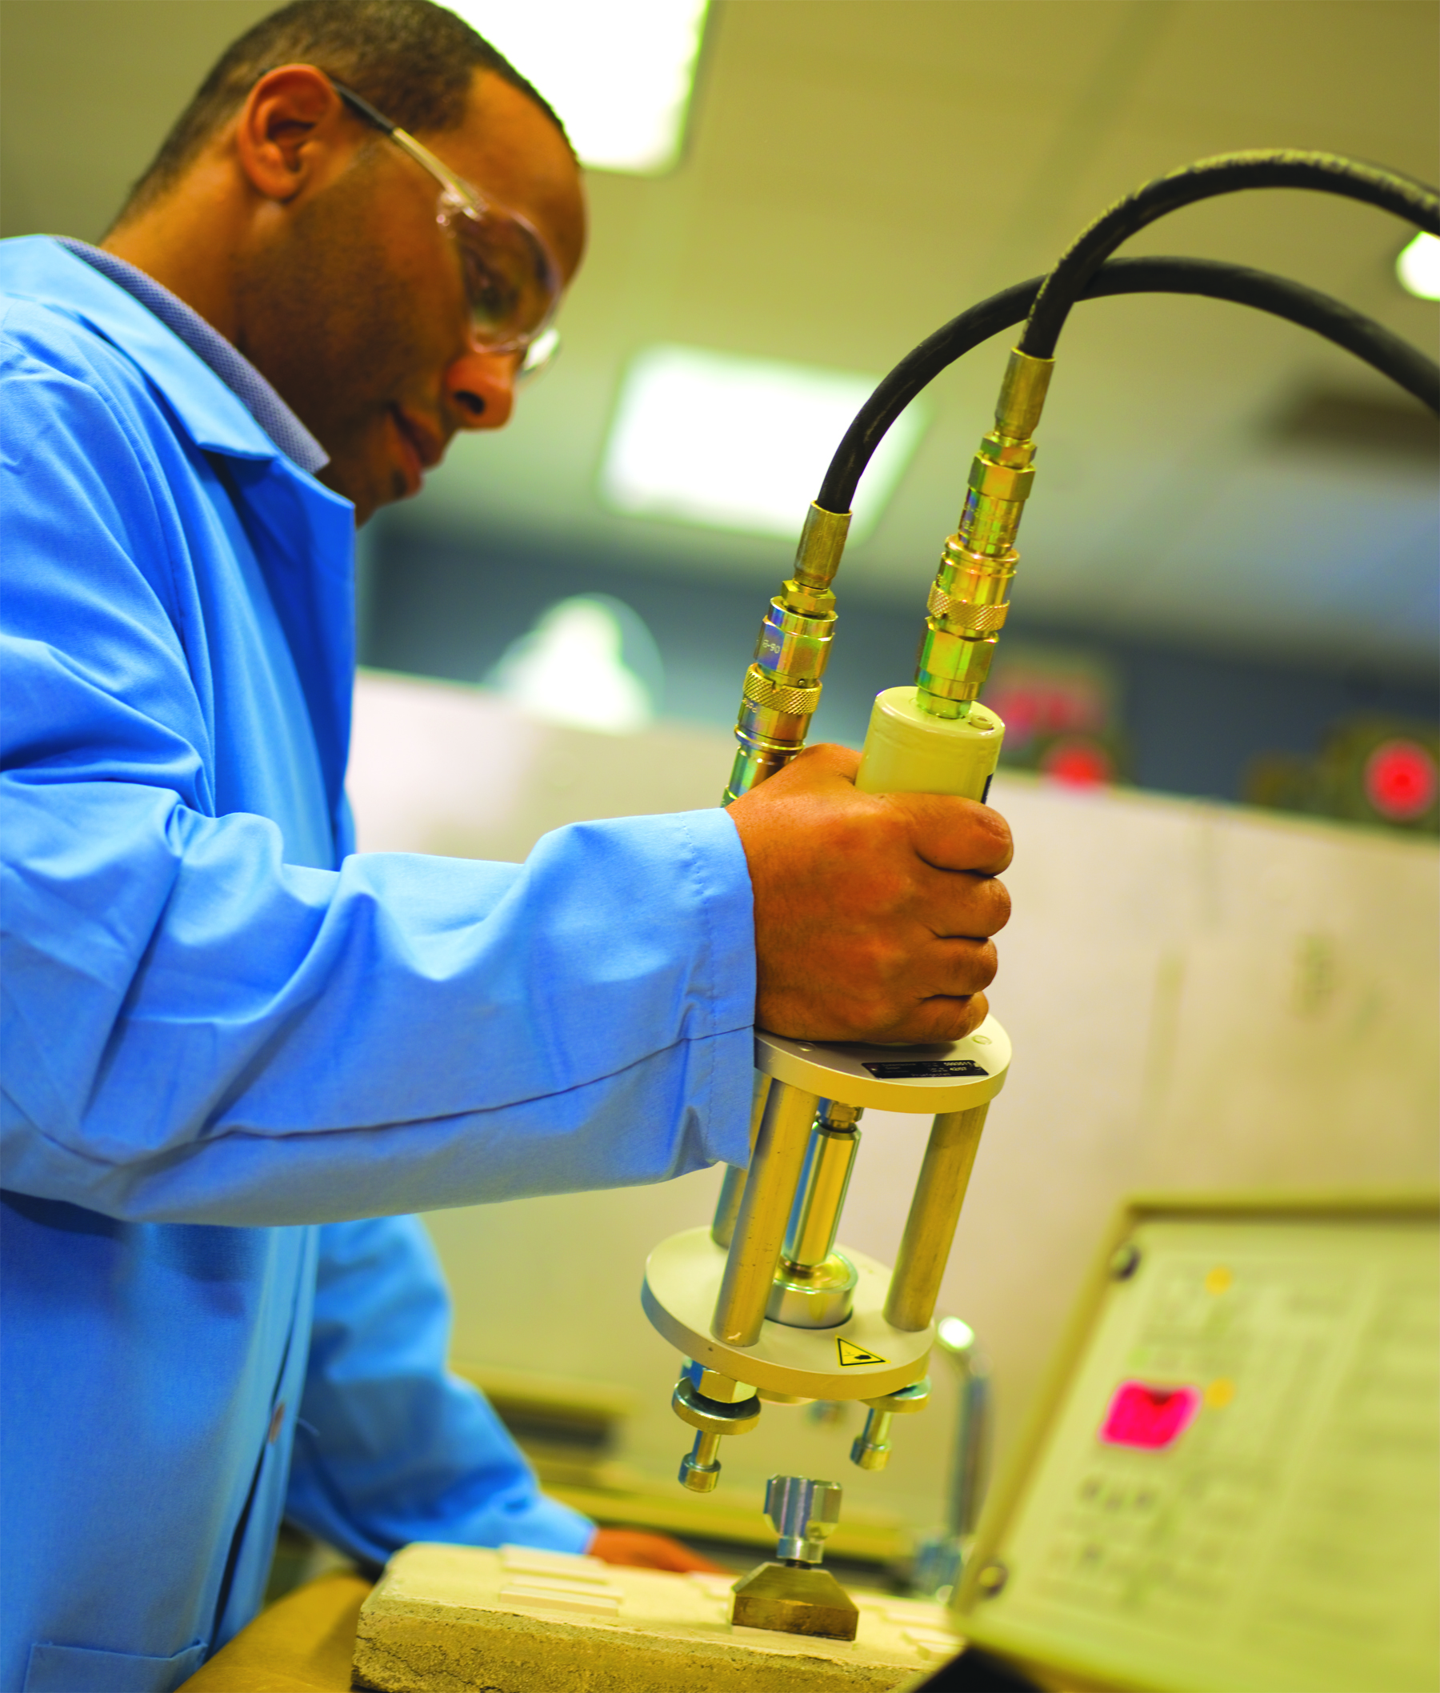
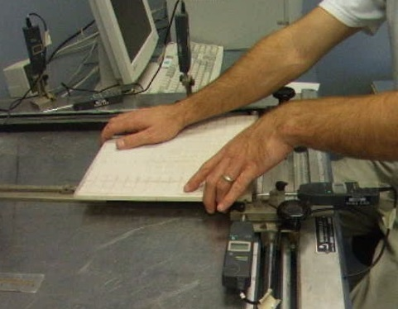
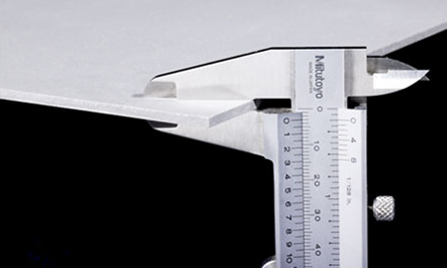
ISO TC 189 tile-related working groups
Working Group 1—Tile Test Methods
  Water absorption, surface abrasion, etc.
Working Group 2—Tile Specifications
  Criteria for rectified tile
Working Group 3—Installation Materials
    ISO mortar and grout specs introduced in 2011
Working Group 4—Thin Tile

Slide 61
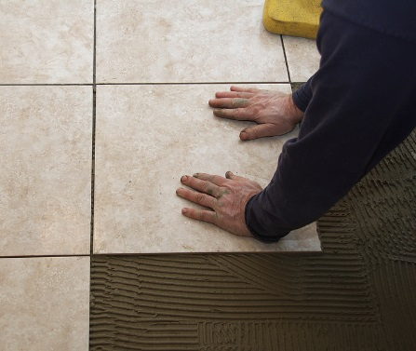
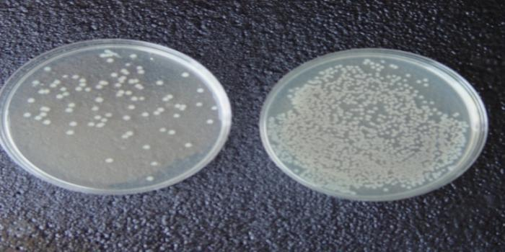
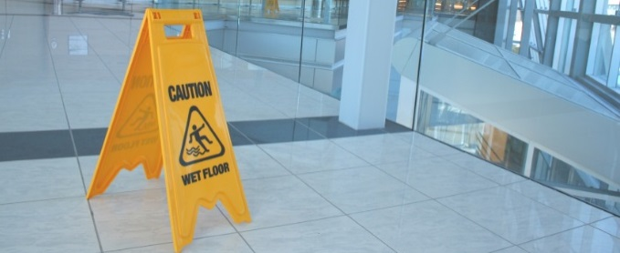
ISO TC 189 tile-related working groups
Working Group 6—Guidelines for Installing Tile
  technical report (non-normative)
Working Group 7—Tile Sustainability
Working Group 8—Antimicrobial Properties of Tile
Working Group 9—Low Modulus Adhesives for Exteriors
Working Group 10—Slip Resistance for Ceramic Tile

Slide 62




sustainability groups and green building standards

Slide 63
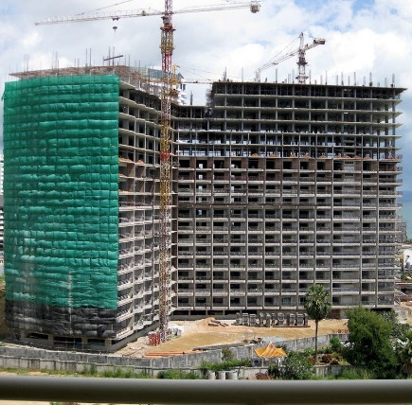
TC 59 (Sustainable Buildings/Construction)
PC 277 (Sustainable Procurement)
Standards for
developing sustainability standards for building products
environmental assessment of buildings
general building sustainability principles
sustainable procurement/purchasing

Slide 64



UL Environment, SCS Global and NSF International
Leading sustainability standards developers and certifiers
NSF — well known for public health standards and certification programs
UL — known globally for safety-related certifications and is on every “green” committee affecting tile (LEED Materials and Resources, LEED Pilot Credit Committee, etc.)
SCS — claims to fame are indoor air quality assessments, recycled content verification, and life cycle assessments

Slide 65


International Code Council (ICC)
  Developer of model building and fire safety codes used by all 50 states, federal agencies, private companies, etc.
  Developed IgCC, the International Green Construction Code
    Similar to other codes (plumbing, electrical, etc.)
    Becomes “the law” if adopted by a jurisdiction
    Contains enforceable language and criteria

Slide 66


US Green Building Council
  Largest green building organization in the world?
  Developer of the LEED rating and certification for green buildings
Notes:
Current recognition of certified green furniture with placeholder for other USGBC approved multi-attribute sustainability standards and programs
Recent meeting at Greenbuild to discuss future strategies

Slide 67





Architectural Sustainability Initiatives Today
  LEED
  Green Globes
  IgCC International Green Construction Code
  ASHRAE Standard for the Design of High-Performance, Green Buildings
  NAHB National Green Building Standard (ICC 700)
  GSA Facilities Standards
  National Institute of Building Sciences (NIBS)

Slide 68

Green Construction
Grows Up
TCNA’s Bill Griese
Age: 8
“Building green” gets more complex, more critical
So many standards and rating systems! How to specify products?
Single-attribute sustainability claims no longer sufficient

Slide 69

Green Construction
Grows Up
In response multi-attribute sustainability standards are developed by other flooring industries: carpet, resilient, laminate, stone…
Other industries with multi-attribute sustainability standards
  Commercial Furniture
  Textiles
  Wall Coverings
  Single Ply Roofing Membranes
  Gypsum Board and Panels
  Door Leafs

Slide 70

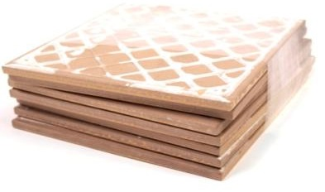
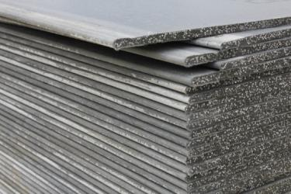
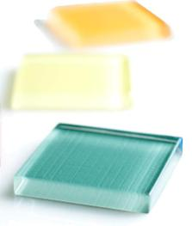
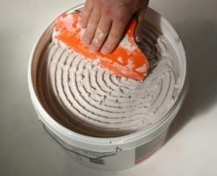
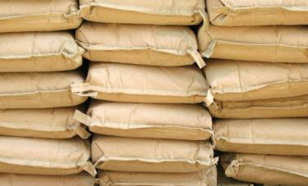
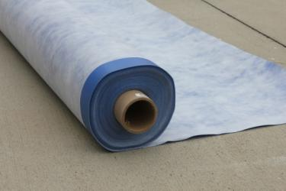
Green Squared
Multi-attribute sustainability standard and certification program launched in 2012 for tile and installation materials
Mandatory and elective requirements in each category
  Product characteristics
  Manufacturing
  Corporate governance
  End of life
  Innovation

Slide 71





Conformance to
Green Squared
Manufacturers can self declare, but 3rd party certification is increasingly important
Certified by “the big guns”
Thousands of certified products today
  12 U.S., Mexican, and European tile mfrs.
  2 U.S. mortar manufacturers

Slide 72

What does Green Squared® mean for the tile industry?
Credibility behind sustainability claims; not perceived as greenwashing
Balanced approach, based on North American norms
Easy to recognize sustainable products
A way to drive tile into green building standards and rating systems like LEED

Slide 73

Stress-Free Sustainability
CREDITS!!!
LEED v4
Green Globes
NAHB National Green Building Standard
COMPLIANCE
IgCC International Green Construction Code
ASHRAE standard for green buildings
GSA Facilities Standards for Public Buildings
CONFIDENCE
Listed in the National Institute of Building Sciences’ Whole Building Design Guide

Slide 74



Taking Sustainability to the Next Level
Products certified to meet a multi-attribute sustainability standard
+
Total transparency, reporting

Slide 75

What’s the difference?
Environmental
Product
Declaration
Performance
Transparency
Minimum criteria that
a product must meet
A report on the various environmental impacts of a product, based on rules of what to report and how to report it

Slide 76
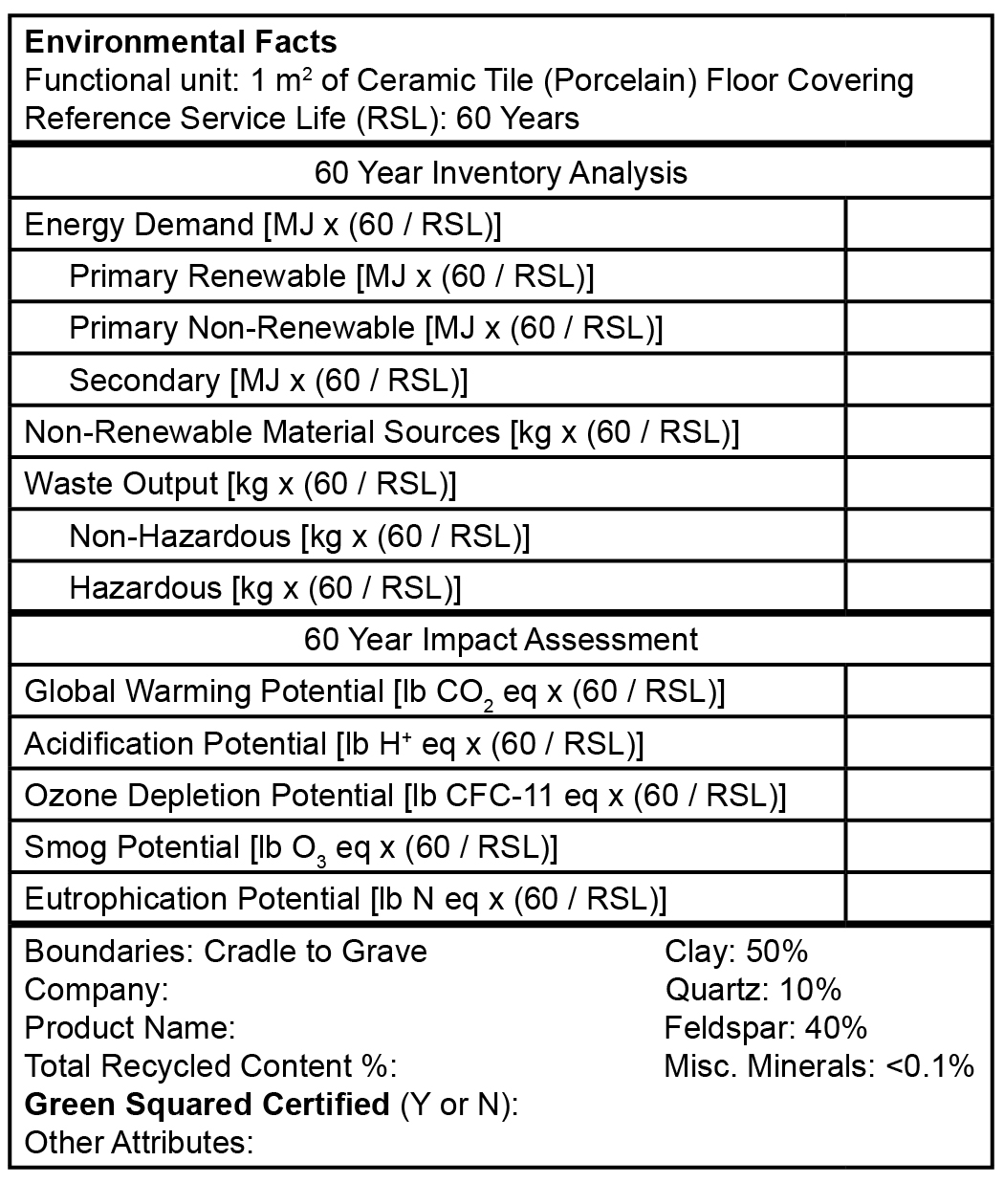
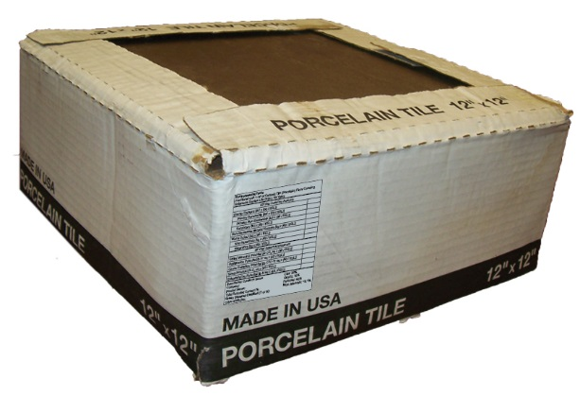

The Ceramic Tile EPD
Similar to a nutrition label
Reporting requirements, but no specific requirements that have to be met
Product category rules (PCRs) are in place so all flooring products report in the same fashion
Comparisons, evaluations, informed choice

Slide 77

The EPD for ceramic tile
PROVES tile has a lower
environmental footprint
than all other floorings ! ! !
You stay classy San Antonio!

Slide 78
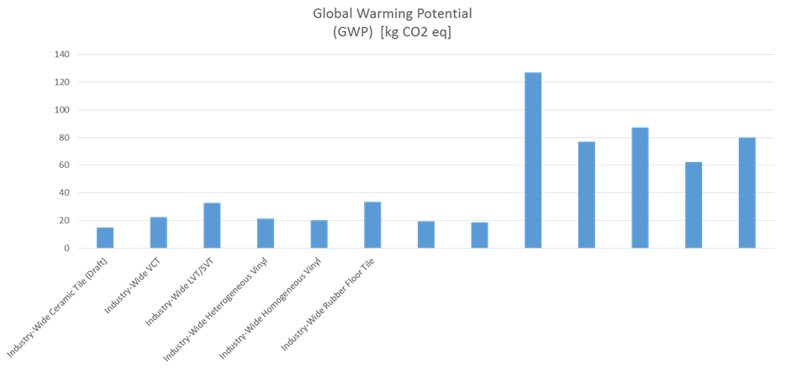
Tile Made in North America Comparison to Carpet and Vinyl—60-Year Carbon Footprint
Sampling of brand-specific carpet products

Slide 79






Tile Made in North America Comparison to Carpet and Vinyl—Other Impact Categories
Smog Formation Potential
Ozone Depletion
Acidification
Eutrophication
Resource Depletion
TCNA’s EPD shows tile to have the lowest 60-year impact across all categories

Slide 80

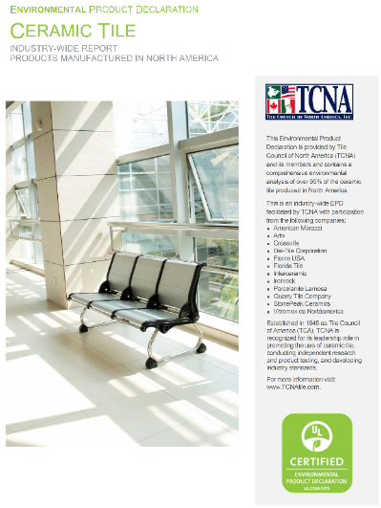
Just Certified by UL Environment!
Green building points for products that were used to create the generic EPD
LEED requires EPDs to be certified
Green Building Community Acceptance
Peer Review by Green Building Experts
CREDIBILITY!

Slide 81

On the horizon: HPDs?

Slide 82

Health Product Declarations (HPDs)
The HPD Collaborative developed the HPD Open Standard for reporting product content and associated health information
Requires complete disclosure of every ingredient and known residual
Top 30 largest architectural firms in the country are now asking for HPDs with some requiring them by 2015 or product will be pulled

Slide 83
HPD Requests, Reasons
Eliminating “known or suspected” hazardous chemicals
Growing interest in product transparency
Notifications range from “preference” for HPDs to required compliance by stated deadlines, or products will be phased out of specs and product libraries

Slide 84

TCNA Response
Publishing information and working with HPD Collaborative to correct false assumptions being made
The tile ingredients known to cause health risks are permanently fused together during firing and no longer a health risk

Slide 85
Standards dcof UPDATE

Slide 86

Old News…
The standard for COF has changed!
After 20+ years of specifying ASTM C1028 as the standard for COF in the U.S., the ANSI A137.1 tile standard was updated with a new method for testing COF, and a requirement was added.
DCOF AcuTest®

Slide 87

0.42 is the new 0.6
Construction professionals need to change from long-time practice of specifying minimum 0.6 SCOF per C1028
The minimum is 0.42 per the DCOF AcuTest for interior level tiles expected to be walked on while wet
TCNA uses the BOT3000

Slide 88


0.42 is the new 0.6
Project plans/specs, maintenance programs, etc., referencing minimum COF of 0.6 per ASTM C1028 (the old COF test method) do not meet the requirements of the ANSI A137.1 tile standard
C1028 was officially withdrawn Feb.1, 2014
Ramifications for using expired, “unsupported” standard???
0.6 and
ASTM C1028

Slide 89


More-recent Developments in COF
ASTM Committee on Pedestrian/Walkway Safety and Footwear
  Created a standard for calibrating/certifying walkway tribometers
  Now working on a way to use tribometers like the BOT3000 in estimating slip resistance thresholds
ISO TC 189 working toward worldwide consensus on COF

Slide 90

More-recent
Developments in COF
TCNA proposal to include DCOF criteria in the International Building Code (IBC) section on “slip-resistant” materials used in areas of egress
Gaining traction for AcuTest: several other hard surface flooring associations are considering following suit

Slide 91

Why all the interest in COF?
Desire to avoid accidents and the associated liability
Desire to match traction to how a floor will be used
Safety in all aspects has become a much bigger concern and is a growing industry unto itself
Need for a reliable way to check initial COF and changes over time (maintenance, wear)
Slipperiness of a floor can affect safety and cleanability

Slide 92

science

Slide 93

Research and Testing for Standards Development
Determine what needs to be measured, defined, standardized
  How to test? Use/tweak existing test? Develop new test?
Generate data, look for trends
As trends emerge, standards can start to take shape
Often back to the drawing board at points along the way

Slide 94


Slide 95

TCNA Laboratory
3rd party, confidential testing
ASTM, ISO, ANSI, etc.
Ceramic tile, glass tile, dimension stone, installation materials, antimicrobial, sustainability, etc.
Current research
  Thin Tile
  Uncoupling Membrane
  Large and Heavy Tile Mortar
  Water absorption
  DCOF

Slide 96

Science
Focus on
Thin tile

Slide 97



Last year at Total Solutions
TCNA “reported” on thin tile
OK…mainly we posed A LOT of theories and questions
  What methods can be used to test?
  Required performance: Same as traditional tile? Less? More?
  What tiles should be tested (size, thickness, method of manufacture, etc)?

Slide 98

One Year Later
TCNA has been aggressively testing thin tiles
Initial focus:
  gauging variation between tiles and effects of variation
  determining most important properties to test
  developing appropriate tests
Objective: thin tile product standard (ANSI A137.3)

Slide 99

Framework of Research
Narrowed down the range of tests and most relevant properties
  System performance (Robinson Test)
  Breaking strength
  Impact resistance
Continuing to perfect test methods

Slide 100

System Testing with Robinson Floor Testing
The most important and studied area, other countries may be following suit
Subjects the test system to increasingly rigorous loading
Checking lippage throughout testing and how/if it affects performance
Could determine thin tile lippage allowances

Slide 101

Two Tests for Breaking Strength
Better idea of average values of products currently in the marketplace
Reinforcing results in two breaks
  initial crack
  final break

Slide 102

Impact
Resistance
Testing
Falling Ball Method
Metal ball dropped once onto tile bonded to block

Slide 103

Impact
Resistance
Testing
Rolling Ball Method
Ball rolls into the edge of a tile bonded to block

Slide 104



Damage from Impact
Correlating impact testing with Robinson performance
Edge appears to be especially relevant

Slide 105
Recommendations and Requirements to Expect
Very specific mortar and grout recommendations
Draft product standards
  Heavy or extra heavy rating
What do we know today?

Slide 106

Science
Focus on water absorption

Slide 107



Water Absorption Test Methods
ASTM C373
(boil)
  ISO 10545-3
  (vacuum)
  ISO 10545-3
  (boil)
5 hours
24 hours
30 minutes
15 minutes
2 hours
4 hours
Stringent
Most time needed
Stringent
Quickest test
Not used as basis for classification
Less stringent
Quicker than ASTM C373
0.85-1.25% 0.5%

Slide 108

Vacuum Method:
Similar to boil methods but faster due to use of vacuum
Current ISO Vacuum Test Uses Effectively Highest Reasonably Achievable Vacuum, so greatest saturation achievable with vacuum
Boil Methods:
Simple equipment, complex protocols
  accuracy to 1/100th of a gram
  clean deionized water every run
  precise boil and soak cycles
  dessicants used during cooling to avoid trapping ambient moisture
  longer boil = more saturation

Slide 109
Why make a federal case out of it?

Slide 110

Revisions to Tariff System Codes
Federal crime to import under wrong code when new codes take effect
All imported tile will be classified according to its water absorption in 2017

Slide 111
Revisions to Tariff System Codes
6907.21 - - Of a water absorption coefficient by weight not exceeding 0.5%
6907.22 - - Of a water absorption coefficient by weight exceeding 0.5% but not exceeding 10%
6907.23 - - Of a water absorption coefficient by weight exceeding 10%
6907.30 - Mosaic cubes and the like, other than those of subheading 6907.40
6907.40 - Finishing ceramics

Slide 112

WCO Described
the New Codes
As Somewhat
Inelegant…

Slide 113

Education and advocacy

Slide 114
Activities
Market updates and quarterly consumption reports
  Abbreviated info regularly made available on www.tcnatile.com
Writing/publishing
Provide materials to TCNA members to use
Testimony in Washington, D.C.
  Congressional hearings
  Office of the U.S. Trade Representative, International Trade Commission
  World Customs Organization
  OSHA
  EPA

Slide 115
Topics and Issues
Import/export, free trade, fair trade
IP theft
COF
True porcelain
OSHA silica
Contractor and installer certifications
Standards, changes to standards
Benefits of ceramic tile, recent emphasis on sustainability

Slide 116


COF Resources at www.TCNAtile.com
ANSI and Handbook language
FAQ-style Technical Bulletin
  PSA-style 1-page bulletin
Articles by TCNA and others explaining the change in methodology and requirements and related issues, such as liability

Slide 117

Water Absorption/Porcelain Tile Resources
at www.TCNAtile.com
Bulletin
  Falsely-labeled porcelain
  Certified porcelain

Slide 118

Sustainability Resources at www.TCNAtile.com
Guide to LEED v4 and Tile
10-page guide, organized by LEED credit category
Tile the Natural Choice
At-a-glace chart of credits and points available for using tile in various green building rating systems

Slide 119
Education and advocacy contractor & installer qualifications

Slide 120
It all boils down to this:
Tile is a largely unregulated trade—easy entry
Marginal installations and bad installations hurt the whole industry
  Lost man hours
  Negative perception of tile/negative experience
Product standards result in quality products, but they have to be assembled

Slide 121

Simple Goals and Strategies to Combat
Marginal Installations and Bad Installations
Inform the tile consuming public
  Key message: identify qualified candidates… then compare prices
Choosing Your Tile Contractor
ACT Certification Guide

Slide 122
Simple Goals and Strategies to Combat
Marginal Installations and Bad Installations
Assist the organizations that develop and administer programs that enable one to identify the qualified companies and individuals
  Curriculum assistance
  Fundraising: over $100K per year
  Support A&D awareness efforts
One more Handbook change…

Slide 123

ACT Program Information Added
Description of the Advanced Certifications for Tile Installers (ACT)
ACT is an evaluation and certification program for tile installers in advanced, specific skills areas:
  large format tile installation and substrate preparation
  mudwork for walls
  mudwork for floors
  shower pan installation
  membrane applications

Slide 124



Sample Spec Language for Requiring Qualified Labor
Ready-to-use spec language provided to require:
  NTCA 5-Star Contractor or TCAA Trowel of Excellence Contractor
  CTEF Certified Tile Installers, Journeyman Tile Setters, or Act Certified Tile Setters
  IMI Certified Foreman
  Equivalent

Slide 125
Sample Spec Language for Requiring Qualified Labor
Making boilerplate spec language available at www.tcna.com
Because…
“a home or any building today is one of the few things still made entirely ‘by hand’ and every aspect of a tile installation relies on the tile contracting company and its installers. How good the finished installation looks, how well it performs, and how long it lasts are in their hands…

Slide 126









Slide 127
The Takeaways …
Despite the vagaries of the tile market, growth is steady on many fronts:
  Standardization – international and domestic
  Sustainability
  Research
  Trade and regulations
  Methods and best practices

Slide 128

Thank You!
Follow @TileCouncil
Sign-up to receive
email notifications!

Slide 129





