Slide 1
LEED v4 and Its Relevance to
Tile

Slide 2
After years of development, LEED v4 was released at Greenbuild in November of 2013 and is among the hottest topics being discussed today by green building architects and designers. This presentation will examine the new requirements in LEED v4 and how they relate to tile systems.

Slide 3
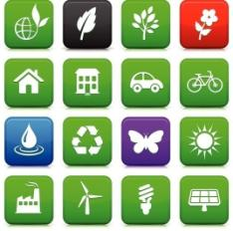
US Green Building Council (USGBC) and the Genesis of
Today’s Green Building Industry
The early 1990s . . .
AIA’s Environmental Resource Guide (1992)
Launching of ENERGY STAR (1992)
Clinton’s “Greening of the White House” (1993)
Formation of USGBC (1993)
Increased green building awareness
= new norm
= new industry
= new architectural
marketplace
1998 . . .
USGBC’s Launching of LEED v1.0
Today . . .
LEED v4.0 and many other green building initiatives
Unprecedented number of green architectural initiatives

Slide 4

What is LEED?
Leadership in Energy and Environmental Design
Developed by the United States Green Building Council (USGBC)
Points-Based Rating System for Green Buildings

Slide 5
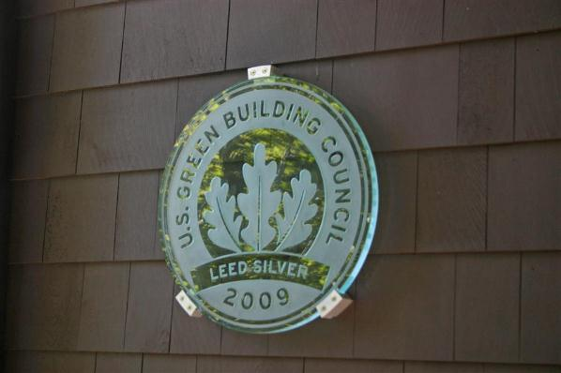
How does LEED work?
Buildings designed, constructed, and operated in accordance with LEED criteria
  The more criteria met, the more “points” earned
  Deferent levels of certification awarded based on total number of points
    Certified, Silver, Gold, Platinum
Certification of buildings, not products, although . . .
  Products are integral to overall design and performance
  Products directly and indirectly influence a building’s points toward certification
  LEED has strongly impacted the building product marketplace

Slide 6
The Impact of LEED
In the US, approximately 50,000 registered or certified projects totaling over 600 million square meters
Outside of the US, LEED certification in over 100 countries
  Many national Green Building Councils (GBCs) worldwide
  Common perceptions for modern-day green building practices
Substantial impact on today’s building product marketplace

Slide 7
How big of an impact?
In 2010, $38.7 billion spent on green building materials due to LEED and similar programs*
By 2015, over $70 billion will be spent*
Estimated, 13% annual expansion*
*According to report on US green building market demand released by Freedonia Group in 2011

Slide 8
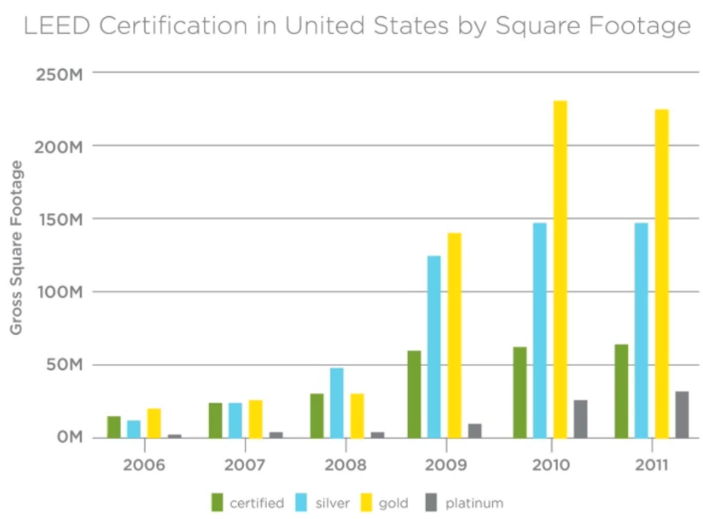
Growth of LEED & Where We Are Today
In 2011, USGBC identified need for LEED v4
Too much separation between certification levels
Plateau/slight reduction in growth rate
  Adopt new philosophies to generate more interest
  Less prescription, more design flexibility
LEED v2.2
(2005-2008)
LEED v3
(2009-2013)
LEED v4
(2014- )

Slide 9
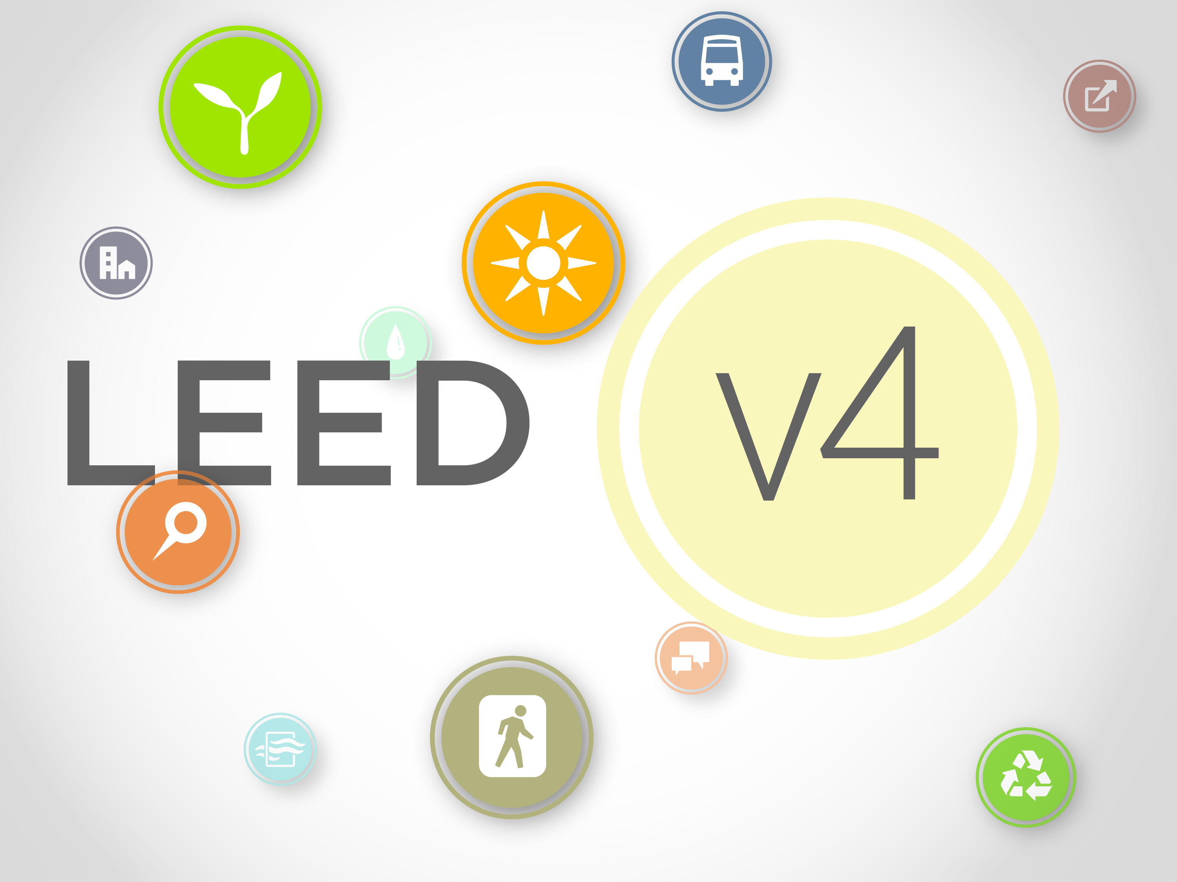
Version 4.0
Released toward the close of 2013
  Big story at GREENBUILD in November
  Throughout 2014, transition to v4 and phase-out of v3
Main objectives
  Increased rigorousness from previous versions
  More design flexibility
    Emphasis on design team collaboration
    Less design prescription
    Requirements for more information about products

Slide 10
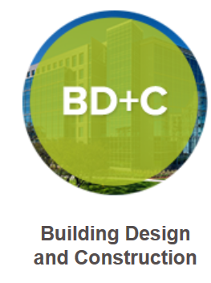
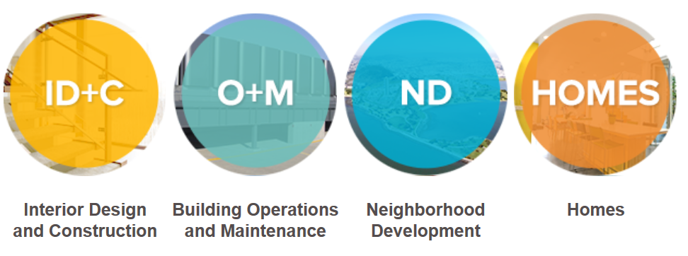
LEED v4 Rating Systems

Slide 11
LEED v4 Rating Systems

Slide 12



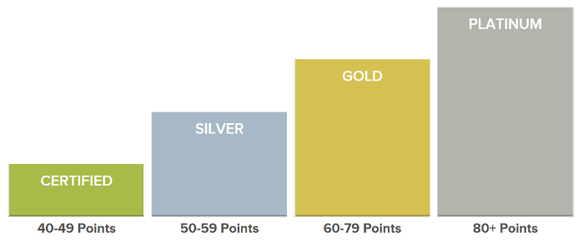






LEED v4 B+C: New Construction
Integrative Process (1 possible point)
Location & Transportation (16 possible points)
Sustainable Sites (10 possible points)
Water Efficiency (11 possible points)
Energy & Atmosphere (33 possible points)
Material & Resources (13 possible points)
Indoor Environmental Quality (16 possible points)
Innovation (6 possible points)
Regional Priority (4 possible points)
110 Possible Points

Slide 13
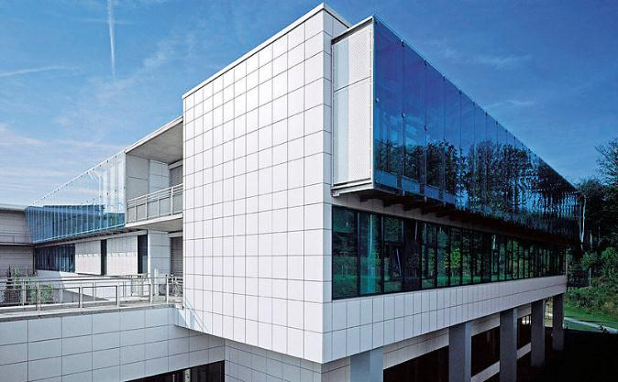
LEED v4 B+C: New Construction
Integrating Tile into Your Design
Integrative Process (1 relevant point)
Sustainable Sites (3 relevant points)
Energy & Atmosphere (18 relevant points)
Material & Resources (13 relevant points)
Indoor Environmental Quality (9 relevant points)
Innovation (6 relevant points)
Regional Priority (4 relevant points)

Slide 14


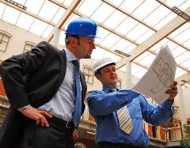
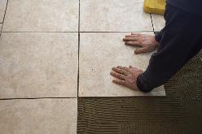
Integrative Process
Credit: Integrative Process (Up to 1 Point)
Relevant Criteria:
Throughout design process, achieve synergies across disciplines and building systems
When Considering Tile:
Influence of interior finishes and building envelope, particularly with regards to energy
Impact of all installation components

Slide 15

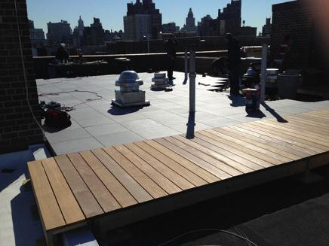
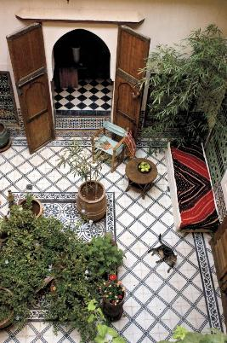
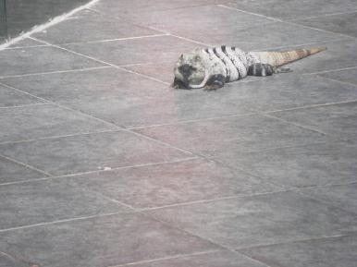
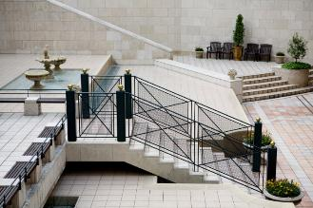
Sustainable Sites
Credit: Open Space (Up to 3 Points)
Relevant Criteria:
Provide outdoor space greater than or equal to 30% of the total site area
Up to 75% can be hardscaped with pedestrian- or recreation-oriented paving materials
When Considering Tile:
Decorative, durable, sustainable hardscaping materials
Blend with natural surroundings
Conducive to social activity and passive recreation

Slide 16
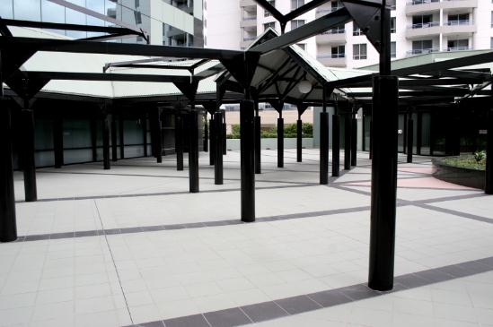
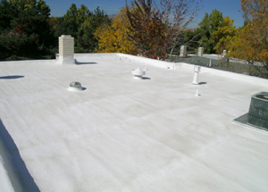
Sustainable Sites
Credit: Heat Island Reduction (Up to 2 Points)
Relevant Criteria:
Non-roof paving materials with high three-year aged Solar Reflectance (SR) Values
High-reflectance roof materials with high three-year aged Solar Reflectance Index (SRI)
When Considering Tile:
Light, colorfast alternatives to traditional paving and roofing materials

Slide 17

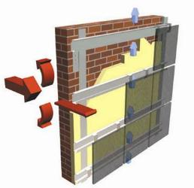
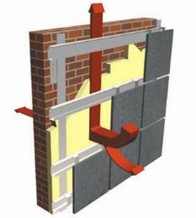
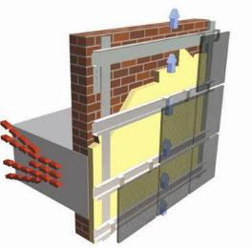
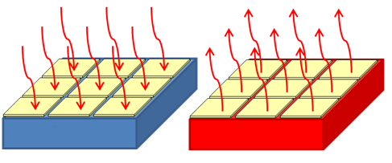
Energy & Atmosphere
Credit: Optimize Energy Performance (Up to 18 Points)
Relevant Criteria:
Achieve increasing levels of energy performance ranging from 6% to 50% beyond baseline requirements
When Considering Tile:
Thermal mass of floors, walls and ceilings and reduced burden on HVAC
Benefits of ventilated facades
Efficiency of radiant and geothermal heating

Slide 18

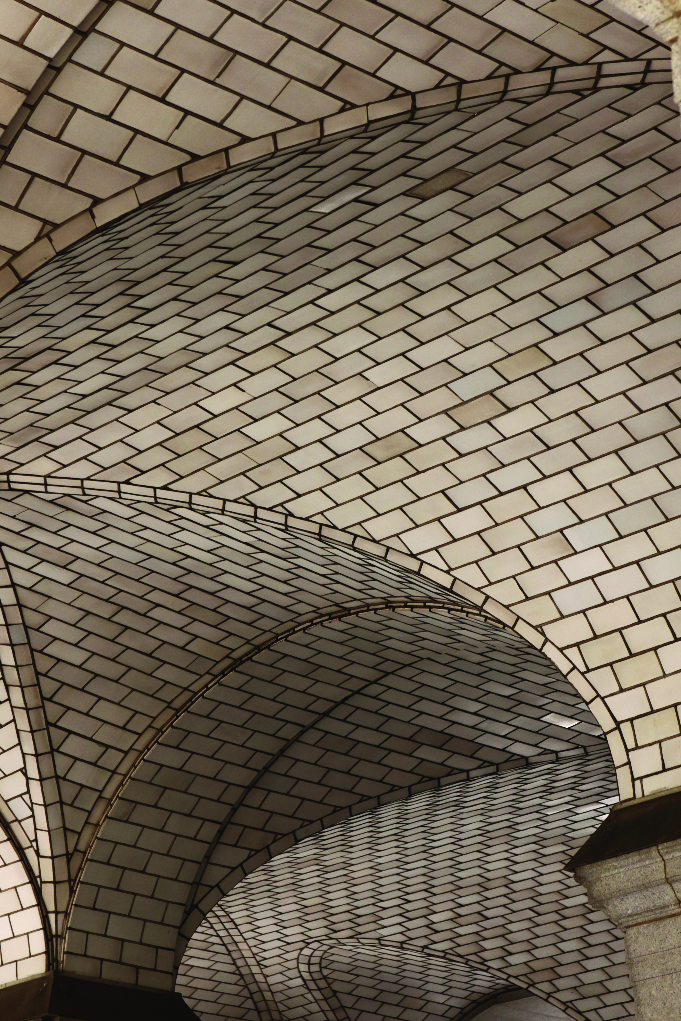
Materials and Resources
Credit: Building Lifecycle Impact Reduction (Up to 5 Points)
Relevant Criteria:
Option: historic building reuse
Option: building and material reuse
Option: whole building lifecycle assessment
When Considering Tile:
Exquisite installations focal to historic preservation projects
Durable materials which can be salvaged with no need for refinishing
Long lasting products with minimal lifecycle impact

Slide 19
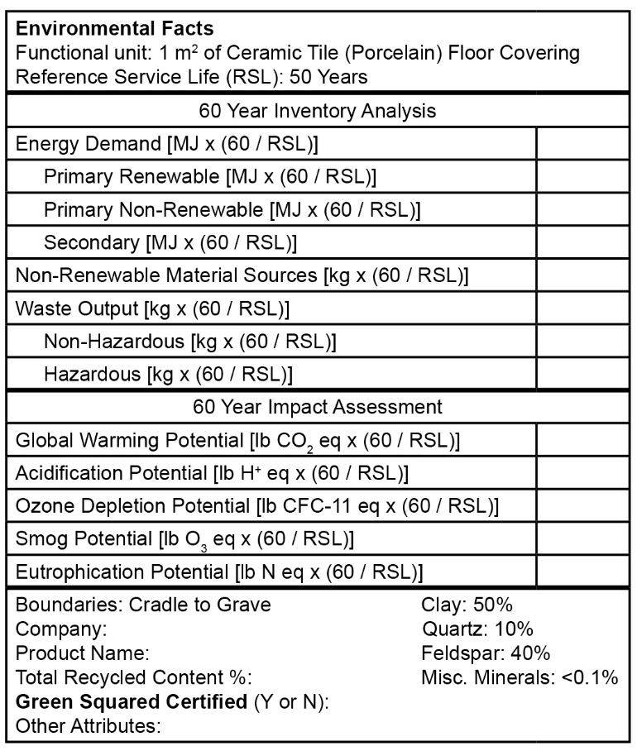
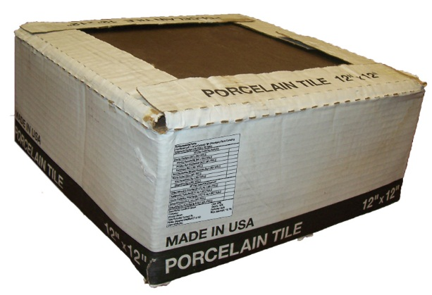
Materials and Resources
Credit: Building Product Disclosure and Optimization – EPDs (Up to 2 Points)
Relevant Criteria:
Option: Use 20 different products with LCAs or EPDs
  Product with LCA (valued as ¼ product)
  Product with generic EPD (valued as ½ product)
  Product with brand-specific EPD (valued as 1 product)
Option: 50% of all products are better than industry average in 3 lifecycle impact categories
When Considering Tile:
Refer to TCNA’s 2014 industry-wide (generic) EPD
Evaluate brand-specific LCA and EPD information

Slide 20
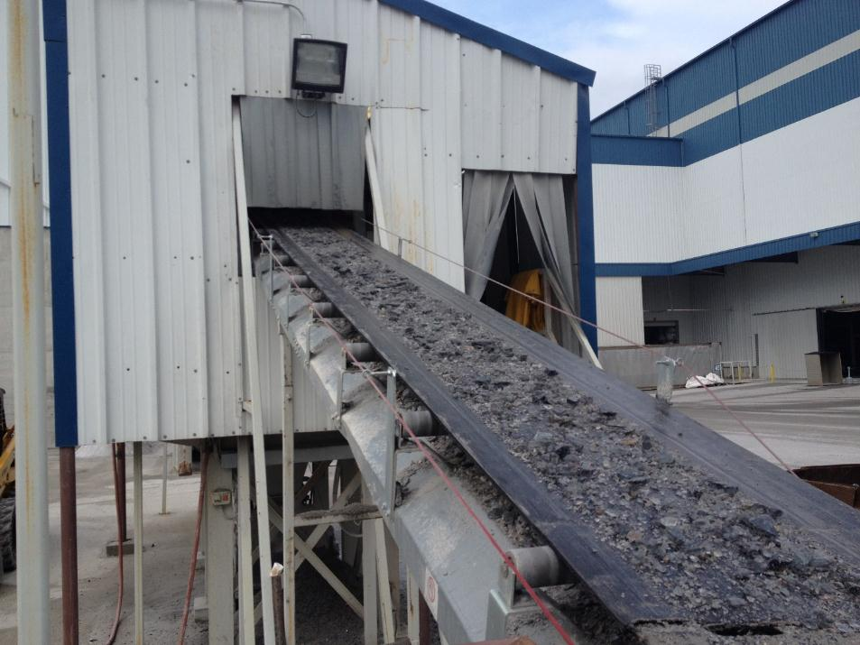
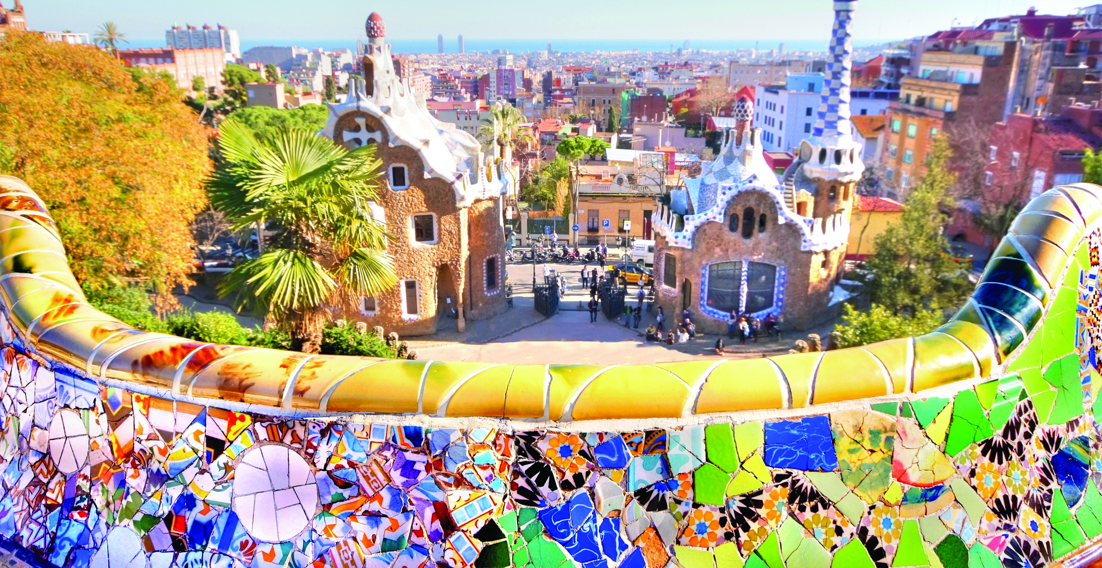
Materials and Resources
Credit: Building Product Disclosure and Optimization – Sourcing of Raw Materials (Up to 2 Points)
Relevant Criteria:
Option: report on extraction practices of raw material suppliers for 20 different products
Option: For 25% of products (cost-based):
  Recycled content
  Manufacturer offers Extended Producer Responsibility (EPR)
  Salvaged, refurbished, or reused
When Considering Tile:
Calculate quantity of recycled content
Ask about demolition take back options (EPR)
Consider material salvaging or refurbishing especially for decorative applications

Slide 21

Materials and Resources
Credit: Building Product Disclosure and Optimization – Material Ingredients (Up to 2 Points)
Relevant Criteria:
Option: Products that provide chemical inventories
Option: Products with chemical ingredients benchmarked at non-hazardous levels
Option: Products with ingredient safety measures throughout entire supply chain
When Considering Tile:
Materials with safe, natural ingredients
Consult with manufacturers about chemical inventories
Become educated about Health Product Declarations (HPDs) and what is being reported

Slide 22
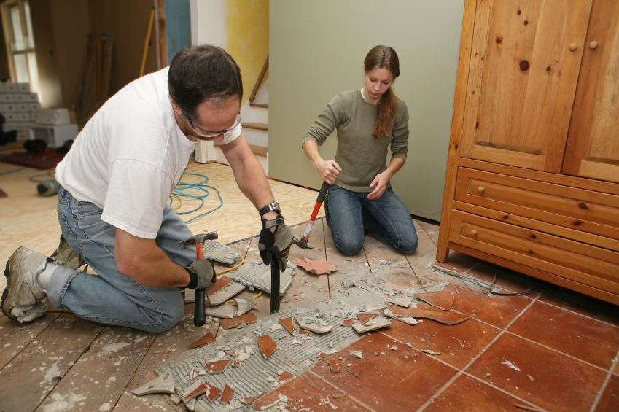
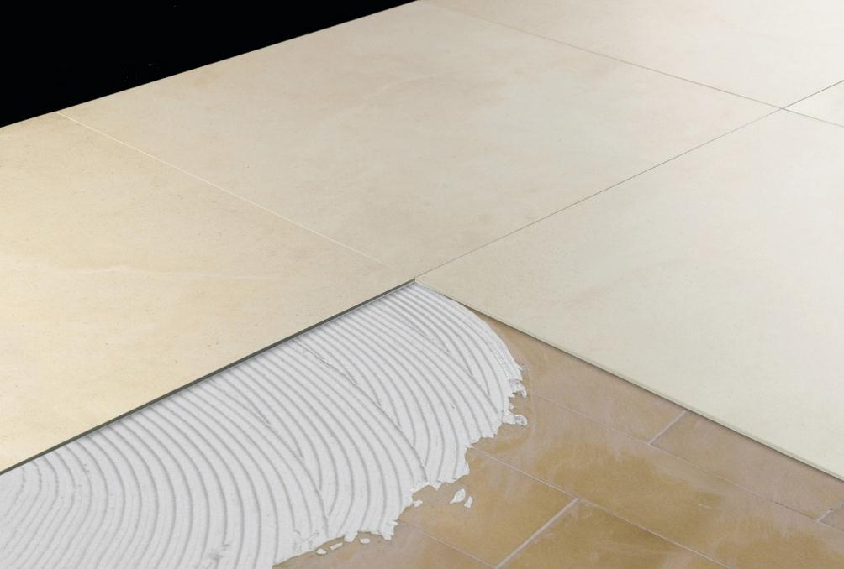
Materials and Resources
Credit: Construction and Demolition Waste Management (Up to 2 Points)
Relevant Criteria:
Option: Divert construction waste using a defined material streams
Option: Generate less than 2.5 psf construction waste
When Considering Tile:
Products which are solid, inert, nonhazardous that can be crushed and recycled and fit easily into diversion streams
Products which are inherently modular, minimizing off-cuts and scraps, and don’t require finishing
Products which can be installed over existing installations, eliminating the need for demolition

Slide 23
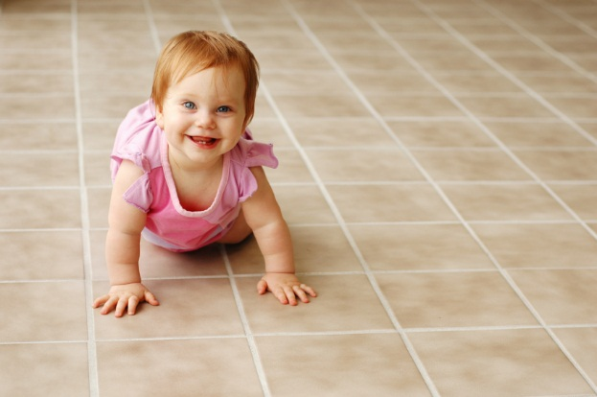
Indoor Environmental Quality
Credit: Low-Emitting Materials (Up to 3 Points)
Relevant Criteria:
Products which are tested and verified to meet maximum VOC content or emission criteria
Products which are inherently non-emitting and considered VOC-free without testing requirements
When Considering Tile:
Tiles are fired above 2000 degrees are inorganic and inherently do not emit VOCs
Tile installation products are inherently low or non-emitting and meet testing requirements

Slide 24

Indoor Environmental Quality
Credit: Construction Indoor Air Quality Management Plan (Up to 1 Point)
Relevant Criteria:
As part of plan, extra care given to construction materials that are:
  Highly toxic
  High in VOCs
  Easily damaged by moisture or mold
When Considering Tile:
Avoid the need for extra care by using:
  Non-toxic products
  Inorganic products
  Mold- and moisture-resistant products

Slide 25
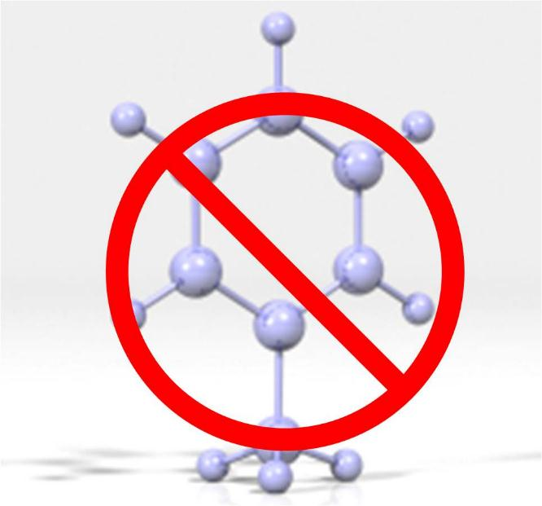
Indoor Environmental Quality
Credit: Indoor Air Quality (IAQ) Assessment (Up to 2 Points)
Relevant Criteria:
Good air quality after construction and before occupancy, based on standardized IAQ testing
When Considering Tile:
Non-toxic, formaldehyde-free and VOC-free products help IAQ Assessments
Wet-cut products minimize airborne dust
Cement products with impervious packaging and dust-reducing technologies also help

Slide 26
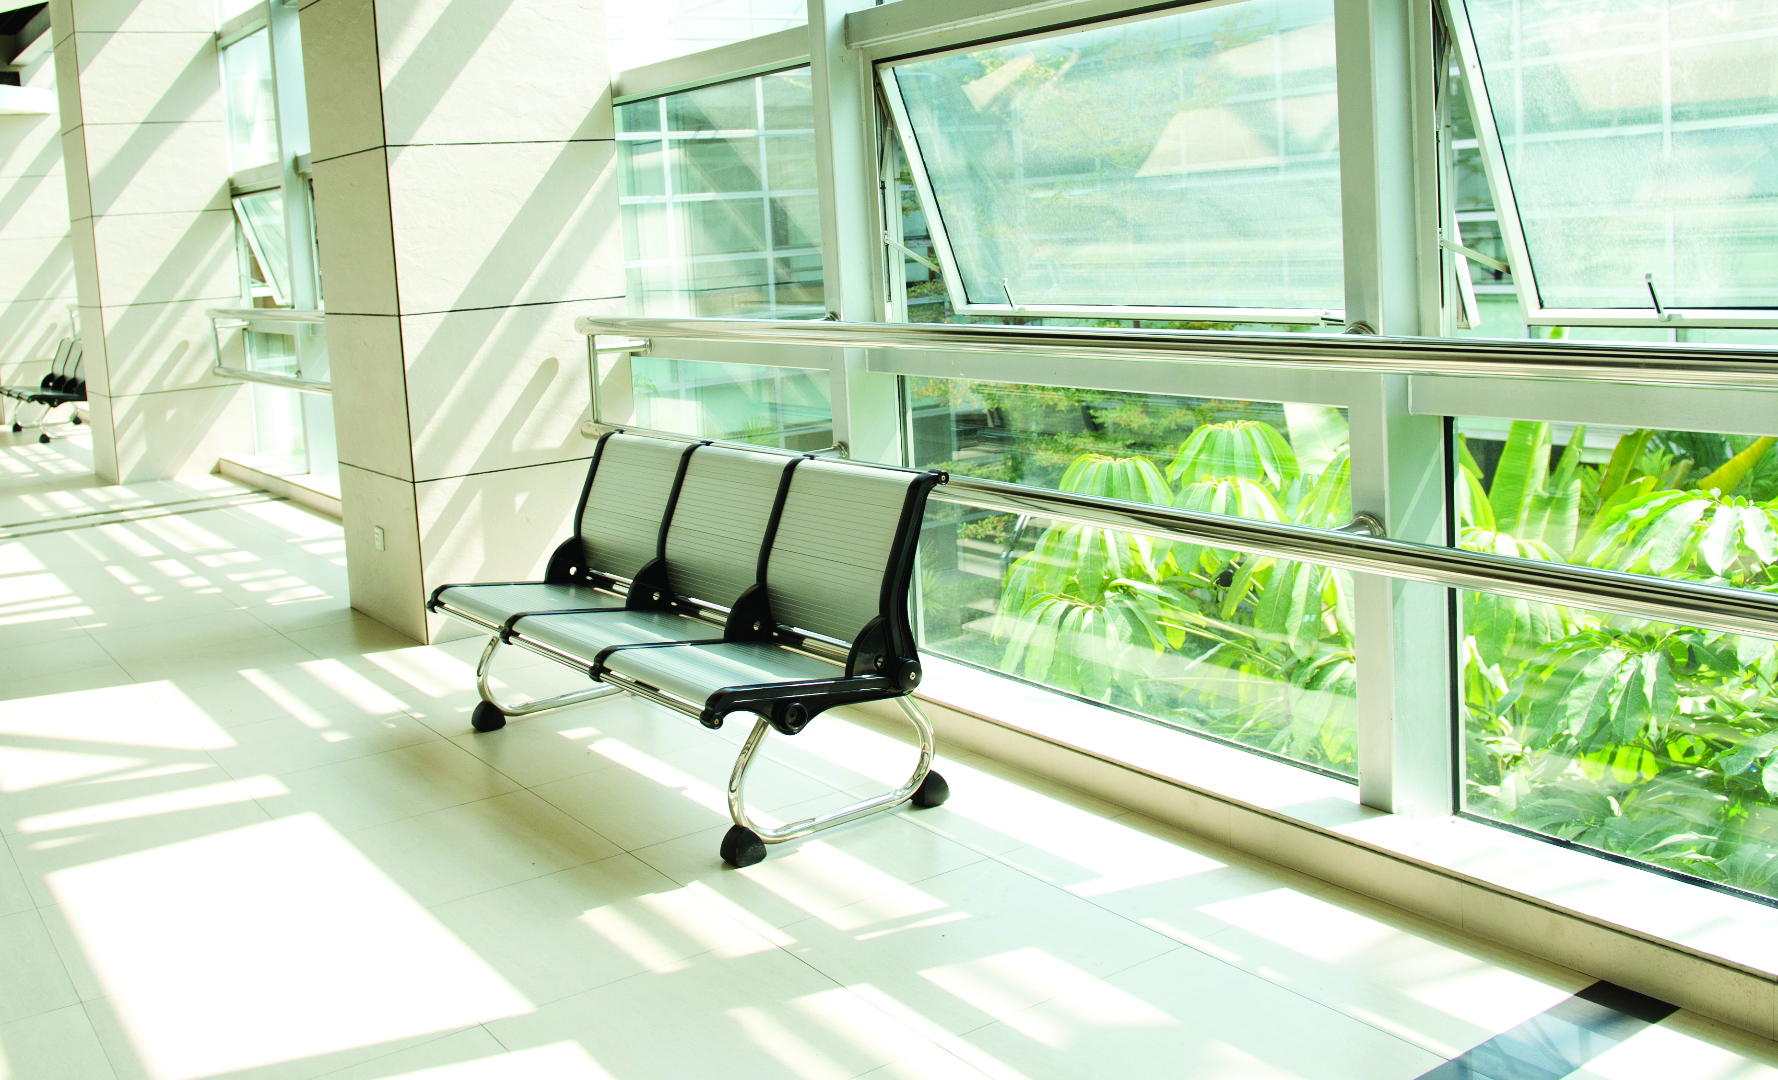
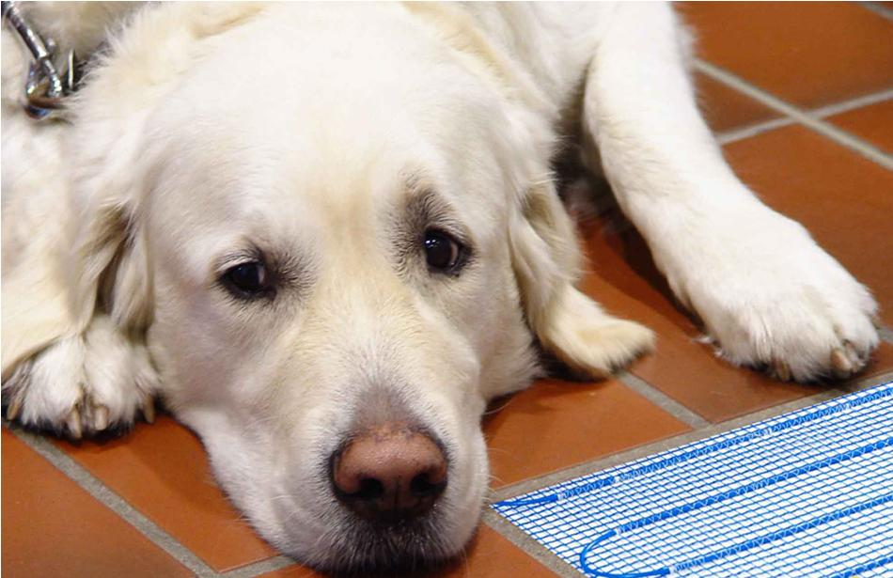
Indoor Environmental Quality
Credit: Thermal Comfort (Up to 1 Point)
Relevant Criteria:
ASHRAE Standard 55 Thermal Comfort Conditions, or
ISO 7730 and EN 15251 thermal comfort provisions
When Considering Tile:
Take advantage of materials which facilitate project candidacy for natural conditioning
  Thermal mass
  Exterior envelope
  Interior finishes
Reduce the need for mechanical conditioning through geothermal or radiant heating

Slide 27
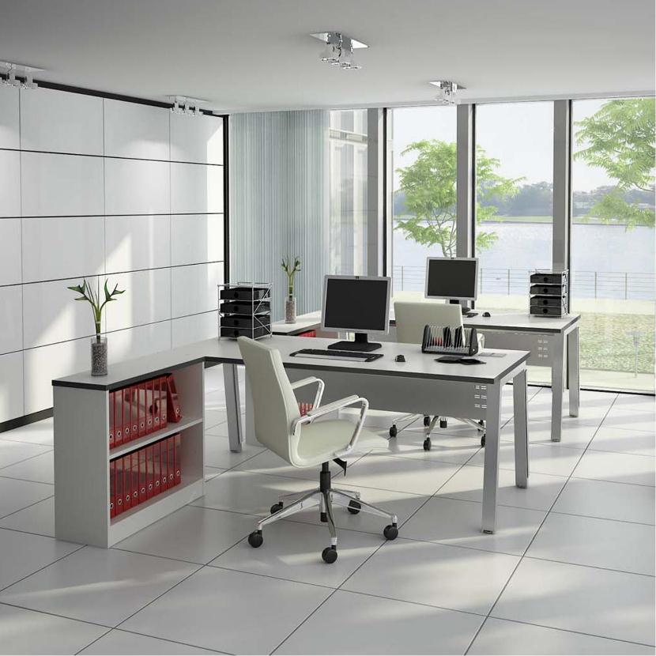
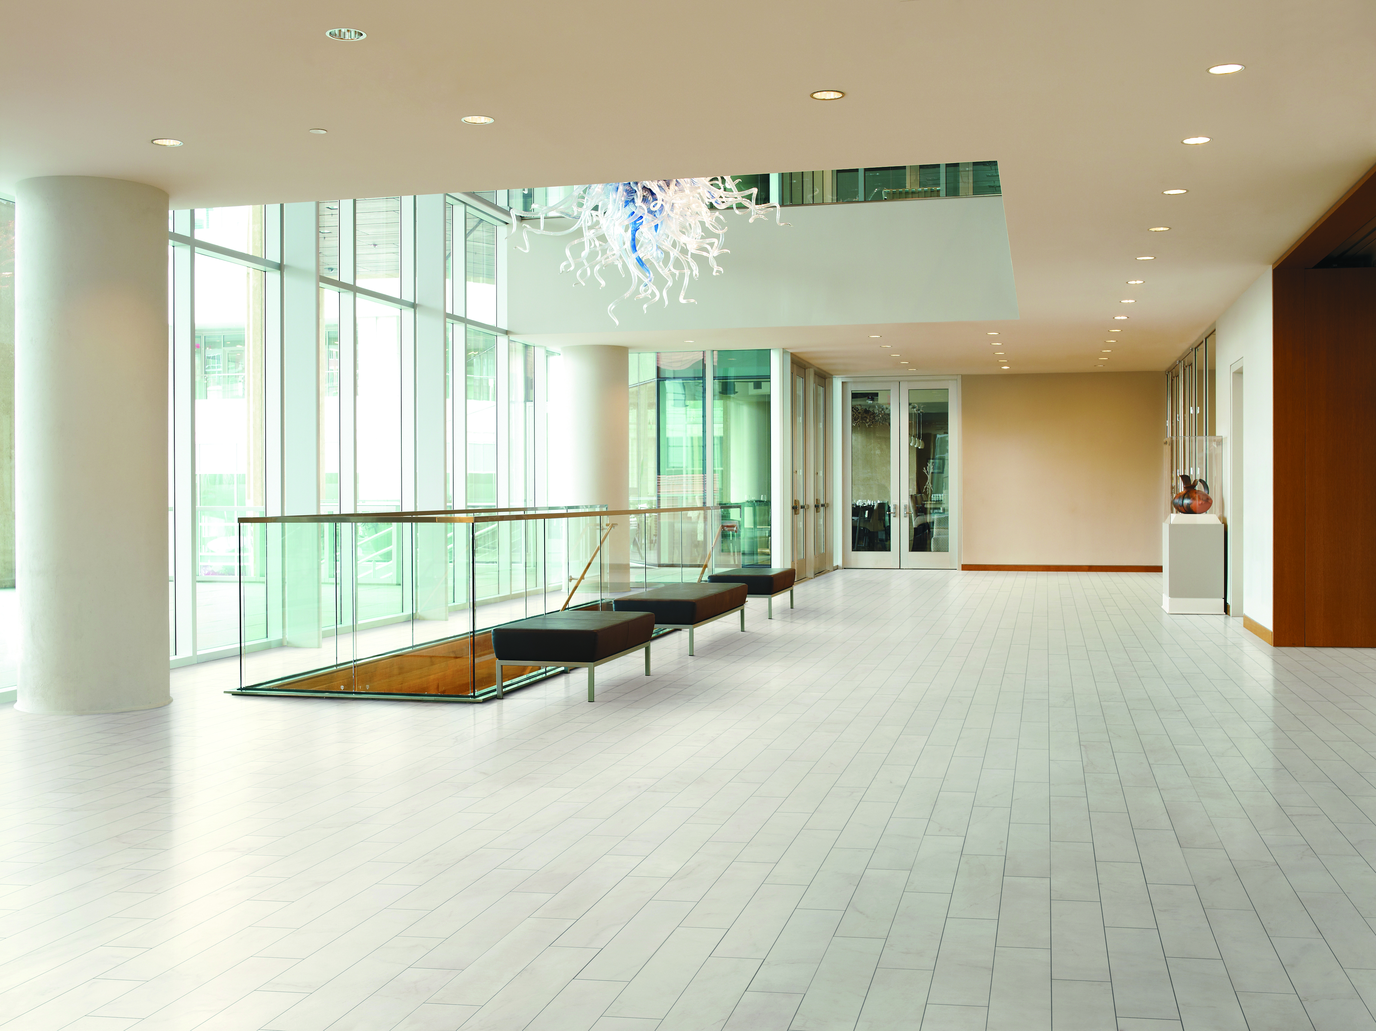
Indoor Environmental Quality
Credit: Interior Lighting (Up to 2 Points)
Relevant Criteria:
Lighting quality strategy: high surface reflectance
  Ceilings: average LRV 85
  Walls: average LRV 60
  Floors: average LRV 25
When Considering Tile:
Light colored surface coverings; LRV measured per ASTM C609
Monolithic envelope maximizes LRV—coverings that continue from floor, to wall, to ceiling
Colorfast materials that maintain brightness throughout lifecycle

Slide 28
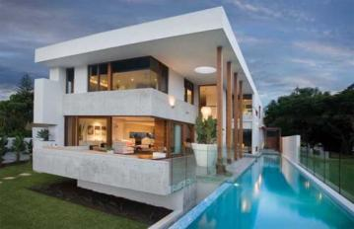
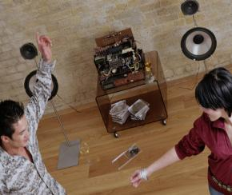
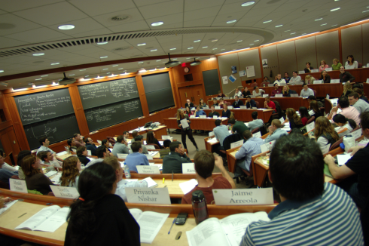

Indoor Environmental Quality
Credit: Acoustic Performance (Up to 1 Point)
Relevant Criteria:
Sound Isolation: Minimum composite sound transmission class (STCC) ratings for all occupied spaces
When Considering Tile:
  High Rise Residences, Hotels, Offices, Homes & Schools
    Floor to floor noise sound transmission
    High Rise Association requirements
    Improve classroom acoustics, speaker/attendee
  Sound Reduction membranes to reduce noise level transmission
  Improve classroom acoustics, speaker/attendee

Slide 29

Regional Priority
Credit: Regional Priority (Up to 4 Points)
Relevant Criteria:
Meet any of the existing LEED criteria which are of particular importance to a project’s region
When Considering Tile:
Exploit opportunities where products satisfy criteria of regional importance
Visit USGBC website for a list of priority credits for each region

Slide 30
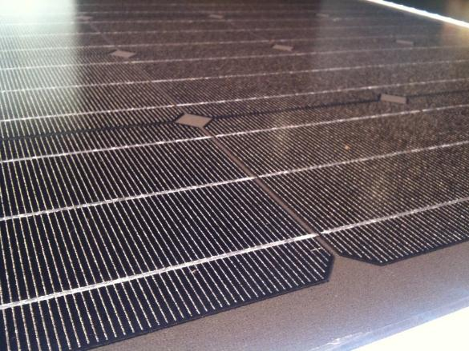
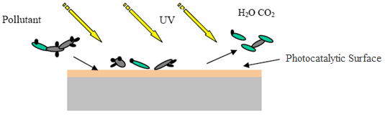
Innovation
Credit: Innovation (Up to 6 Points)
Relevant Criteria:
Option: Use a strategy or material not already addressed by LEED
Option: Meet Pilot Credit criteria
Option: Achieve exemplary performance
When Considering Tile:
New exciting technologies (e.g. photocatalysts, photovoltaics, antimicrobial additives, geothermal underlayments)
LEED Pilot Credit Library for updated product and industry specifications
Exploit opportunities where products contribute in an exemplary fashion

Slide 31
Challenges for Manufacturers
Expense in preparing LCAs, EPDs, HPDs, and certifying the supply chain without ROI
Customers unwilling to pay more for products that comply
‘Transparency’ vs ‘handing your formula to your competitors’
Potential for liability lawsuits

Slide 32
Challenges for Architects and Designers
Desire to select products for performance, not ‘points’ or degree of ‘transparency’
Need to understand the chemistry of products
Litigation concerns
Confusing path(s) to compliance
Requirements for ‘20 products from 5 manufacturers’ challenging to achieve
Cost

Slide 33
Pushback
Legislation in various states preventing state-funded projects from pursuing various LEED v4 Materials Credits and/or banning LEED altogether
Allowance of Green Globes as alternate path for sustainable Federal buildings after initially rejecting LEED v4 based on cost
Various industries appealing LEED HPD provisions

Slide 34
The Path Forward
Compliance?
Increased reliance on competitive systems?
Market rejection?
A compromise solution?

Slide 35
The Path Forward – Compliance
Industry average EPD’s
Manufacturers EPD’s, HPD’s, and Certified Supply Chains
Increase reliance on consultants and outsourcing for environmental reporting and compliance

Slide 36
The Path Forward – Competitors
Green Globes
ASHRAE
International Green Construction Code
Local building codes
CHiPs, state programs, NAHB Green Building (ICC 700), etc.

Slide 37
The Path Forward – Market Forces
Challenges through legislation
Rejection by architects and designers
Lack of available compliant materials
Lawsuits
Declining numbers of LEED certified buildings and projects

Slide 38
The Path Forward – Compromise
LEED has the longest track record and most name recognition
Thousands of industry professionals are dedicated to making it work
Some tweaks are almost surely in the works, voluntarily or otherwise

Slide 39
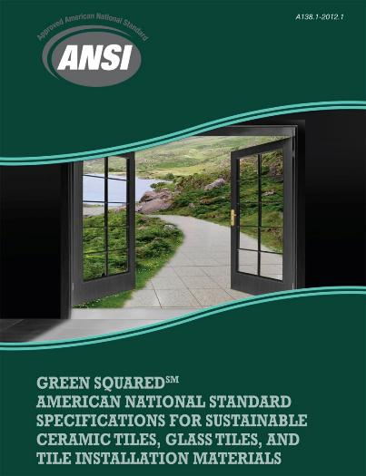
Tile industry meeting the demands: Green Squared®
Released in 2012
Standard and certification program for sustainable tile products
  Multi-attribute, balanced approach
  Includes setting materials
  Based on North American norms/expectations
  Hundreds of certified product lines currently in marketplace
Green Squared Certified® products fulfill a broad range of criteria specified throughout LEED v4

Slide 40
Green Squared® References in Green Building Standards/Rating Systems
Direct contribution to points/credits
  Green Globes for New Construction
  NAHB National Green Building Standard
  ASHRAE 189.1
Formal industry effort underway to reference Green Squared®
  International Green Construction Code (2014 Code Change Proposal Preliminarily Approved)
  LEED (Continued discussion of Pilot Credit 80)
Government specifications for Green Squared Certified products
  GSA Facilities Standards for the Public Buildings Service
  National Institute of Building Sciences (NIBS) Whole Building Design Guide (WBDG)

Slide 41
Tile industry meeting the demands: Generic EPD for Tile
Recently Completed
60-year Lifecycle Assessment of Tile Produced in North America
  Resource Depletion
  Acidification Potential
  Eutrophication Potential
  Global Warming Potential
  Ozone Depletion Potential
  Smog Formation Potential
Results show that tile outperforms carpet and vinyl in all impact categories over a 60 year period

Slide 42

Generic EPD for Tile: Relevance to LEED v4 and other Green Building Standards
Points for participating manufacturers
Opportunity for manufacturers to compare their products to industry average
  Baseline data and framework for future initiatives
  Potentially additional points for outperforming industry average
Generic comparison of tile to competitive surface coverings facilitates ecological product selection

Slide 43
LEED v4/Tile 11-Page Guide in 2014 TCNA Handbook

Slide 44
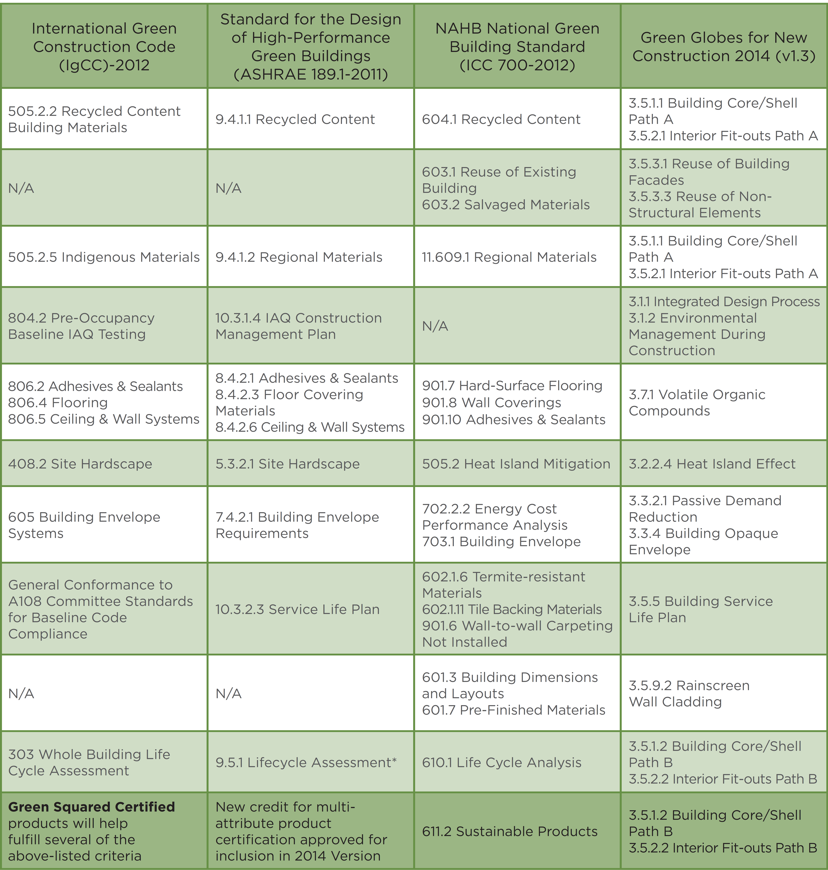
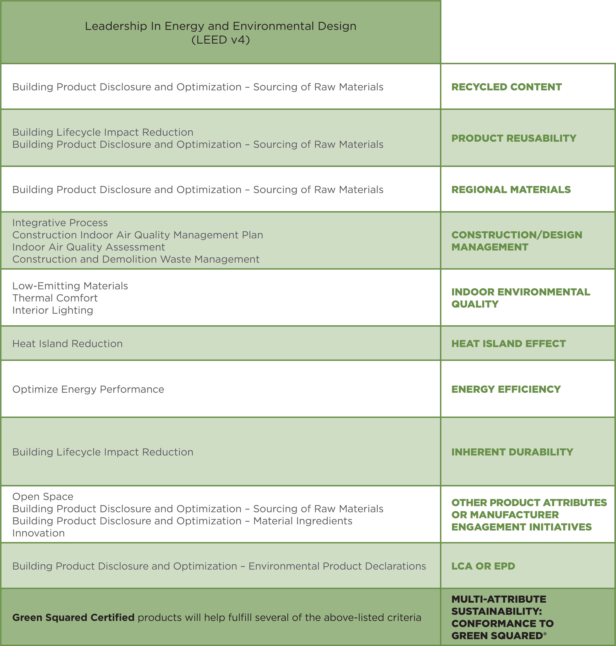
Green Standards Reference Guide
Chart Outlining Tile-Relevant Credits
Chart outlining various tile-relevant credits in various green building standards and rating systems
Part of Tile the Natural Choice in 2014 TCNA Handbook

Slide 45
More on EPDs, Green Squared Certified Products, Direction of Green Building
Tile Council of North America (TCNA)
UL Environment http://industries.ul.com/environment
SCS Global Services http://www.scsglobalservices.com/
NSF International http://www.nsf.org/services/by-industry/sustainability-environment
PE International
http://www.pe-international.com/america

