Slide 1
Hot Issues
In
Tile standards
And
design

Slide 2
  What we’ll cover…
Standards
  What’s going on in ANSI?
  Changes to ASTM C373 and porcelain enforcement in the U.S. and Mexico
  2014 Handbook changes and some possible changes to the 2015 Handbook
  Labor Certifications

Slide 3
  What we’ll cover. . .
  Sustainability
  Thin tile
  Ventilated facades
  High def digital printing for facades

Slide 4
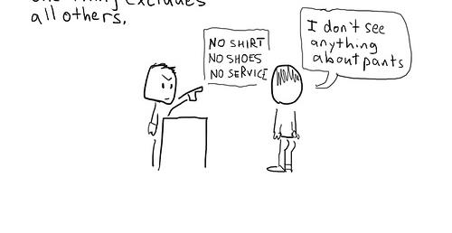
…be forewarned on legal issues

Slide 5

FIRST! A VERY IMPORTANT REMINDER
Changes to coefficient of friction (COF) for ceramic tile

Slide 6

0.42 is the new 0.6
Construction professionals need to change from the long-time practice of specifying minimum 0.6 SCOF per C1028 for tile floors
New test method: DCOF AcuTest
Minimum 0.42 for interior level tiles expected to be walked on while wet

Slide 7

0.42 is the new 0.6
Change to ANSI occurred late in 2012
BUT MANY ARE STILL SPECIFYING 0.6!
The test methods do not directly correlate
Project plans/specs, maintenance programs, etc., referencing a min. COF of 0.6 per ASTM C1028 (the old COF test method) do not meet the requirements of the ANSI A137.1 tile standard

Slide 8


0.42 is the new 0.6
C1028 was officially
withdrawn, effective
Feb.1, 2014
C1028
??-2/1/14
Ramifications for using
an expired, “unsupported”
standard???

Slide 9

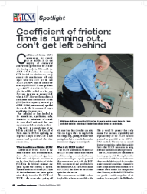
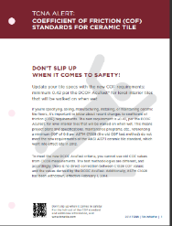
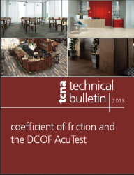
COF Resources
www.TCNAtile.com
  ANSI language
  Handbook language
  FAQ-style Technical Bulletin
  PSA-style bulletin
  Articles by TCNA and others explaining the change in methodology and requirements and related issues, like legal liability issues

Slide 10
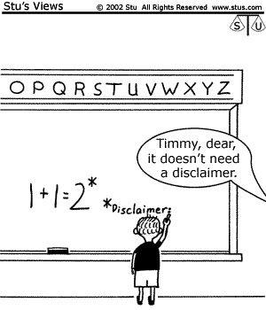
Disclaimer
This does not constitute legal advice

Slide 11
What’s Going on in ANSI?
Recap: TCNA’s role in ANSI
  Secretariat to A108 Committee on product and installation standards for tile and related materials
  Committee represents diverse group of interests
    Manufacturers
    Installers
    Consultants
    Distributors
    Environmentalists
    Many more . . .

Slide 12
ANSI A108 Committee Work
Mortar standards
Saw-tooth joints
Floor flatness for large tiles
Glass tile
Additional tile offset pattern specifications
Percent coverage calculation
Thin tile

Slide 13

ANSI A108 Committee Work

Slide 14
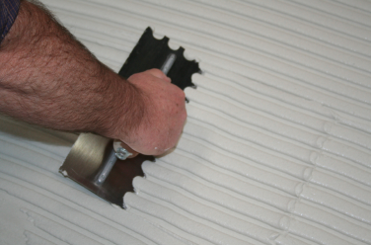
Medium Bed Mortar
(Long-time debate)
Use of the marketing term “medium bed” has brought confusion over its function as an adhesive for thin-bed installation, not a thinner version of a mortar bed

Slide 15
Medium Bed Mortar
(Long-time debate)
Current thinking . . .
  Medium bed mortars are OK up to ?”
  Ongoing discussion on lower end of range, i.e. where does thin-set end and medium bed begin? 3/16”?
  Debate on terminology, test methods
  What size tiles “require” medium bed?
Proposal for new standards discussed yesterday

Slide 16


Meanwhile…
Lack of a standard further contributes to confusion
Contractors are getting job specs asking for tile to be installed by “medium bed method” wherein a very thick coat of mortar would be applied
  If substrate prep is intended, there are products for this
  If formation of slopes or other height adjustment/transition is desired, mortar does not work

Slide 17

Train Wreck

Slide 18
Medium bed Mortar
for thin-bed installation
not for truing or leveling
“a product, not an installation method”
How much is known about performance of the system when “poured” as a thick layer?

Slide 19
ANSI ASC A108 and MMSA
Trying to fix this problem on an urgent basis
MMSA met today to further discuss
Stay tuned for additions to TCNA Handbook

Slide 20
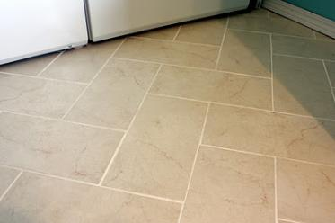
Additional Tile
Offset Specifications
Current criteria for off-set patterns:
  Running bond and brick patterns
  Maximum 33% off-set
  Special lippage criteria
Problems:
  What about other types of off-set patterns?
    Herringbone
    Basket weave
    Modular patterns
    Others . . .
  33% isn’t always possible
  Should lippage considerations be different?

Slide 21
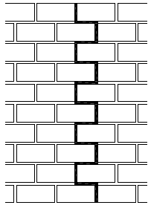
Saw-Tooth
Soft Joints
Proposal to permit saw-tooth soft joints in certain applications
Currently, not recommended per A108.01
Ongoing discussion
    Applicable to “movement joints” not “expansion joints”
    What works and what doesn’t
    Who to consult with to approve job-specific saw-tooth configurations?

Slide 22
Other A108 Items Being Discussed
Glass tile
  Ongoing maintenance of A137.2
  Potential discussion on refinements to installation standards
  Reference A137.2 in your specs!!
  No Installation standard yet except mosaics
Floor flatness
  Discussion on special provisions when large tiles are being installed
  Include maximum out of plane criteria
  1/4 in 10’ over 300’ is what? 7.5”!!
Mortar coverage and voids
  How to calculate coverage?
  Properties of voids and what is tolerable

Slide 23

Big Steps in
Water Absorption Research!
Industry’s water absorption method (ASTM C373) recently updated
Ongoing research to determine new, quicker alternatives to ASTM C373

Slide 24


ASTM C373
Then (1950s) . . .
Now . . .

Slide 25
ASTM C373
Most rigorous test for water absorption
Nobody wants a test for partial water absorption but test now takes 30 hours
Why is this important?
  Test defines what is porcelain
  ISO Test takes less than 8 hours but often results in incomplete saturation
  Efforts towards world-wide harmonization of water absorption determination

Slide 26

Porcelain Certification in Mexico
Adoption of PTCA certification program:
  The program started in the US in 2008
  During 2013 Mexican members of TCNA certified hundreds of series
  Certification of water absorption based on ASTM C373

Slide 27

Porcelain Certification in Mexico
Launch of certification program
  Presented to distributors in October during Expo CIHAC 2013
  Deployment in stores of the entire country is taking place during 2014 with support of the distributors

Slide 28
WCO Approved Changes

Slide 29
WCO Approved Changes
The World Customs Organization’s (WCO) Revision Committee has approved several important changes to the HS codes for ceramic tile.
The official text approved unanimously by the customs officials in the WCO’s Revision Committee is as follows:

Slide 30
WCO Approved Changes
CHAPTER 69.
Heading 69.07.
Delete and substitute.
“69.07 – Ceramic flags and paving, hearth or wall tiles; ceramic mosaic cubes and the like, whether or not on a backing; finishing ceramics.
Flags and paving, hearth or wall tiles, other than those of subheadings 6907.30 and 6907.40:
6907.21 - - Of a water absorption coefficient by weight not exceeding 0.5%
6907.22 - - Of a water absorption coefficient by weight exceeding 0.5% but not exceeding 10%
6907.23 - - Of a water absorption coefficient by weight exceeding 10%
6907.30 - Mosaic cubes and the like, other than those of subheading 6907.40
6907.40 - Finishing ceramics”
Heading 69.08.
Delete this heading.

Slide 31

A Word of Caution
Today, falsely labeling porcelain perhaps constitutes “false advertising”
Once the Tariff schedule changes, false reporting to customs is a criminal offense

Slide 32
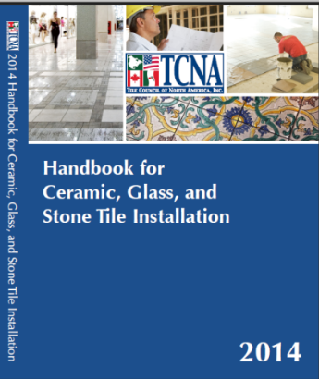
Changes to the
2014 TCNA Handbook

Slide 33


2014 Handbook:
A118.15 Mortars Added to Methods
ANSI A118.15 mortars
  higher bond strength
  de facto more deformable
  marketplace need to better delineate mortar performance, especially for bidding
    Good contractors already know when better mortar should be used, but have difficulty getting jobs when they include them because others don’t

Slide 34
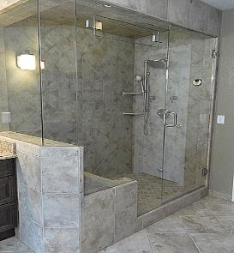
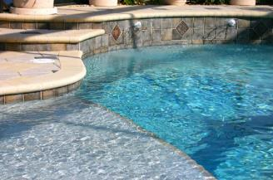
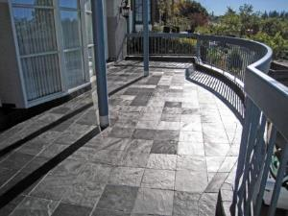
2014 Handbook:
A118.15 Mortars Added
Replaces A118.4 as the min. in above-ground exterior decks (F103, F103B, F104), steam showers, and pools

Slide 35
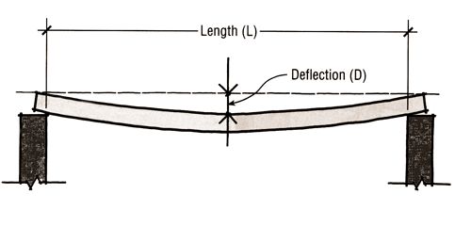
2014 Handbook:
A118.15 Mortars Added
Replaces A118.4 as the min., when a membrane is not used, in above ground methods F111, F112, F113A, F114, F116A, F205A, F121, and F135

Slide 36
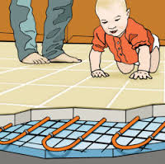
2014 Handbook:
A118.15 Mortars Added
Replaces A118.4 as the min., when a membrane is not used, in all radiant heat methods
Replaces A118.4 as the min., when a membrane is not used, in exterior wall methods: W201, W202E, and W244E

Slide 37
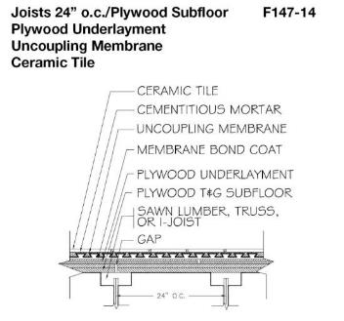
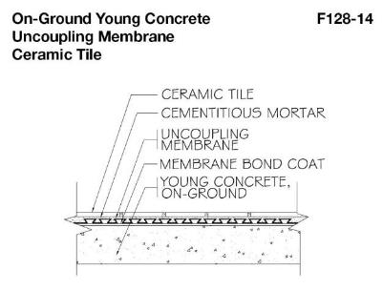
2014 Handbook: Minimum Shear
Bond for Uncoupling Membranes
2013 Handbook: no product standard or product performance requirements for uncoupling membranes

Slide 38
2014 Handbook: Minimum Shear
Bond for Uncoupling Membranes
2014 Handbook: minimum shear bond strength added in “Materials” section of all methods that reference an uncoupling membrane
Uncoupling membrane—recommended by manufacturer; must achieve 50 psi or greater shear bond strength in 7 days per the test method in ANSI A118.12 Section 5.1.3.

Slide 39

2014 Handbook: Minimum Shear
Bond for Uncoupling Membranes
Submission prepared by MMSA “to eliminate bonding issues, which led to failures in the field…an interim solution until a standard can be developed for uncoupling membranes”
Speaks to the utility/need for product standards

Slide 40
2014 Handbook: Minimum Shear
Bond for Uncoupling Membranes
Many more uncoupling membranes are on the market today than 5 years ago
  Approach is similar to poured gypsum underlayment, i.e., no product standard referenced but Handbook requirements added over time based on field issues:
  minimum compressive strength
  Robinson test
  mfr.-approved applicator

Slide 41

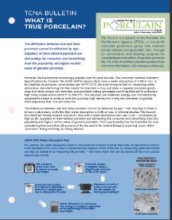
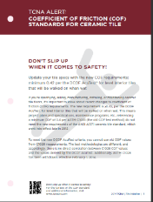
2014 Handbook:
Tile Initiative, updated
Content adapted to provide essential info as useful bulletins
  DCOF
  True Porcelain Tile
  Selecting Installers or Contractors

Slide 42

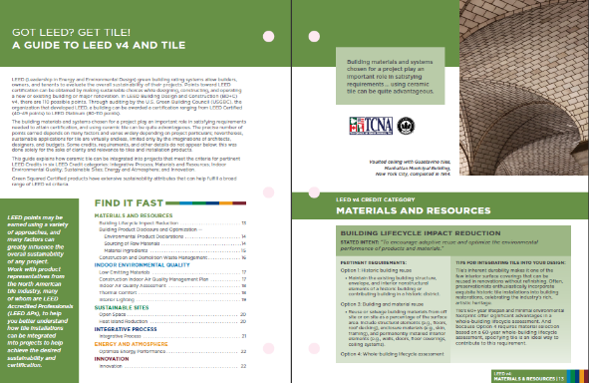
2014 Handbook:
Tile Initiative, updated
10-page guide to LEED v4 and tile, organized by credit category

Slide 43
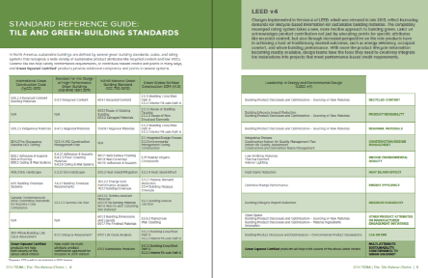

2014 Handbook:
Tile the Natural Choice, updated
Reflects LEED v4 as it relates to tile, plus increased recognition of Green Squared Certified products

Slide 44

2015 Handbook Meeting
June 26, Atlanta
Possible changes to 2015 Handbook
  Curbless shower methods/options/info
  More stone methods
  Expanded section on qualified labor to include references to ACT certification for tile installers

Slide 45
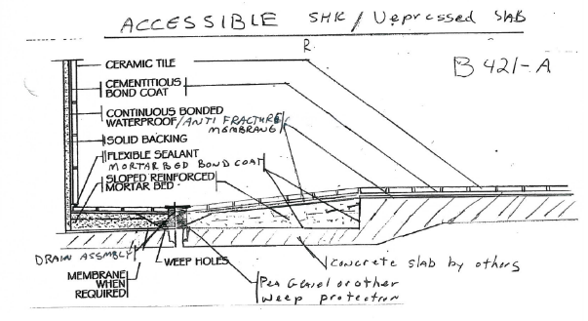
2015 TCNA Handbook
Possible new method for curbless shower
Variation of B421/B422
  Showers fully waterproofed just below tile layer

Slide 46
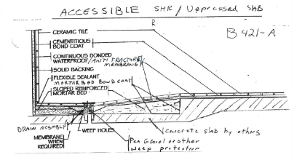
2015 TCNA Handbook
Possible new method for curbless shower
Addresses long-term issues w/water getting outside shower, then having nowhere to go due to poor design
Requires a depressed slab so there is no additional height at room entrance/threshold

Slide 47
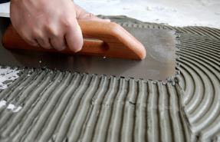
2015 TCNA Handbook
Possible: change to medium bed mortar definition
Reflecting its popularity, due to increasing tile sizes, medium bed mortar definition was first added in 2011
  “to minimize slump and facilitate thicker bond coats…useful for setting heavy tiles and/or tiles with ungauged thickness and for setting tiles with at least one side greater than 15” where the final embedded thickness of the mortar will exceed 3/16”
  intended as bond coat 3/16” to 3/4” thick

Slide 48
2015 TCNA Handbook:
Possible change to medium bed mortar definition
for thin-bed installation, not truing/leveling
Working on greater clarity that it’s not an installation method, while a standard is developed

Slide 49
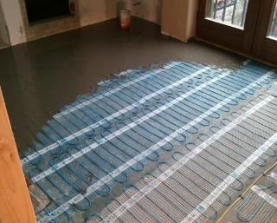
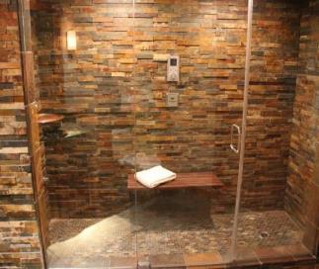
2015 TCNA Handbook
Possible: additional stone methods
Adaptations of tile methods
  radiant heat tubes within poured gypsum underlayment or cementitious self leveler, over concrete substrate
  electric heat system encapsulated in self leveler over concrete
  steam shower methods

Slide 50
2015 TCNA Handbook
Possible: boilerplate language for specifying qualified contractor/installers
Add-on to existing language added in 2012
Similar to ARCOM MasterSpec language added to master format in 2013 as optional spec language
Would enable design professional to easily take action if sold on the concept

Slide 51

Installer Certifications
CTEF certified the 1,000th installer!!
  CTEF Certified Tile Installer (CTI)
5 NEW! tests Advanced Certifications for Tile Installers (ACT)
  Standards-based
  Written and hands-on

Slide 52
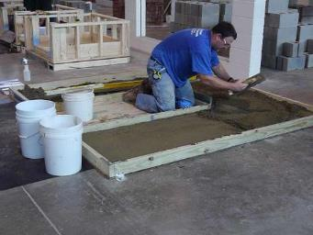
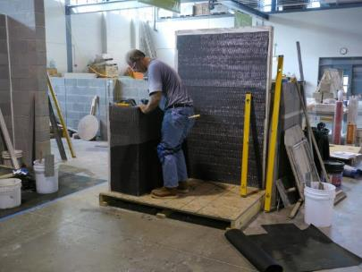
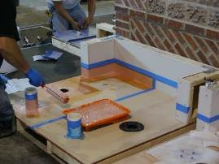
Advanced Certifications for Tile Installers (ACT)
Membranes
Shower base
Large Format Tile
Mud Walls
Mud Floors

Slide 53
Advanced Certifications for Tile Installers (ACT):
Curricula were developed by teams of manufacturers, contractors, and associations
  Study guides
  Hands-on tests, scoring, and evaluation methodology
Certifications being conducted by CTEF and IMI
TCNA fundraising helps support operational/administrative costs

Slide 54
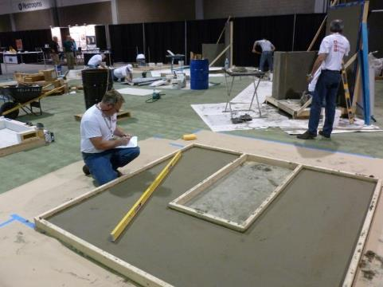
Advanced Certifications for Tile Installers (ACT) is a Meaningful Certification Program
In-person, detailed evaluation of critical installation skills
Evaluators don’t help or demonstrate
A percentage fail

Slide 55

Sustainability
More and more a driving consideration in product selections
TCNA involved in and leading numerous initiatives

Slide 56

It’s Here!
Environmental
Product
Declaration
For Tiles Produced in North America

Slide 57
TCNA-led EPD for
Tile Made in North America
Generic “ceramic tile”
  Report of the environmental footprint of tile produced in North America
  Based on rapidly growing demands for transparency and environmental facts

Slide 58

TCNA-led EPD for
Tile Made in North America
  Arto
  Crossville
  Dal-Tile/American Marazzi
  Florim USA
  Florida Tile
  Interceramic
  Ironrock
  Porcelanite Lamosa
  Quarry Tile Company
  StonePeak Ceramics
  Vitromex
Applicable to more than 95% of the tile made in North America

Slide 59
What is an EPD?
In-depth, standardized report based on information calculated from a lifecycle assessment (LCA)
Emphasis on lifecycle/environmental impacts categories:
  Resource Depletion
  Acidification Potential
  Eutrophication Potential
  Global Warming Potential
  Ozone Depletion Potential
  Smog Formation Potential

Slide 60
Ceramic Tile EPD: Preliminary Results
Draft results finished; reported by PE INTERNATIONAL
60-year Lifecycle Impact per Square Meter
Comparison to generic vinyl EPDs and a sampling of brand-specific carpet EPDs
  Outperforms carpet and vinyl in all impact categories!

Slide 61
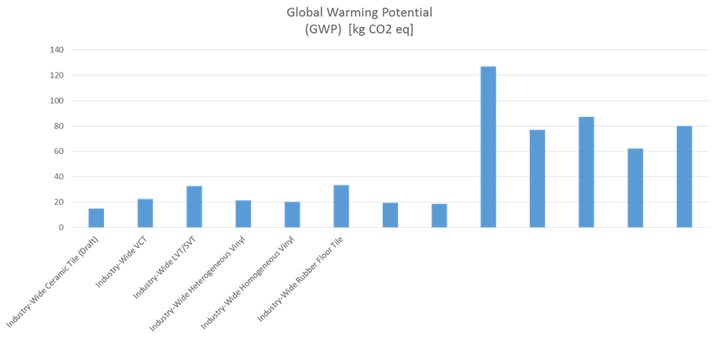
Ceramic Tile EPD: Preliminary Results
A quick taste . . . what is the 60-year carbon
footprint of tile produced in North America?
Sampling of brand-specific carpet products

Slide 62

North American Tile EPD
Points for participating manufacturers in LEED and other green building standards
Opportunity for manufacturers to compare their products to industry average
Baseline data and framework for future initiatives

Slide 63
North American Tile EPD
Potentially, additional points for outperforming industry average
Generic comparison of tile to competitive surface coverings in the context of 60-year building service
Facilitates ecological product selection

Slide 64

What about HPDs?
Demands are rapidly emerging for Health Product Declarations (HPDs)
  Points in LEED
  Broad promotion by the Healthy Building Network and the green building community
  25 of the largest architecture firms requiring HPDs from prospective product suppliers by 2015
What is an HPD?
  Voluntary declaration of product content and direct health hazards associated with exposure to individual contents

Slide 65
HPDs: Issues Ahead
Are HPDs misleading?
Are industries being incorrectly reported on by independent HPD benchmarking organizations?
Will HPDs lead to involuntary disclosure of proprietary formulas?
Who’s managing standards and associated lists of chemical hazards
Growing market for 3rd party certification and interpretation of HPDs
  “Voluntary” participation is already being forced
  Possibility of increased costs for manufacturers

Slide 66
Brief update on Green Squared®
Standard and certification program for sustainable tile products
  Multi-attribute, balanced approach
  Includes setting materials
  Based on North American norms/expectations
12 mfrs with certified products
  10 tile manufacturers
  2 installation material manufacturers
  Hundreds of certified product lines

Slide 67
Green Squared® References in Green Building Standards/Rating Systems
Direct contribution to points/credits
  Green Globes for New Construction
  NAHB National Green Building Standard
  ASHRAE 189.1
Formal industry effort underway to reference Green Squared®
  International Green Construction Code (2014 Code Change Proposal)
  LEED (Continued discussion of Pilot Credit 80)

Slide 68
Green Squared® References in Green Building Standards/Rating Systems
Government specifications
  GSA Facilities Standards for the Public Buildings Service
  National Institute of Building Sciences (NIBS) Whole Building Design Guide (WBDG)

Slide 69

Thin Tile

Slide 70

What We’ll Be Covering:
Thin Is In
What Is Thin Tile?
How Is It Different?
Thin Tile Standards for Manufacturing and Installation
Why Is Thin Tile Exciting?
Thin Tile Applications: Familiar & New

Slide 71

It’s Different
Different properties & characteristics
Important differences in performance
and the way it needs to be installed

Slide 72
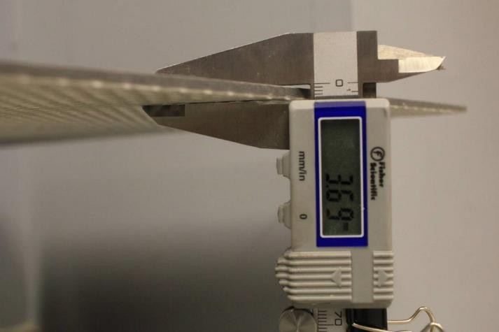
Thin Tiles Range from 3 mm to 6.0 mm

Slide 73
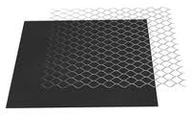

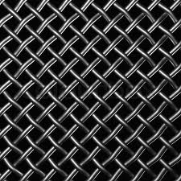
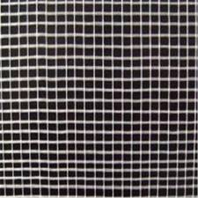
Often Reinforced with Fiberglass,
Plastic, or Metal Mesh

Slide 74

It’s Different
Reduced thickness means:
  Lower breaking strength
  Increased edge sensitivity
  Flexibility: a new consideration
  Higher coverage requirement
  Tighter lippage requirement
  Greater sensitivity to point loading

Slide 75
It’s Different
Large surface areas mean:
  Current dimensional analyses do not apply
  Sampling procedures need to be reconsidered
  Flatter substrate and floor prep needed
  Job site handling is changed
  Shipping is changed
  Greater mortar thickness
  Breakage is big money

Slide 76
It’s Different
Reinforcing on some products means:
  Need to develop requirements such as bond strength to the tile and bondability to thin-set
  What happens when tile cracks
  Alkali sensitivity of the mesh and adhesive
  Metal film reactivity to the mortar
  Water absorption of mesh
  Freeze/thaw effect
  VOCs

Slide 77

Under
Construction
  ANSI A137.3 American National Standard Specifications for Thin Porcelain Tile and Thin Porcelain Tile Panels
  ANSI A108.19 Installation of Thin Porcelain Tile and Thin Porcelain Tile Panels by the Thin Bed Method with Latex-Portland Cement Mortar

Slide 78


Sneak peek into the exciting world of standards development…
Even giving it a name can be a challenge
Why not just call it “thin tile” ?

Slide 79
Properties being considered for standardization (A137.3)
  Thickness and Dimensions*
  Water absorption*
  Breaking Strength*
  Robinson*
  Impact*
  Bond strength*
  Point load (when membranes are relevant)*
  Freeze/Thaw*
  Abrasion*
  Chemical Resistance*
  Stain Resistance*
  Crazing Resistance*
  Thermal Shock Resistance*
  Shade variation
  Color uniformity
  DCOF*
* Industry research underway

Slide 80

Ongoing Thin-Tile Research:
Robinson Floor Tests
Industry accepted test for determining which products can work on floors
  Thin tile products which are not able to achieve “Extra Heavy” with perfect installation, directly bonded to concrete, will likely not be recommended for floors

Slide 81
Ongoing Thin-Tile Research:
Robinson Floor Tests
Evaluation of setting procedures and combination of materials
  For direct bond to concrete, what is required to achieve Extra Heavy rating?
  How does lippage affect performance?
  How do membranes affect performance?
Currently being analyzed:
  Proprietary installation material combinations from most major manufacturers
  Epoxy grout and cementitious grout

Slide 82
Breaking Strength and Impact Resistance
Objectives
To better understand the relevance of these properties, particularly as they relate to installed performance
Possibility a correlation between Robinson floor tests and these properties i.e. breaking strength and impact resistance

Slide 83

Breaking Strength
Testing of “scraps” from each piece used in every Robinson Floor Test
Test methods followed:
  ASTM C648
  Proposed ISO Test Method for thin tile (based on ISO 10545-4)
Other properties being evaluated, especially for reinforced tiles:
  Total deflection, especially for reinforced tiles
  Modulus of elasticity

Slide 84
Impact Resistance
Testing of “scraps” from each piece used in every Robinson Floor Test
Three test methods to be assessed to develop qualitative and quantitative criteria for impact resistance and edge chipping
Falling Ball
Rolling Ball
Schmidt Hammer

Slide 85
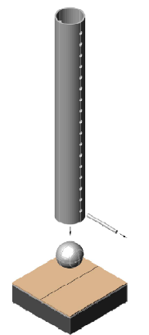
Impact Resistance
Falling Ball Method
Weighted sphere dropped onto tile bonded to block with standardized mortar
  One drop from 36”
  One drop from 48”
  Each drop on separate test specimen
Diameter of impact area measured
Maximum allowable diameter TBD

Slide 86
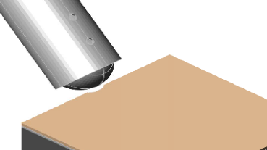
Impact Resistance
Rolling Ball Method
Weighted sphere allowed to roll 24” down a chute at a 45 degree angle into the edge of a tile bonded to block with standardized mortar
Length of impact area measured
Maximum allowable length TBD

Slide 87
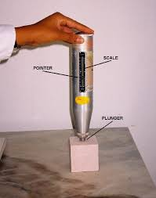
Impact Resistance
Schmidt Hammer
Commonly used in construction and mining industries to test surface hardness and penetration resistance of concrete and to assess the crushability of rocks.
Hammer yields a rebound number
Possible correlation between impact resistance of bonded tile and rebound number

Slide 88
Point load with membranes
Based on ANSI A118.12
Relevant to thin tile Robinson Floor Test research with membranes
Point load value to be determined for tiles and membranes used in each Robinson test to determine correlation

Slide 89
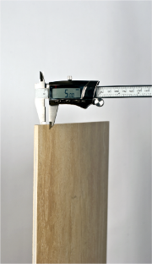
Likely to Be Included in A137.3
Definition:
  Thickness: 0.236 inches (6.0mm)
  or less
  Thin Porcelain Tiles ≤ 1 square meter
  Thin Porcelain Tile Panels > 1 square meter

Slide 90

Thin Tile Installation:
A Moving Target?
Lack of product standard makes development of installation standards or guidelines difficult

Slide 91

Thin Tile Installation
The trade is essentially unregulated, so installation practices vary widely and are difficult to control …yet thin tile requires special precautions and procedures for all aspects of handling and installation

Slide 92
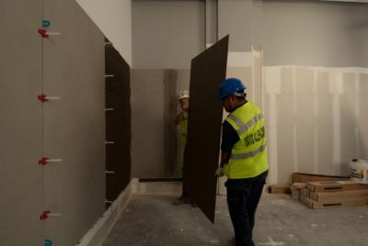
Likely to Be Included in A108.19
Modified version of A108.5
Limited scope
  Interior
  Thin-bed
  Cementitious mortars

Slide 93
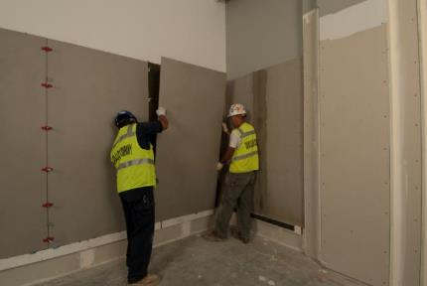
Likely to Be Included in A108.19
Select substrates
  Floors: concrete, mortar bed over concrete
  Walls: concrete, CMU, drywall, backer boards
Tile over tile? Who determines soundness of existing tile?

Slide 94
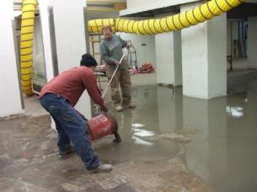
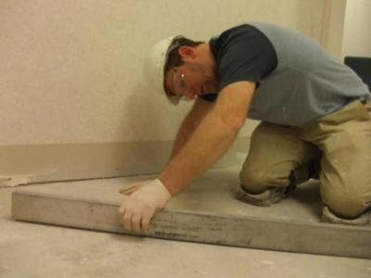
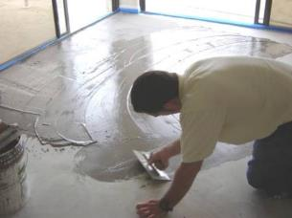
Likely to Be Included in A108.19
Required substrate flatness:
  1/8” in 10 feet
  1/16” in 1’
Substrate prep required, like VCT flooring

Slide 95

Likely to Be Included in A108.19?
Jobsite Requirements
  Clear pathways
  Elevator, buck hoist, or boom lift may be needed
  Emphasis on restriction of traffic and impact

Slide 96
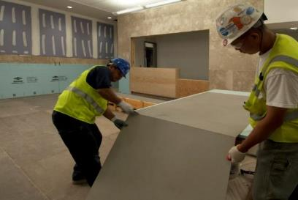
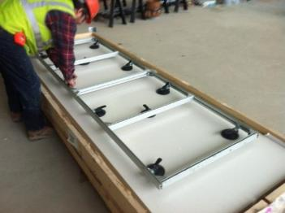
Likely to Be Included in A108.19?
Handling large pieces:
  Rack with suction cups?
  2 people? 4 people?
  Specialized tools for cutting and transporting?
  Dedicated workstation?

Slide 97
Likely to Be Included in A108.19?
Unpacking/handling:
  How to ensure material isn’t damaged since cracks are often not obvious
  Documentation
  Necessary equipment and procedure for moving crates around jobsite
    Long arms on forklift
    Keep large pieces vertical when carrying

Slide 98
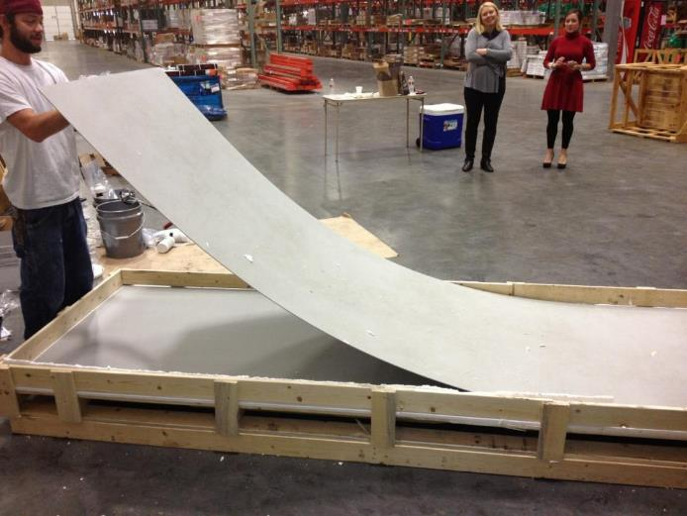
Here’s What NOT to Do

Slide 99
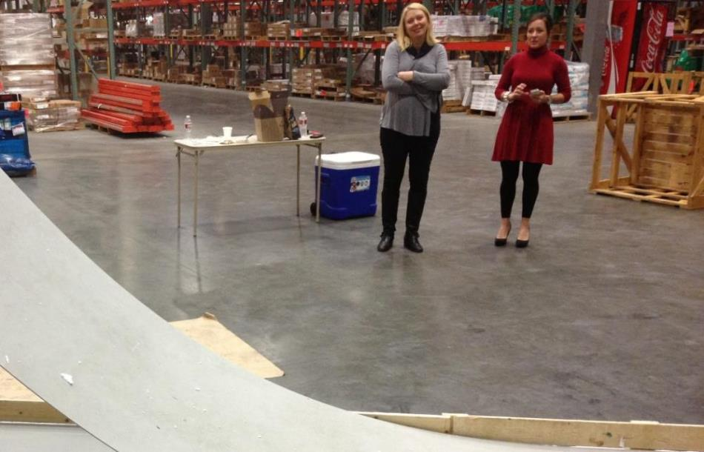

Slide 100
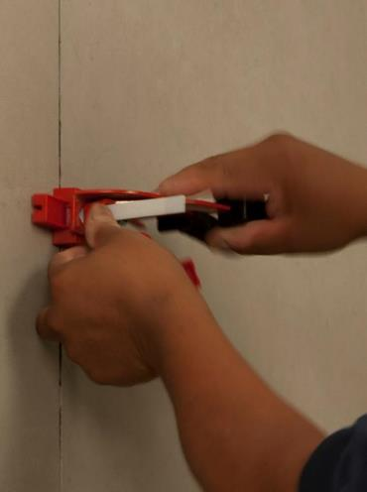
Likely to Be Included in A108.19?
Use of leveling system?
Lippage tolerances being discussed: 1/64” to 1/16”
  With a 3 mm tile, 1 mm is 1/3 the tile’s thickness
  Is edge fracture more likely?

Slide 101
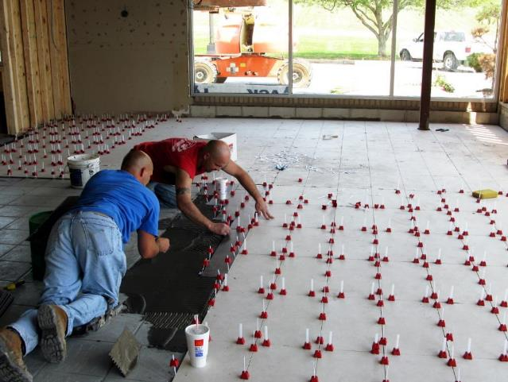
Look Easy?

Slide 102
Likely to Be Included in A108.19?
Finished installation flatness?
Is ¼” in 10’ reasonable or are “waves” created during installation?

Slide 103
Likely to Be Included in A108.19?
Do existing standards for grout joint width apply?
Existing standards aim at wider grout joints to accommodate facial dimensions and warpage
But ... Some feel edges are more susceptible to impact with wider joints

Slide 104
Likely to Be Included in A108.19?
Will facial dimensions and warpage be tight enough for the desired “credit card” joints?
OR
Will dimensions and warpage HAVE TO be tight enough for “credit card” joints needed to minimize impact?

Slide 105
Likely to Be Included in A108.19?
Either way…full grout joints are imperative to minimize impact

Slide 106
Likely to Be Included in A108.19: Movement Joints
By existing standards, if large sizes are used, almost every joint would need to be a movement joint, especially for wet and sun exposed areas
Tile edge performance with soft filler unknown
Can control joints in concrete be relocated to nearest joint?

Slide 107
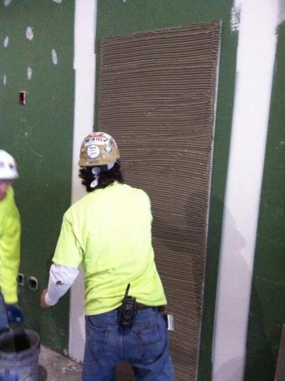
Likely to Be Included in A108.19?
Coverage
  How much is enough?
  How to get coverage on edges without trapping air?
  How to check, especially for large, thin sizes?

Slide 108

Likely to Be Included in A108.19
Embedding the Tile
  Walk on it?
  Vibrate?
  Thinner thin-set?

Slide 109

Likely to Be Included in A108.19?
Varying Opinions on Application Thickness
  3/8” needed for workability?
  Susceptibility to thin-set shrinkage?

Slide 110

Likely to Be Included in A108.19?
Mortar Cure Time
  Are rapid sets needed? Realistic?

Slide 111
Likely to Be Included in A108.19?
With all of these challenges and questions, it seems likely that contractor and installer qualifications and certifications will be required

Slide 112

Contractor Viewpoint
Until more is known about performance, contractors are worried

Slide 113
Thin Tile Opportunities/Warning
The following slides present and explain many thin tile opportunities
In the absence of established consensus standards, seek guidance from manufacturers and qualified installation professionals

Slide 114

Why Is Thin Tile Exciting?
Thin Tile Over Tile: Renovations Are Cleaner, Faster, and More Time- and Cost-Efficient
Lower Environmental Impact
Versatile Design Profile
Flexibility

Slide 115

What’s So Great About
Thin Tile Over Tile?
One Word: RENOVATION
According to Architecture 2030:
Every year, approximately 5 billion square feet.
By the year 2035, approximately three-quarters (75%) of the built environment will be either new or renovated.

Slide 116

Hotels Must Renovate Frequently:
Thin Tile Over Tile Can Help
In the Age of Expedia, Hotels.com, Priceline, Trip Advisor, etc. Word of Bad Experiences Travels Quickly
Guests’ Expectations Are High
Sluggish Economy = More Competition
Typical Renovation Cycles Are Between 6-12 years, but Some Hotels Renovate as Often as Every 3-5 Years

Slide 117

Thin Tile Over Tile:
Time & Cost Savings
Hotel Renovation Project:
Update Guest Bathrooms
Number of Rooms: 540
Number of Floors: 22
95%+ Occupancy Rate Year-Round
1/8” Thin Tile
3’ x 10’ Panels Cut to Size
Thin Tile-Over-Tile Installation
Total Installation Time: 30 Days
Typical Installation Time with Traditional Demolition and Installation? TWO YEARS

Slide 118


Sayonara 1990s!

Slide 119



A new look…

Slide 120



…without the downtime…

Slide 121

Thin Tile over Tile:
Client Satisfaction Is Key
In the Hospitality, Medical & Dental, & Apartment Rental Sectors:
Noise is a Liability
Dust is Verboten
Time is Money in Terms of Project $ Spent as Well as Revenue Lost on Unoccupied Units

Slide 122
Environmental Impact:
Thin Tile vs. Traditional Tile
50%
LOWER
SHIPPING
WEIGHT
LESS
RAW
MATERIAL
LESS ENERGY USED TO PRODUCE
LESS ENERGY USED TO TRANSPORT

Slide 123
Lower Environmental Impact
LESS ENERGY USED TO PRODUCE
LESS ENERGY USED TO TRANSPORT
REDUCED CARBON EMISSIONS
GREATER SUSTAINABILITY

Slide 124

Versatile Design Profile
Large Panels Are Still Lightweight
Easier to Install at High Elevations than Other Large-Format Wall Cladding
Hotel: Modena, Italy
Panel size: 1 m x 3 m
Thickness: 3 mm

Slide 125

Versatile Design Profile
Faux Finishes on Large Thin Tile Panels: The Look of Genuine Marble or Stone Tile without the Weight or Cost
Panel size: 5 ft. x10 ft.
Thickness: 6 mm

Slide 126

Versatile Design Profile:
Uniform, Sleek Appearance
Luxury Hotel, Rome
Panel Size: 1 m x 3 m
Thickness: 3.5 mm

Slide 127

Versatile Design Profile:
Dramatic Elements
Panel size: 1 m x 3 m
Thickness: 3 mm

Slide 128


New options for
surfaces
More flexible than traditional tile
Reinforcement increases flexibility
CURVED
Panel Size: 1 m x 3 m
Thickness: 3 mm

Slide 129

Thin Tile: It Bends!
Tunnel Autostradale, Bologna-Firenze

Slide 130

Thin Tile Applications:
Familiar and New Markets
Walls
Floors
Countertops
Furniture
Photovoltaic Panels
Pleasure Boats

Slide 131

Familiar Thin Tile Applications:
Walls
Panel size: 1 m x 3 m
Thickness: 3 mm

Slide 132

Familiar Thin Tile Applications:
Floors
Airport installation
Thickness: 3 mm

Slide 133

Panel size: 1 m x 1 m
Thickness: 3.5 mm

Slide 134

New Thin Tile Applications:
Countertops
Panel size: 1 m x 3 m
Thickness: 3 mm

Slide 135

Panel Size: 3 ft. x 10 ft.
Thickness: 3 mm

Slide 136

Panel size: 5 ft. x 10 ft.
Thickness: 6 mm

Slide 137


New Thin Tile Applications:
Furniture
Panel Size: 1 m x 3 m
Thickness: 3 mm
Panel Size: 1 m x 3 m
Thickness: 3.5 mm

Slide 138

Panel Size: 1 m x 3 m
Thickness: 5.7 mm

Slide 139

Panel Size: custom
Thickness: 3 mm

Slide 140


New Thin Tile Applications:
Pleasure Boat Interiors
Thin Tile Panels Are Lightweight Enough to Cover Surfaces in a Pleasure Boat!
Panel Size: 1 m x 3 m
Thickness: 3.5 mm

Slide 141

3 mm thin tile on all surfaces*
*except window, upholstery, pillows, food, telephone, or appliances

Slide 142

New Thin Tile Applications:
Photovoltaic Panels
Smooth Integration with External Cladding and Ventilated Façades
Façades Can Conserve & Generate Energy
Attractive Way to House Solar Power Sources

Slide 143

Building Retrofitted with Ventilated Façade and Integrated Photovoltaic Thin Tile Panels
(Aadorf, Switzerland)

Slide 144

Photovoltaic Thin Tile Panels Integrated Seamlessly into Cladding

Slide 145
More Exciting Exterior Tile

Slide 146

Ventilated
Ceramic Façades
Another Use for Thin Tile
Popular in Europe
Gaining Popularity in the US
Apartment Building, Pasubio Quarter, Parma, Italy

Slide 147


Moisture, Thermal, &
Acoustic Management
Open cavity and cladding protect back-up (primary) wall
Open joints/ventilated cavity allow evaporation, eliminate thermal bridges
Rigid insulation (up to 4”) maintains temperature, reduces sound transmissions, and eliminates dew point condensation within primary wall
Sheds 95% of rain

Slide 148

Structural
Efficiency
Maximum strength to weight efficiency similar to glass curtain wall; better than conventional solid wall cladding
Flexible design to suit project-specific structural requirements
Movement between building and cladding is isolated

Slide 149

Architectural & Engineering Evaluation
U.S. Market – Structural
Evaluated for structural safety ASCE 7-05 per 2006 IBC Code
Wind loading is the governing structural issue

Slide 150

Private Home in Modena, Sassuolo, Italy

Slide 151

Villanesi Spa, Torino, Italy

Slide 152

Central Saint Giles
London, England

Slide 153



Marjorie & Arnold Ziff Building, University of Leeds
Farrell & Clark, Leeds
12,000 ft²
Notes:
CLICK TO NEXT SLIDE

Slide 154



The Shoe Factory, Leicester
Metropolis Architecture Ltd, Coventry
6,000 ft²
Notes:
CLICK TO NEXT SLIDE

Slide 155



Grimsby Institute
Ryder Architecture, Newcastle Upon Tyne
31,000 ft²
Notes:
CLICK TO NEXT SLIDE

Slide 156

And Now …
High-Definition
Digital Ink-Jet
Printing
Produces highly detailed and complex images on tile in ultra high definition
  Realistic images
  Faux finishes
Faux Fabric Tile: “Jacquard”

Slide 157

Faux Wood

Slide 158

Faux Slate

Slide 159

Faux Metal
(Copper Finish Hexagonal Tile)

Slide 160

Faux Marble

Slide 161

Faux Cement

Slide 162

Faux Leather

Slide 163

Faux Parquet Flooring

Slide 164

Faux Antique Wallpaper

Slide 165

Faux Flocked Wallpaper

Slide 166

Faux Crumpled Paper
Yes, Really.

Slide 167

Large Faux Gemstone Panels
A rich, vibrant finish that is lighter and less expensive than stone
“Gemstone” can be used where stone or marble cannot/should not
Allows consumers to use finishes that would otherwise be unavailable.
“Carnelian Agate”

Slide 168

“Light Blue Agate”

Slide 169

“Blue Agate”

Slide 170


Slide 171

Other Exciting Applications:
Large-Scale Image Reproductions
Any image can be reproduced on tile and displayed anywhere!
Ultimate flexibility in personalizing or branding a space in a unique and compelling manner.
21st Century Tower
Dubai

Slide 172

Building Façade in China
Mona Lisa reproduced on 3 mm thin tile

Slide 173



“Juego de la Oca”
Grao de Castellón
Castellón de la Plana, Spain

