Slide 1
Environmental
Product
Declaration
for
Tile Made in North America

Slide 2
Demands for Environmental Product Declarations (EPDs) are on the rise, and requirements are beginning to show up in nearly every green building standard and rating system. So just what is an EPD? Similar in concept to a nutrition label, an EPD tells a product’s full environmental story in a familiar reporting framework so an end user can make an informed decision. This session provides an in-depth review of a just-released EPD for generic North American-made ceramic tile, explains how it can be applied to green building initiatives today, and illustrates its relevance to future industry initiatives.

Slide 3


Slides 4 – 32 developed by:
Slides 33 – 60 developed by:

Slide 4
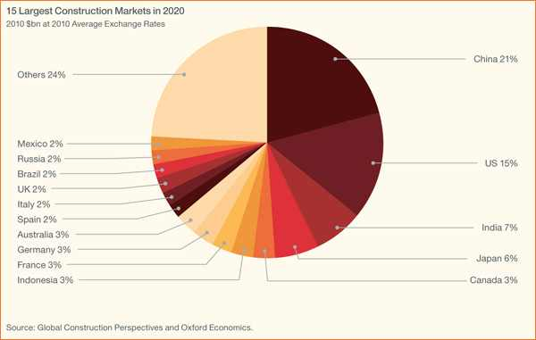
The Global Construction Market
Global construction to grow by almost 70%
from $7 trillion today to 12 trillion by 2020

Slide 5
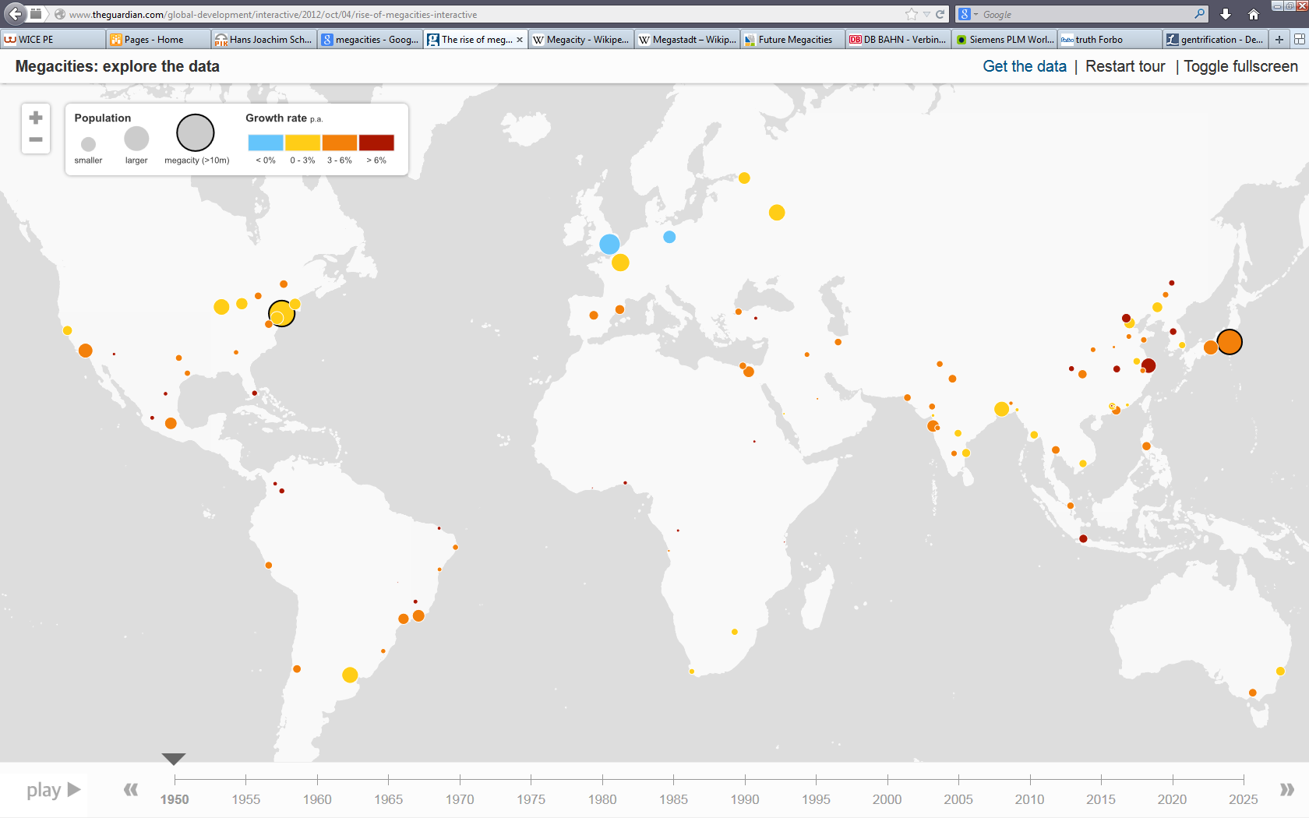
Development of Cities 1950 - 2025
Notes:
This global growth in construction is driven by increased population and the development of urban areas.

Slide 6
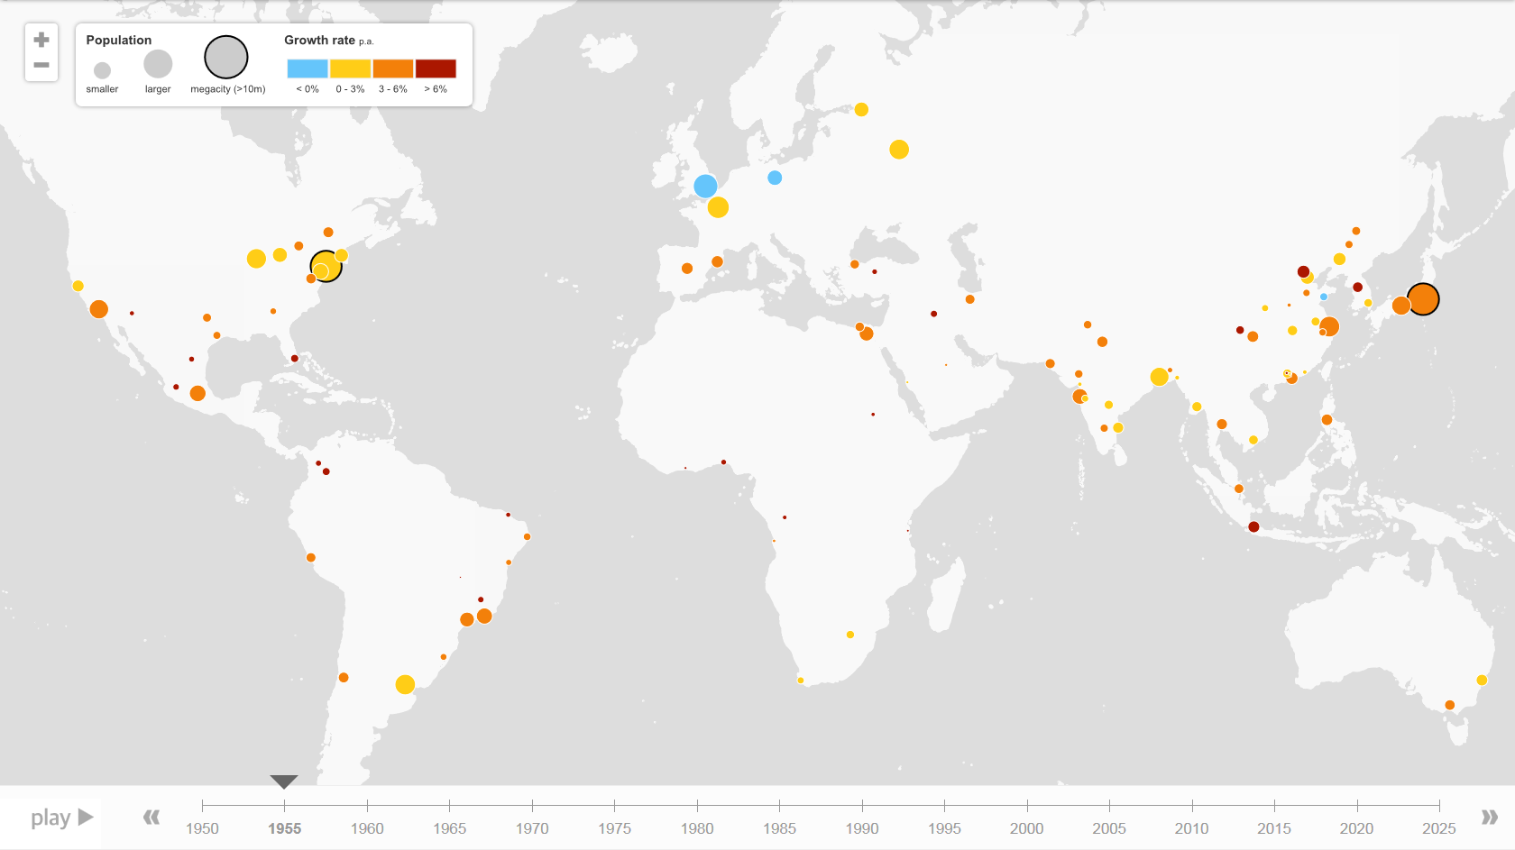
“City Heat Map“ 1955

Slide 7

“City Heat Map“ 1960

Slide 8

“City Heat Map“ 1965

Slide 9
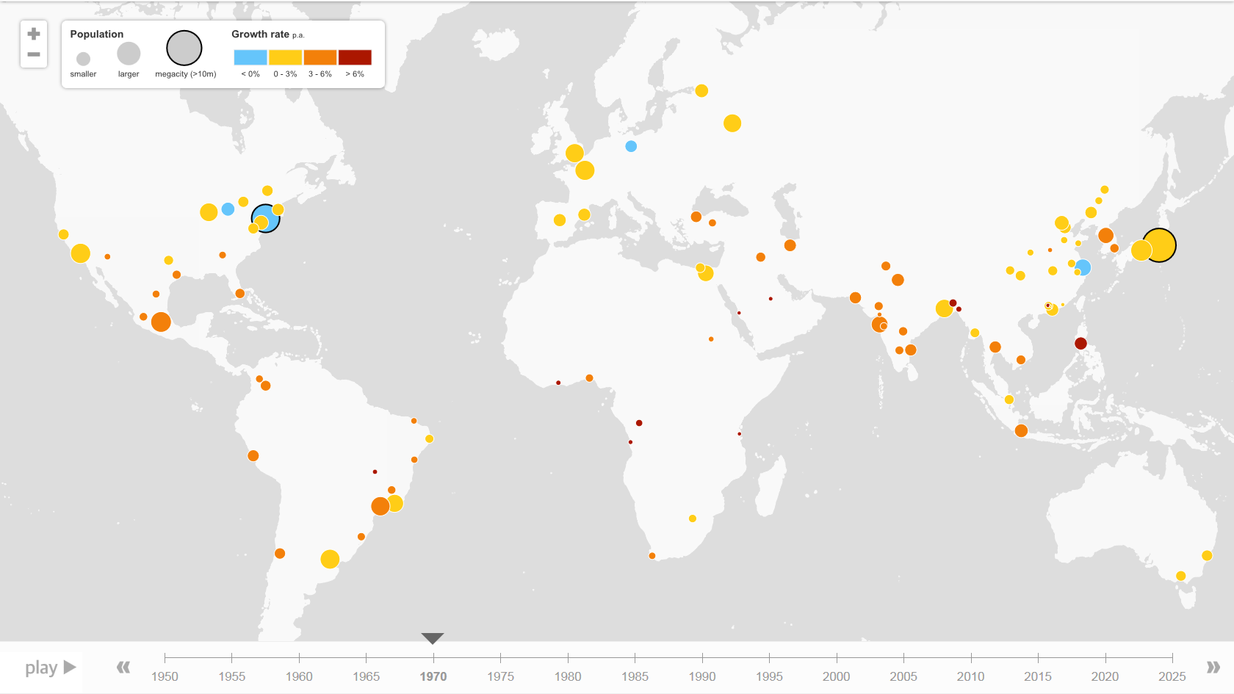
“City Heat Map“ 1970

Slide 10
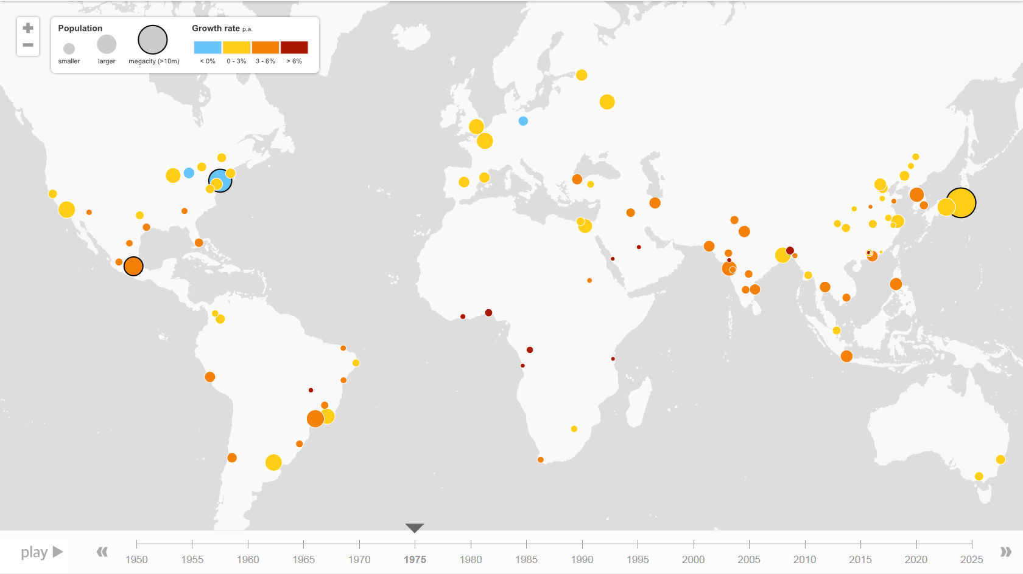
“City Heat Map“ 1975

Slide 11

“City Heat Map“ 1980

Slide 12

“City Heat Map“ 1985

Slide 13
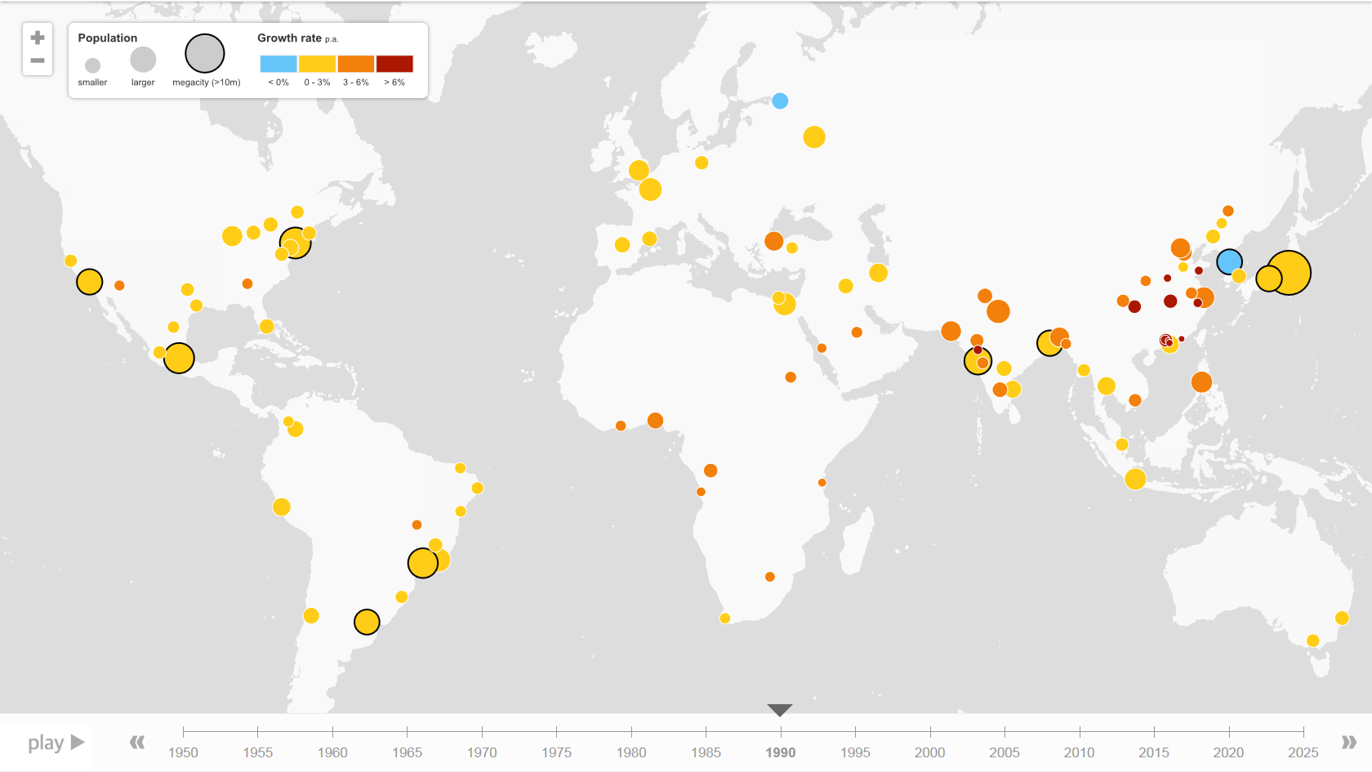
“City Heat Map“ 1990

Slide 14

“City Heat Map“ 1995

Slide 15
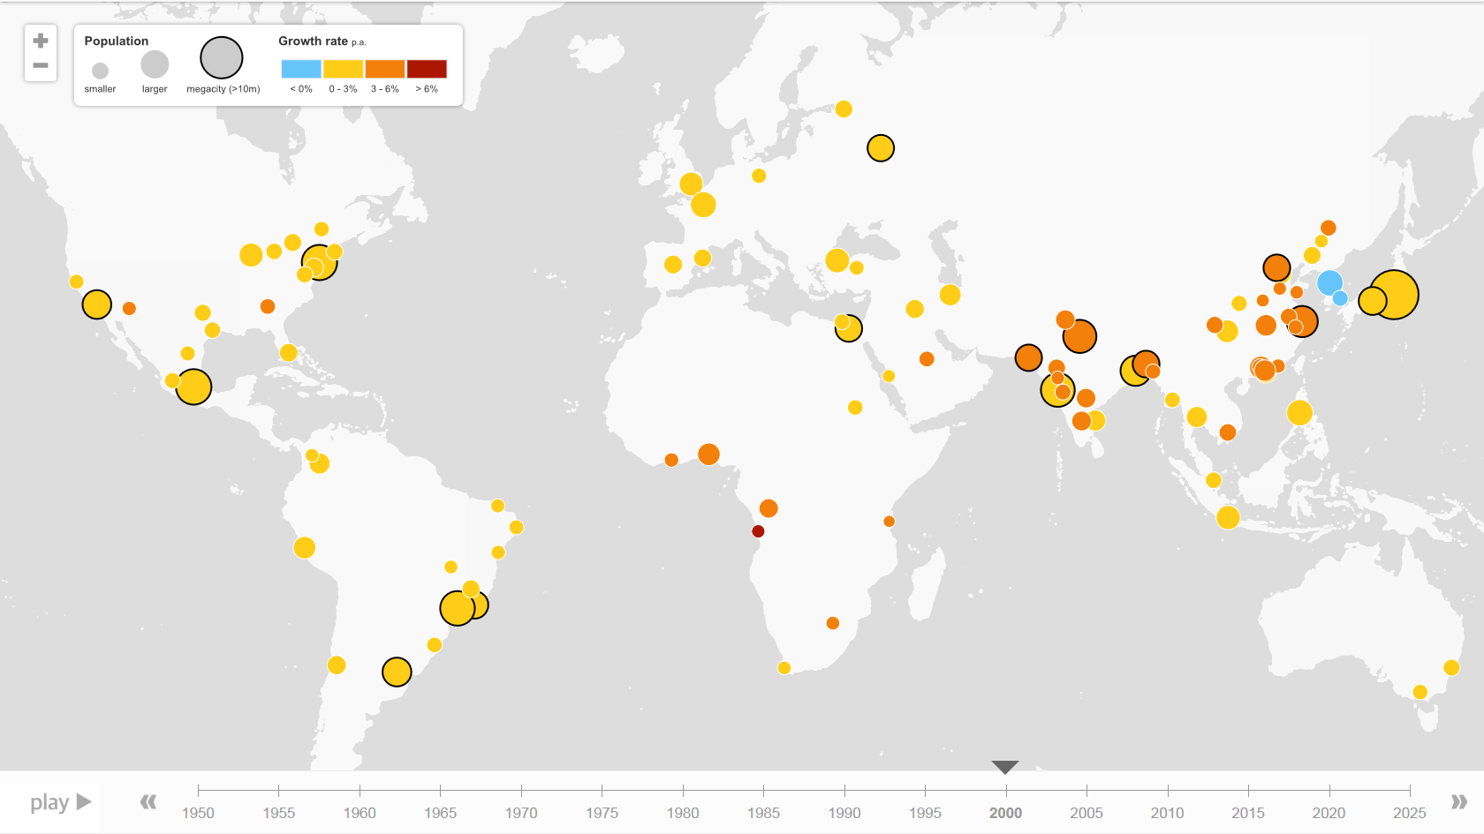
“City Heat Map“ 2000

Slide 16
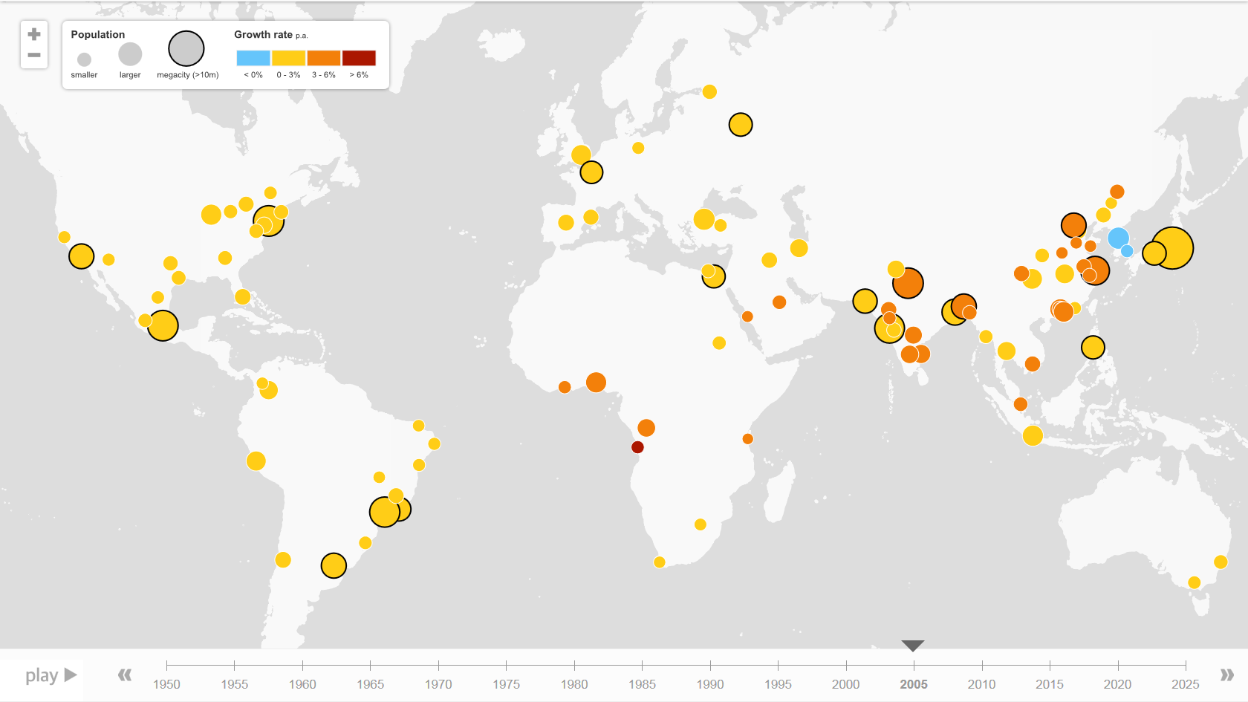
“City Heat Map“ 2005

Slide 17
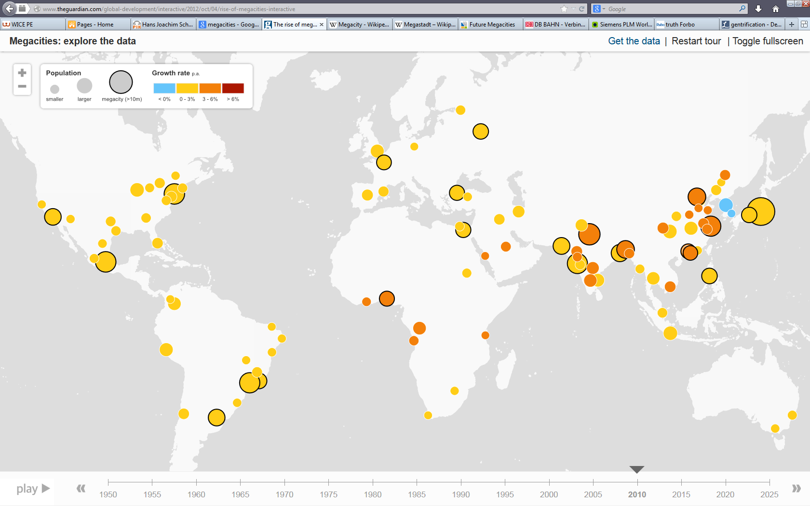
“City Heat Map“ 2010

Slide 18

“City Heat Map“ 2015

Slide 19
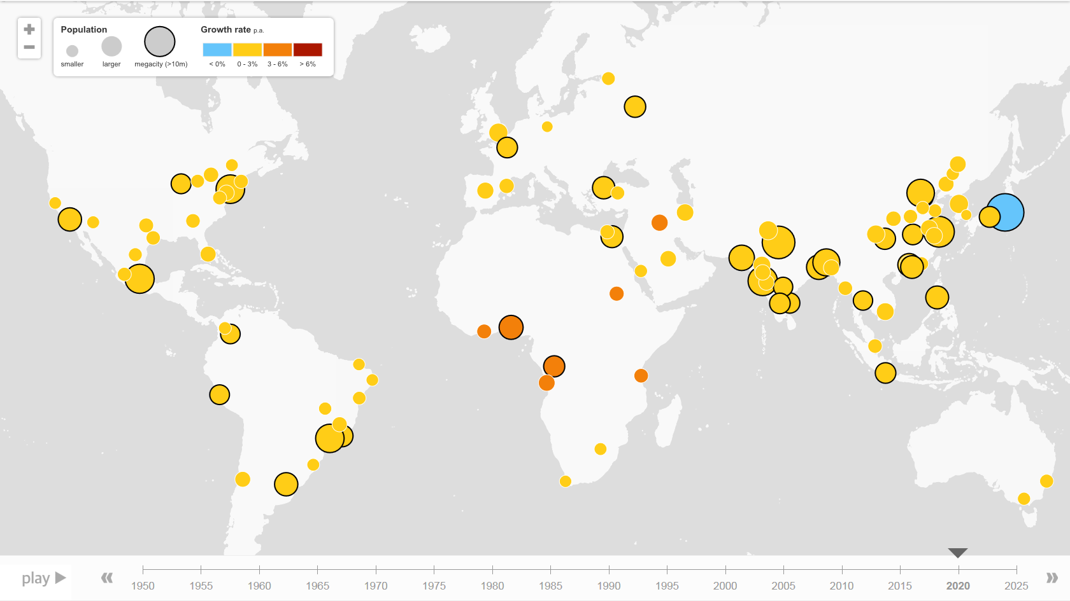
“City Heat Map“ 2020

Slide 20

“City Heat Map“ 2025

Slide 21
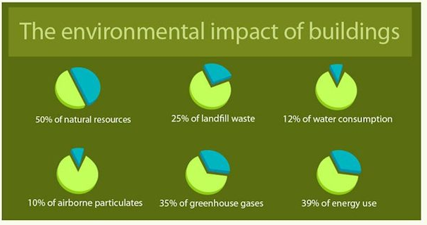
Need to Balance Growth With…
To mitigate risk and drive value.

Slide 22
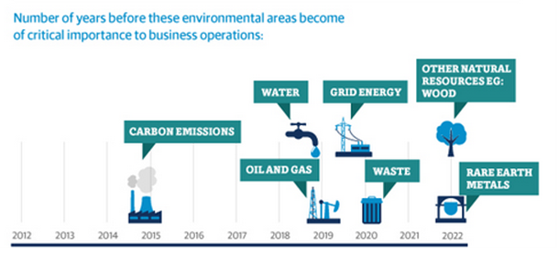
Need to Balance Growth With…
To mitigate risk and drive value.

Slide 23
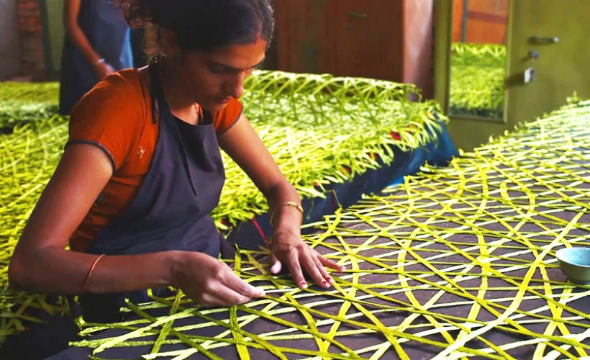
Need to Balance Growth With…
To mitigate risk and drive value.

Slide 24
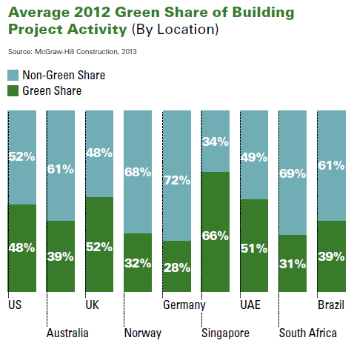
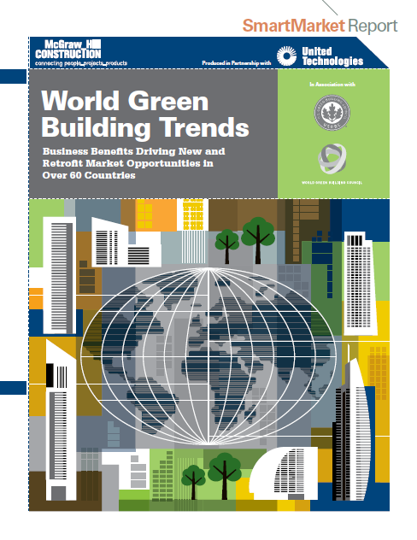
The Green Share of the Global Construction Market
Green building is no longer a niche part of construction around the world
Awareness is established and growing

Slide 25
Green Building Market Growth: North America
Green Building Becoming Standard practice in the United States.
“The firms in this study represent the green building market… rapid acceleration planned in the future”

Slide 26
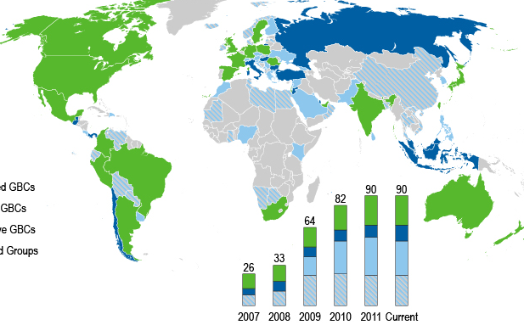











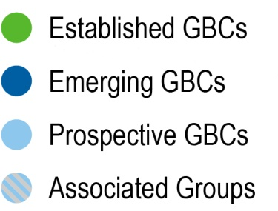








Green Building Councils are providing the metrics

Slide 27
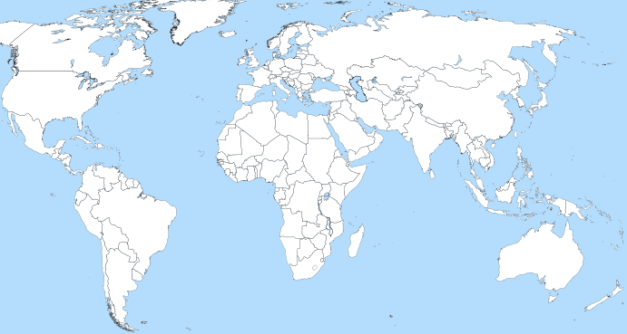













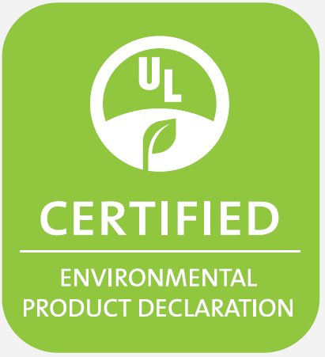






EPD Systems are organizing the process

Slide 28

Green Building Rating Systems
LEED v4
  MR c1: Awards project teams that conduct a whole building LCA
  MR c2: Awards projects for LCA and EPD
  MR c3: Awards projects for raw material/supplier engagement (GRI, supply chain data collection & reporting)
  MR c4: Awards projects for Ingredients Assessment and Disclosure (HPD)
Other rating systems incorporating demand for Transparency & Disclosure, and Multi Attribute Certifications

Slide 29
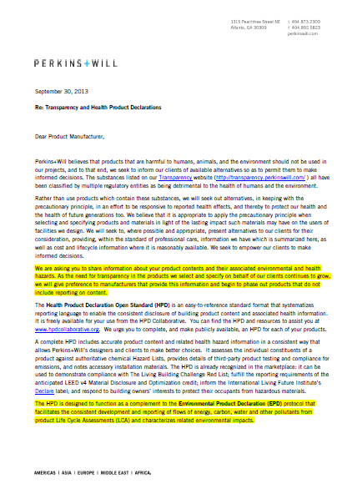
Drivers: AEC Firms and Owners Demanding Transparency & Disclosure Beyond LEED Requirements
Firms denying manufacturer representatives and sales associates product pitch meetings if they don’t have HPD/EPD
Firms represent substantial construction spend, represent large private and public developments (see next slide for example)
If manufactures do not comply they can not present their products to firms.

Slide 30
Transparency & Disclosure
Transparency & Disclosure
Health
HPD
“Alternative Pathway”
Environment
EPD
Supply Chain & Social
Supply Chain/Raw Materials report

Slide 31


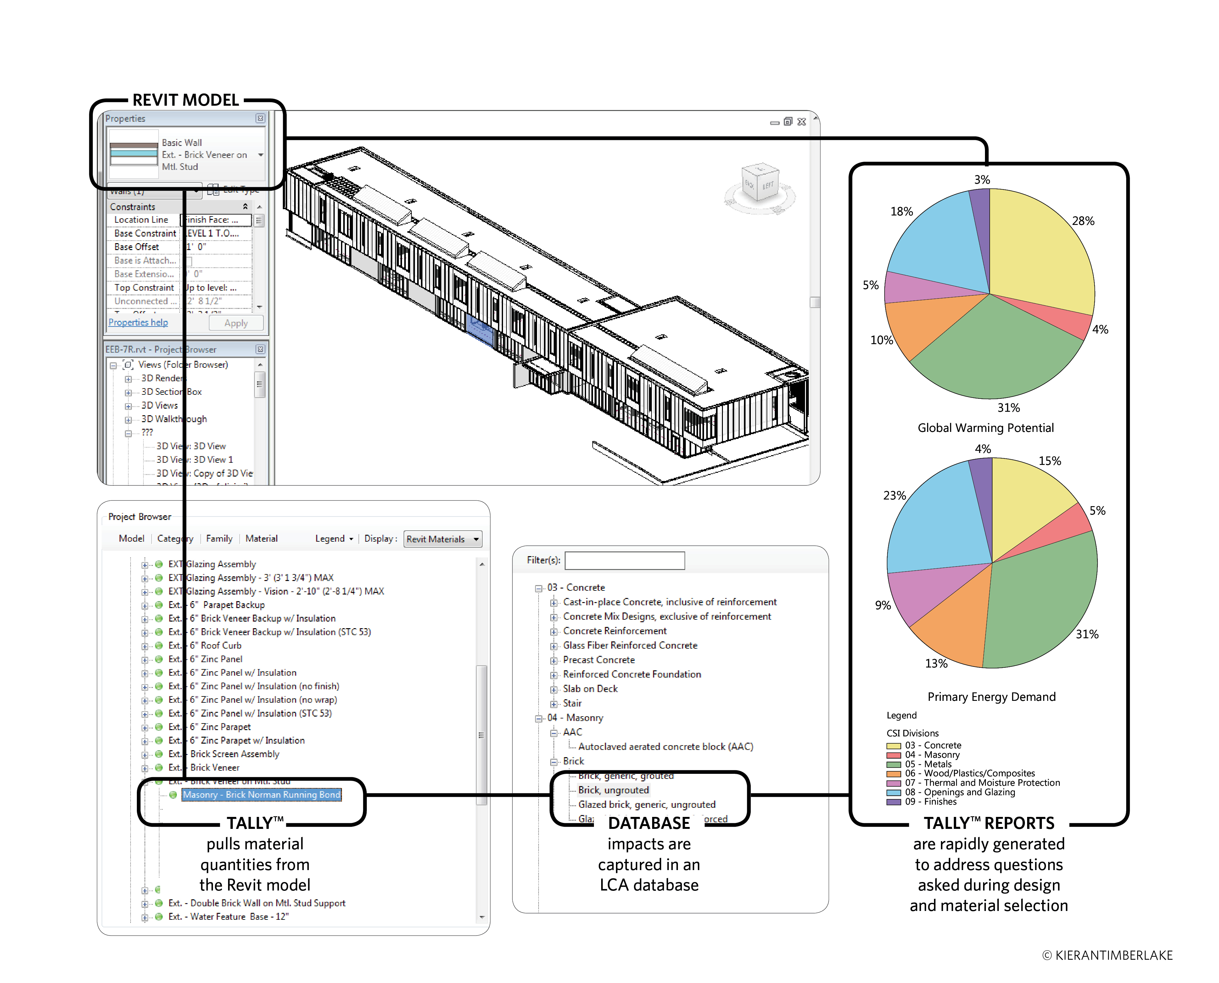
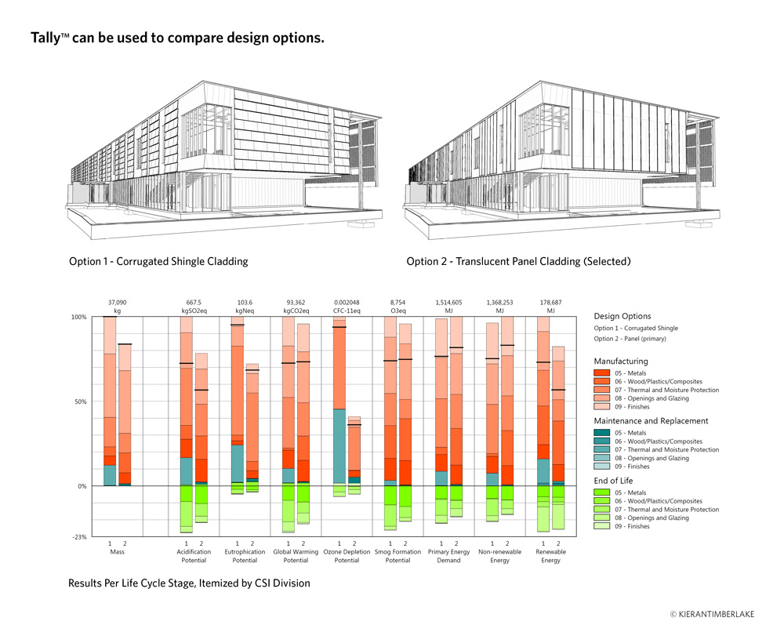
Embedding LCA Data into Revit
Connecting Product Data with the Tools of Design

Slide 32
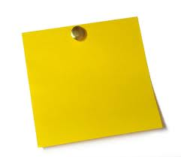

Don’t forget to ask how the process works?
TCNA
Available PCR Search
*Create new PCR
Conduct the LCA
Create the EPD
EPD Verification
Register EPD
Verify LCA
Manages Process
P.O
P.O
P.O
P.O
  P.O = Program Operator = PE Responsibility

Slide 33

What is the North American tile industry doing?
It’s here!
Environmental
Product
Declaration
For Tiles Produced in North America

Slide 34
TCNA Industry-Wide EPD Project
Generic “ceramic tile”
  Report of the environmental footprint of tile produced in North America
Participating manufacturers
  Arto
  Crossville
  Dal-Tile/American Marazzi
  Florim USA
  Florida Tile
  Interceramic
  Ironrock
  Porcelanite Lamosa
  Quarry Tile Company
  StonePeak Ceramics
  Vitromex

Slide 35
Ceramic Tile EPD Project
Program Operator: UL ENVIRONMENT
LCA Practitioner: PE INTERNATIONAL
Draft report completed
Report and LCA results submitted to the Program Operator, UL ENVIRONMENT, for peer review and certification
60-year Lifecycle Impact per Square Meter
Over 2 billion square feet of tile represented in study

Slide 36

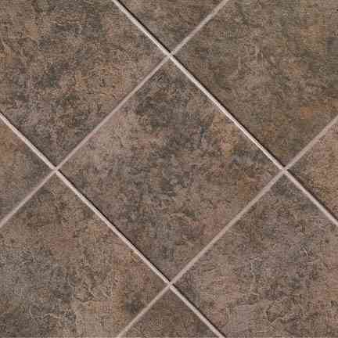
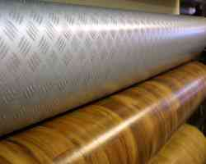

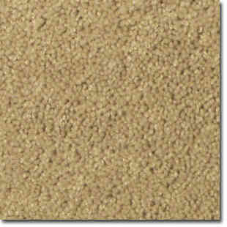
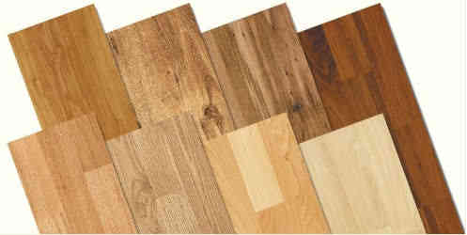
Based on North American Flooring PCR
Collaboration with competitive industries to establish consistent flooring Product Category Rules (PCRs)
  TCNA
  CRI
  RFCI
  NALFA
  NWFA
Published by NSF International

Slide 37
Why the Flooring PCR?
Resilient Floor Covering Institute (RFCI)
Carpet and Rug Institute (CRI)
ISO Type 3 Flooring EPD
PCR
ISO 14040 LCA
Tile Council of North America (TCNA)
North American Laminate Flooring Association (NALFA)
National Wood Flooring Association (NWFA)

Slide 38
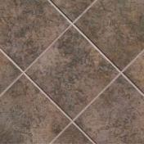
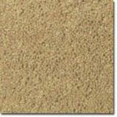


Flooring PCRs = Standardized Rules for Environmental Reporting Across North American Flooring Industry
“Apple to Apple” comparison enables consumers and architects to make informed product decisions.

Slide 39
North American Flooring PCR
Life Cycle Impact Assessment
  Over the span of 1 year and 60 years
  Impacts required to be reported in Flooring EPD
    Global Warming Potential (kg CO₂ equivalents)
    Photo-Oxidant Formation Potential (kg Ethene equivalents)
    Ozone Depletion Potential (kg R 11 equivalents)
    Acidification Potential (kg SO₂ equivalents)
    Eutrophication Potential (kg Phosphate equivalents)
    Abiotic Resource Depletion Potential—Elemental (kg Sb equivalents) and Fossil (MJ)

Slide 40

Global Warming Potential
Measured by emissions of carbon equivalent gases to air
Potentially, climate change and associated adverse effects
  Ecosystem health
  Human health
  Material welfare
Draft result for ceramic tile:
  Total for 1 year: 15 kg CO₂ eq
  Total for 60 years: 15 kg CO₂ eq

Slide 41
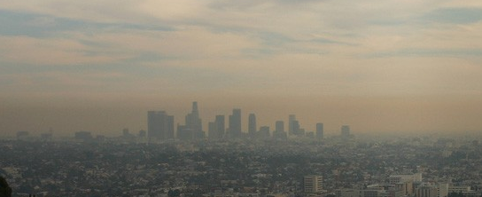
Photo-Oxidant Formation Potential
Largely associated with the formation of smog
Draft result for ceramic tile:
  Total for 1 year: 0.0051 kg Ethene eq
  Total for 60 years: 0.0052 kg Ethene eq

Slide 42
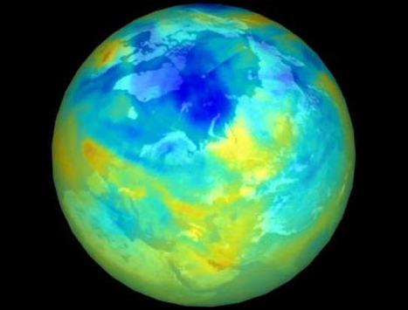

Ozone Depletion Potential
More UV-B radiation reaches earth surface
  Harmful effects on human health, animal health, terrestrial and aquatic ecosystems, biochemical cycles and materials
Draft result for ceramic tile:
  Total for 1 year: 7.4E-010 kg R 11 eq
  Total for 60 years: 8.1E-010 kg R 11 eq

Slide 43
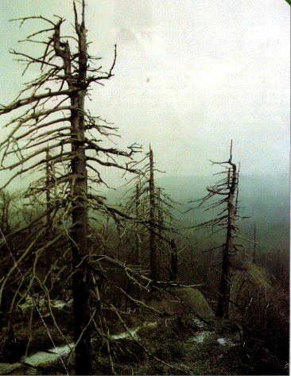
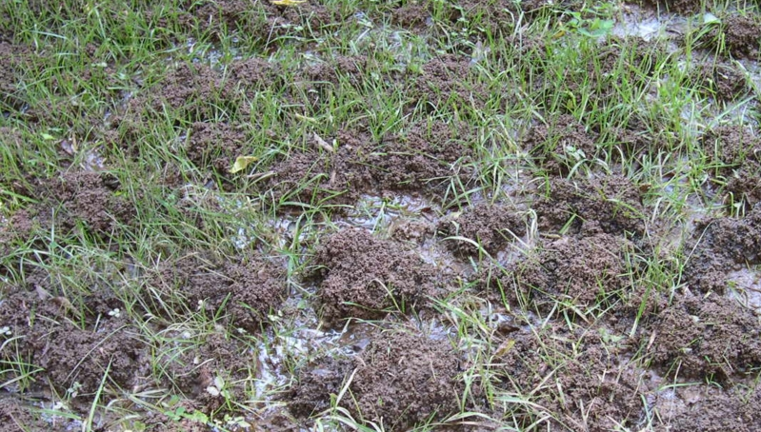
Acidification Potential
Impact of acidifying substances on soil, groundwater, surface water, organisms, ecosystems and materials (buildings).
Draft result for ceramic tile:
  Total for 1 year: 0.056 kg SO₂ eq
  Total for 60 years: 0.057 kg SO₂ eq

Slide 44
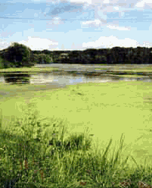
Eutrophication Potential
Excessive richness of nutrients in a body of water
  Nitrates and phosphates from fertilizer or sewage
  Dense growth of plant life and death of animal life from lack of oxygen
Draft result for ceramic tile:
  Total for 1 year: 0.056 kg SO₂ eq
  Total for 60 years: 0.057 kg SO₂ eq

Slide 45
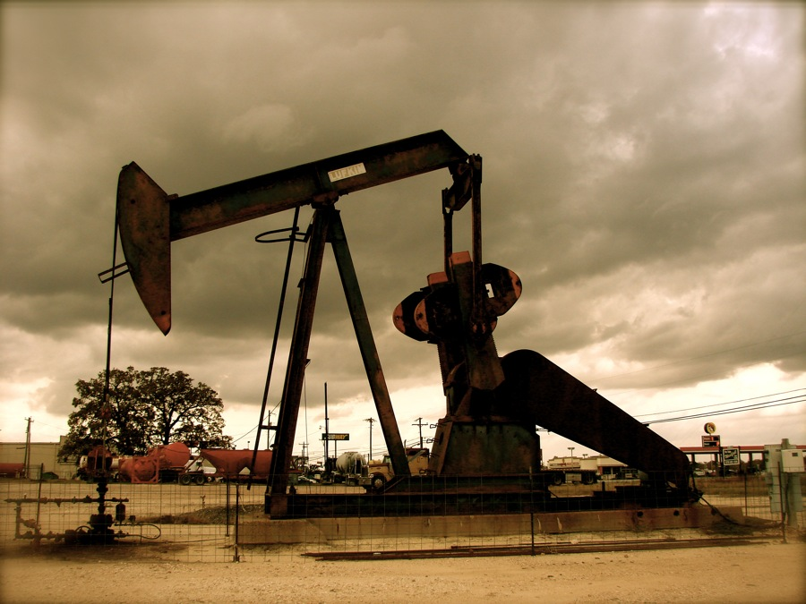
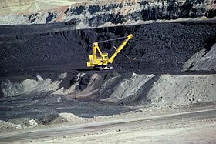
Abiotic Resource Depletion Potential
Impact on resources are that come from non-living, non-organic material (e.g. land, fossil fuels, metals)
Draft result for ceramic tile:
  Elemental
    Total for 1 year: 1.2E-005 kg Sb eq
    Total for 60 years: 1.2E-005 kg Sb eq
  Fossil
    Total for 1 year: 220 MJ
    Total for 60 years: 220 MJ

Slide 46
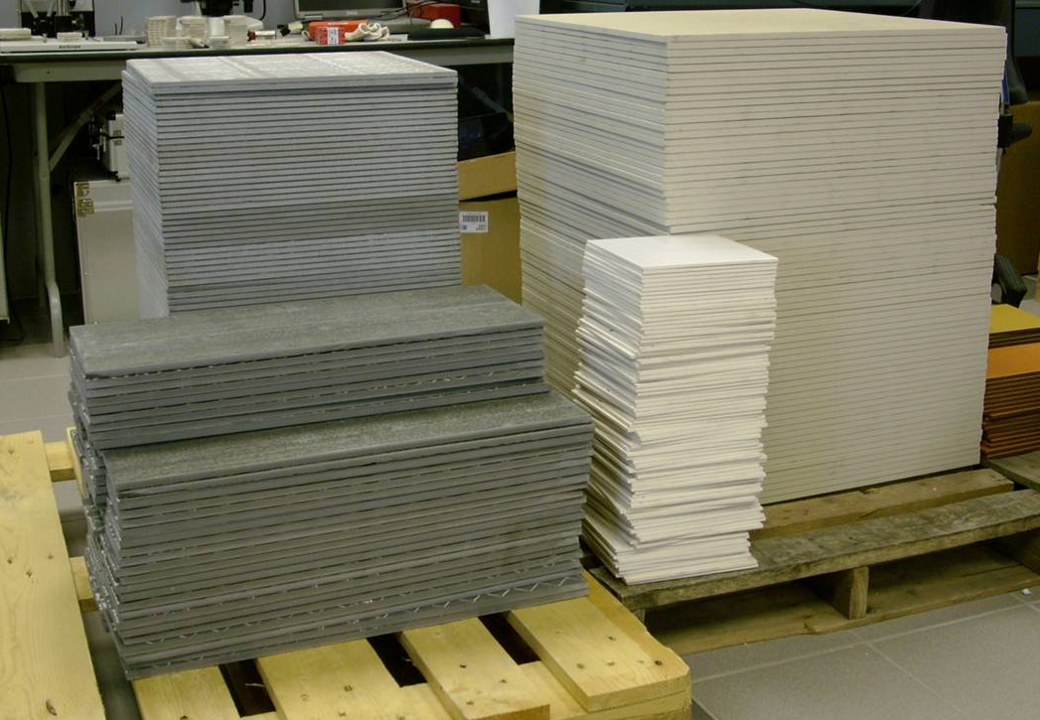
How to make sense of all of these numbers?
How does tile stack-up in comparison with other floor coverings?
Quick comparison to other types of floor coverings
  Generic resilient floor covering products
  A sampling of proprietary carpet products
Tile has lowest 60 year impact across all impact categories!

Slide 47
What else does the North American PCR require our EPD to report?
General description of the product
  How it’s made
  How products are classified
  Inherent attributes
  Installation and maintenance environmental aspects
Relevant quality and performance standards
Environmental certification program availability

Slide 48
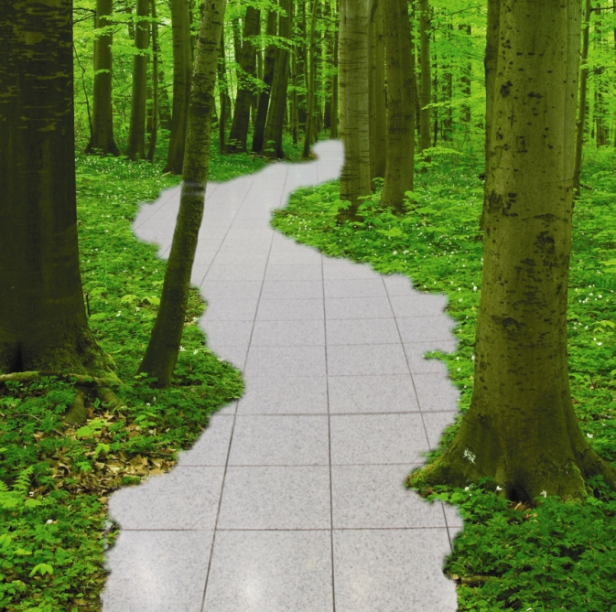
What’s Ahead?
Relevance of Generic Tile EPD
Established framework for EPD reporting
Environmental state of the industry—regular reporting
Increased recognition in Green Building

Slide 49
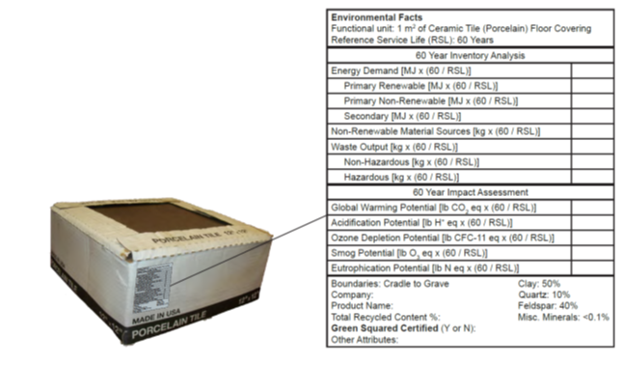
Framework for Future Initiatives
Baseline values for comparing product-specific EPDs
  Enables manufacturer optimization
  Marketing potential
Standardized reporting format
  Future EPD updates
  EPDs for other industry sectors
Population of building product databases

Slide 50

Unprecedented Level of Industry
Environmental Reporting

Slide 51

Using the New Tile EPD in LEED v4
Building Product Disclosure and Optimization—EPDs
Use 20 different products which have one of the following (1 point):
  Peer-reviewed LCA (counts as 1/4 product)
  Industry-wide EPD (counts as ½ product)
  Product-specific EPD (counts as 1 product)
50% of products whose LCA show impacts lower than industry average in three impact categories (1 additional point)

Slide 52
LEED v4 and the Tile Industry
With the establishment of industry-wide EPD
  Option for product contribution generically or proprietarily
  Possible contribution towards 2 points
North American tile industry is a LEEDer!
  Only the 2nd North American flooring sector to establish generic EPD
Building LCA databases populated with 60-year generic tile information
  Tile likely to be more widely recognized as “an option” with up-to-date data in most building LCA software modules
  Whole building LCAs becoming more popular in LEED

Slide 53
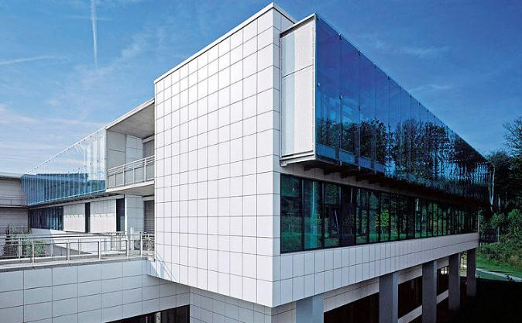
North American Tile EPD
Relevance to Other Green Building Standards and Rating Systems

Slide 54
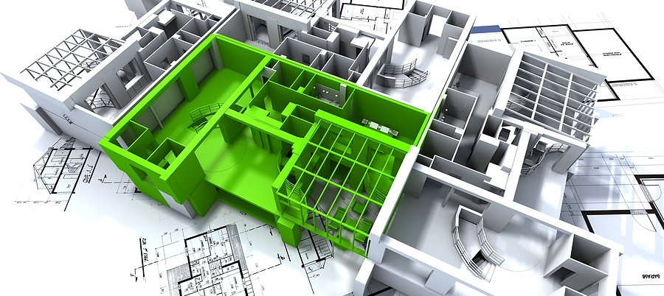
Trending Requirement for Green Building Products
Multi-Attribute Sustainable Product Certifications: Products certified to meet a multi-attribute sustainability standard
AND
Environmental Product Declarations (EPDs): Products which declare environmental characteristics in standardized reporting format

Slide 55
Tools for the North American
Tile Industry
Multi-Attribute Sustainable Product Certification—Green Squared®
  Performance
EPD for North American Tile
  Reporting
Both are important and facilitate the specification of products according to modern green building trends

Slide 56
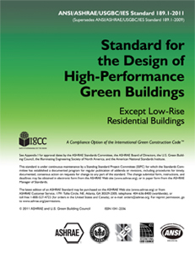
  Standard 189.1 for the Design of High-Performance, Green Buildings
ANSI/ASHRAE/USGBC/IES Standard 189.1
To be included in updated 2014 version
  9.4.1.4 Multi-Attribute Product Declaration or Certification
    Use at least 10 products that have a third party multi-attribute certification or EPD
    Products with LCAs, generic EPDs and brand-specific EPDs contribute

Slide 57
Green Globes for New Construction
Section 3.5.2.2.1
Points if certain percentage of products, based on cost have a combination of industry-wide EPD, product-specific EPD, or multi-attribute certification
  10% of products (5 points)
  27% of products (7 points)
  40% of products (10 points)

Slide 58
International Green Construction Code (IgCC)
Currently, 5 Code Change Proposals to specify product selection based on availability of EPDs and/or multi-attribute certification
Preliminary Hearings in Memphis, this week
Stay tuned . . .

Slide 59
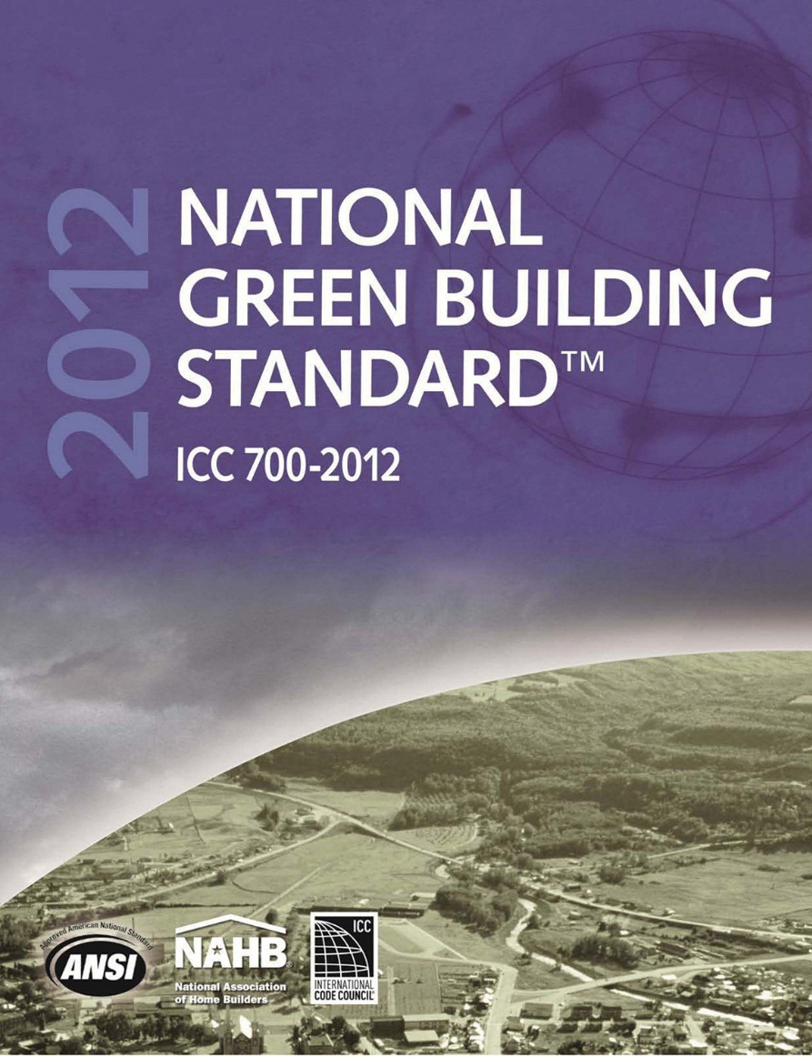
2012 National Green Building Standard
Section 610 Life Cycle Analysis
  When comparing two products within a common category
    Product selection based on best environmental performance within over 60 years
    2 or 3 points per product selection, depending on number of impact categories compared
Section 611.2 Sustainable products
  Select products with multi-attribute certifications

Slide 60
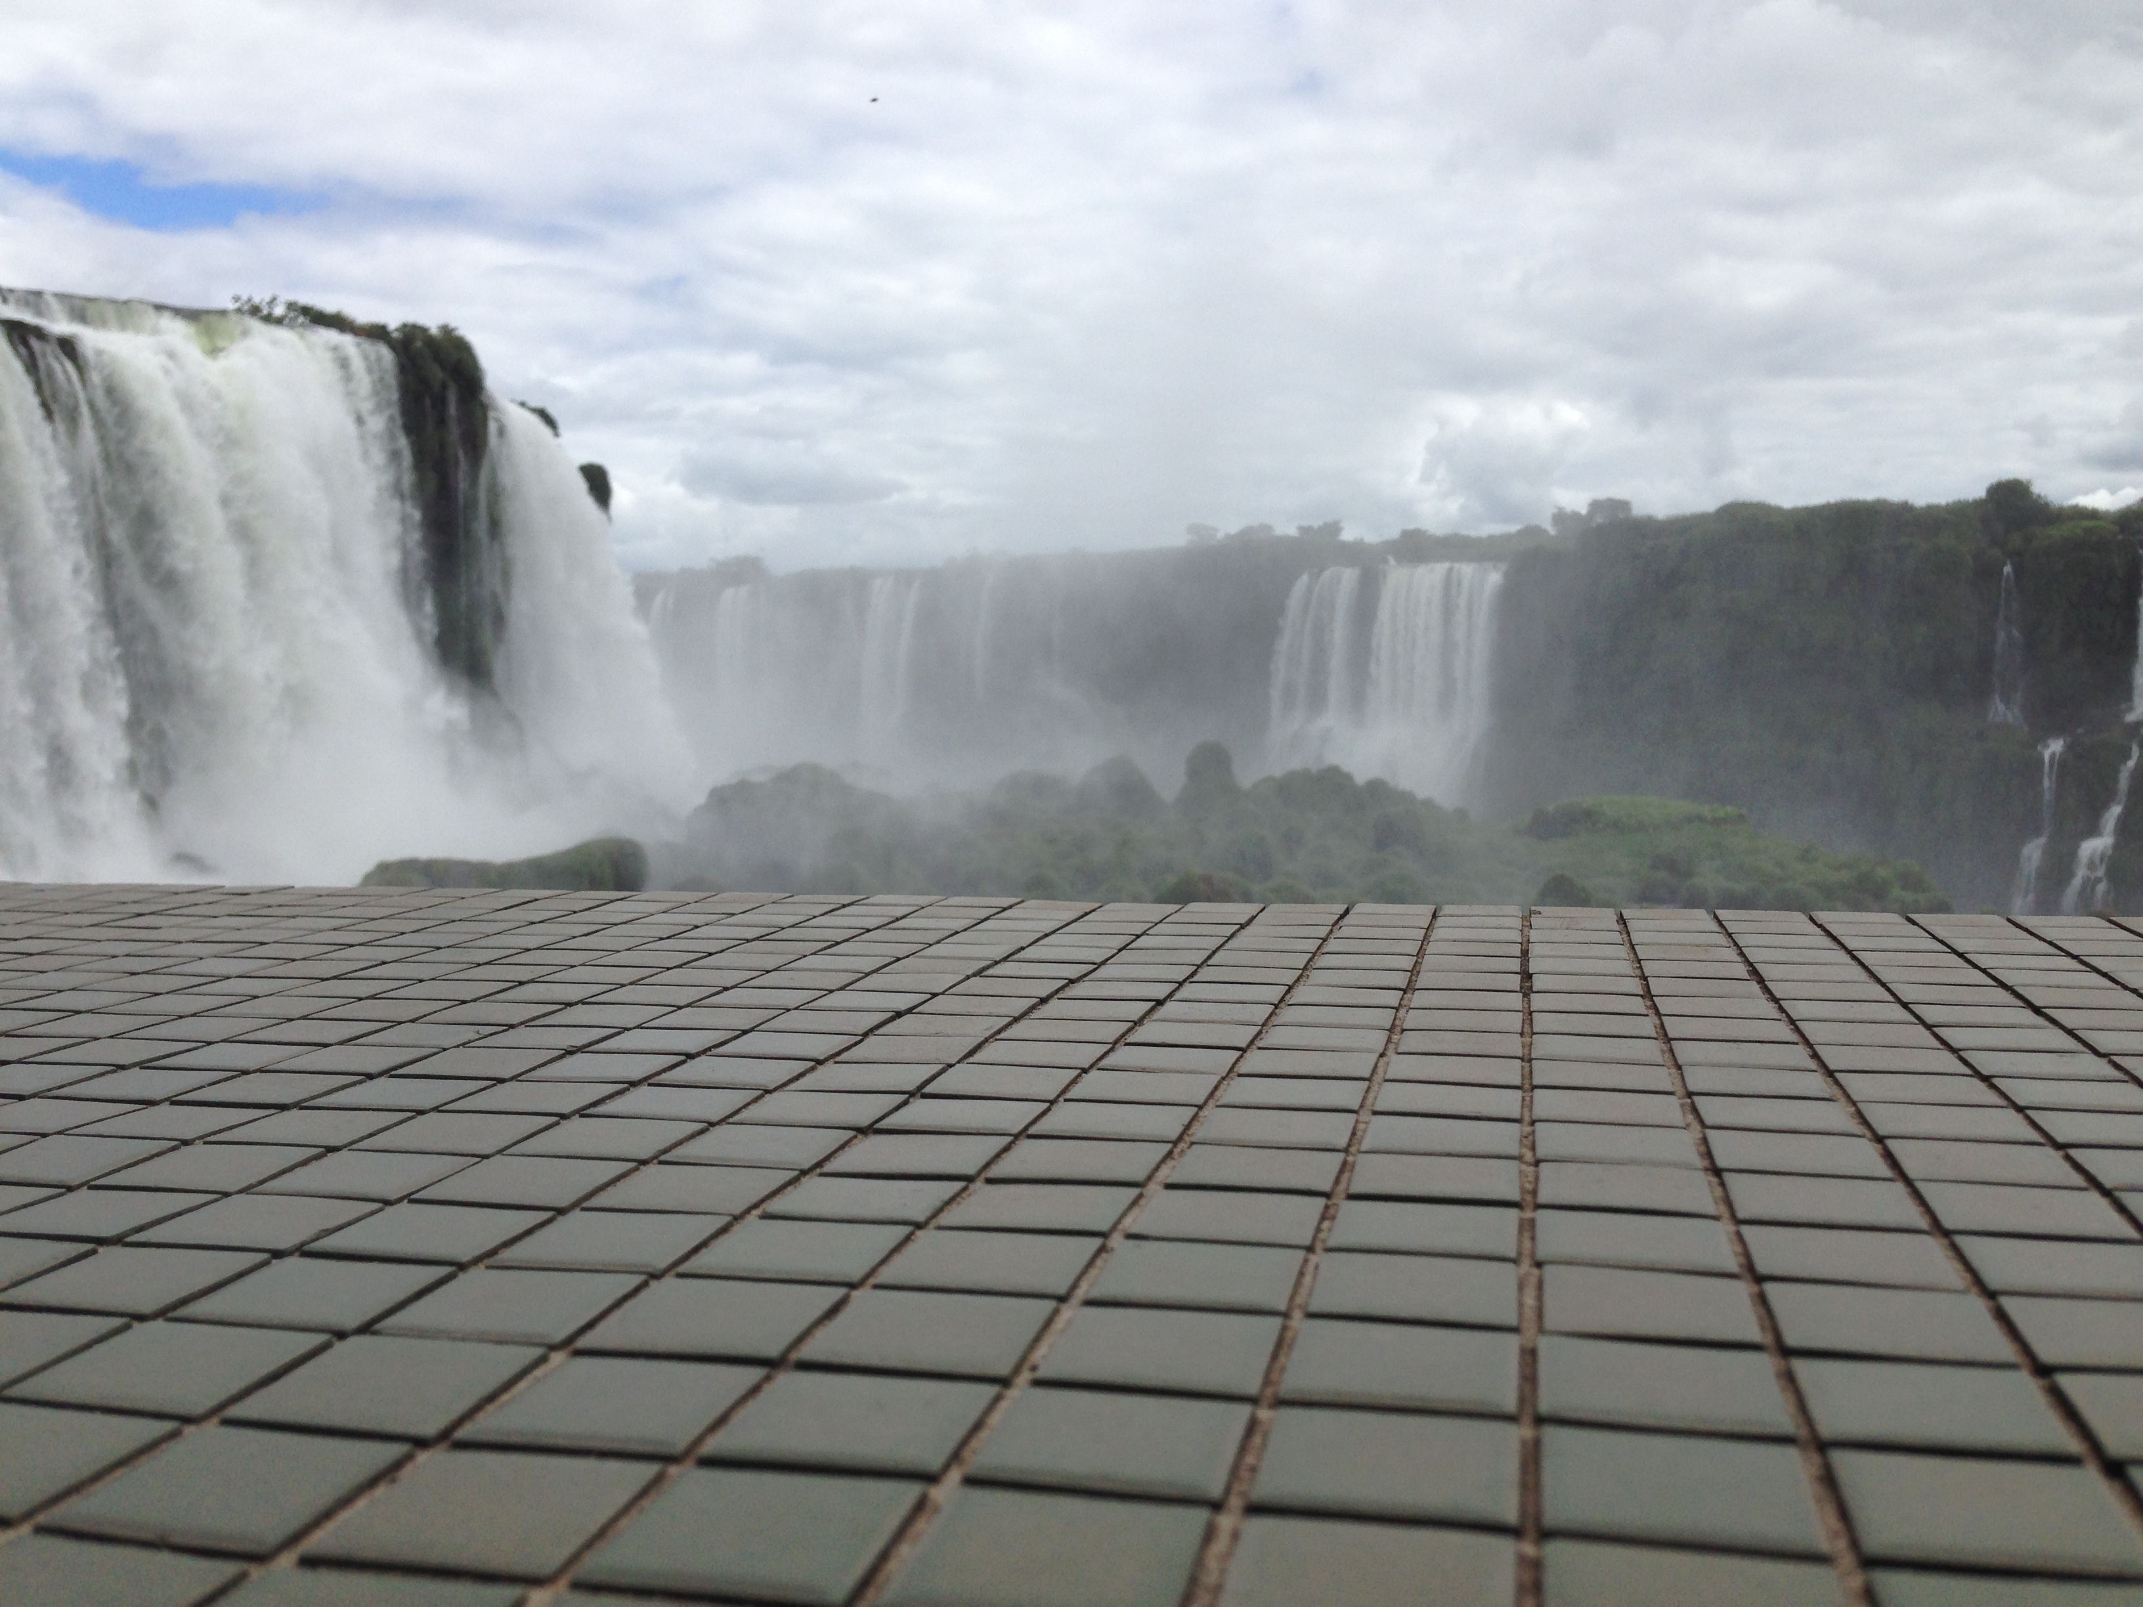
North American Tile EPD;
What This Means for the Industry
Continued relevance in green building initiatives for the foreseeable future
  Points in green building!
Ecological comparison of product data
  Proprietary products compared to industry average
  Tile industry compared to other industries
Tile industry life cycle data up-to-date and accurate

