Slide 1
DCOF AcuTestSM:
The New and Improved Method for Coefficient of Friction

Slide 2
The Standard for Coefficient of Friction in the U.S. Tile Industry has Changed!

Slide 3
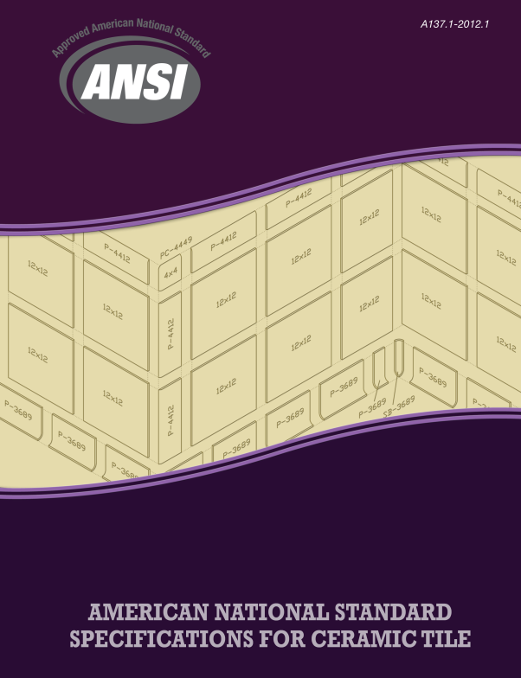
The Standard for COF has Changed
  After 20+ years of specifying ASTM C1028 as the standard test method for COF in the U.S., the ANSI A137.1 specification now has a new method and new requirement.
  This change went into effect September 2012.

Slide 4
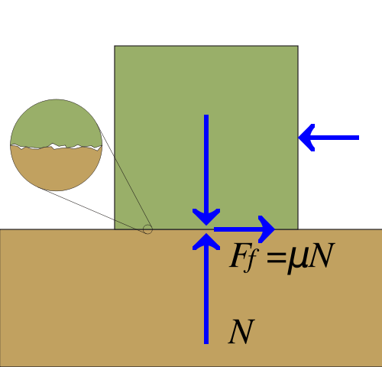
What is Coefficient of Friction?
  COF – Coefficient of Friction is a dimensionless ratio of tangential force divided by normal force (the force perpendicular to the tangential force)
  On a level floor, it is simply the force resisting sideways movement divided by the weight of the object (COF = F/N = μ)

Slide 5

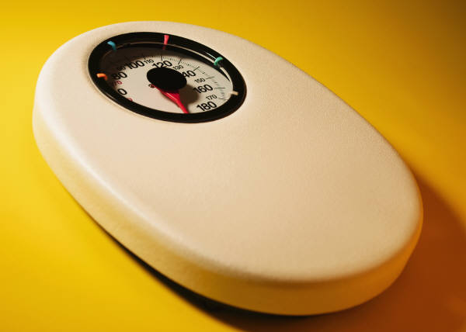
Coefficient of Friction =
“The Force”
“Weight”

Slide 6
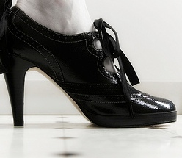
What is Coefficient of Friction?
COF is dependent on the two surfaces in contact
For example: Shoe sole and tile surface
Other Variables that affect COF:
Surface contaminants
    Residual soap on floor
    Grease/oil
    Food debris

Slide 7
More Variables that affect COF
Geometric properties at the interface
    Smooth
    Rough
    Textured
Temperature & Humidity

Slide 8
What is Coefficient of Friction?
Is it always the same?
    No, dependent on the variables discussed.
Can you say a tile has a COF of 0.60?
    No, it is not a property of the tile.
    Refers to the value obtained between a test sensor and the tile (i.e. COF of 0.6 when tested per ___

Slide 9
Definition of DCOF
Dynamic Coefficient of Friction (DCOF): The ratio of force necessary to keep a surface already in motion sliding over another divided by the weight (or normal force) of an object.
DCOF = Dynamic Force (F)/weight of object

Slide 10
Definition of SCOF
Static Coefficient of Friction (SCOF): Is the ratio of the force necessary for a surface to begin sliding over another divided by the weight (or normal force) of an object.
SCOF = Maximum frictional force (F_{max}) before sliding begins/weight of the object
< F_{max} – Sliding does not occur
> F_{max} – Sliding does occur

Slide 11
What is Coefficient of Friction?
  EXAMPLES:
  If it takes 60 lbs. of force to start a 100 lb. object moving sideways, the static coefficient of friction (SCOF) is 60/100 or 0.60
  If it takes 45 lbs. of force to keep the object moving at a constant velocity (not accelerating), then the DCOF is 45/100 or 0.45

Slide 12
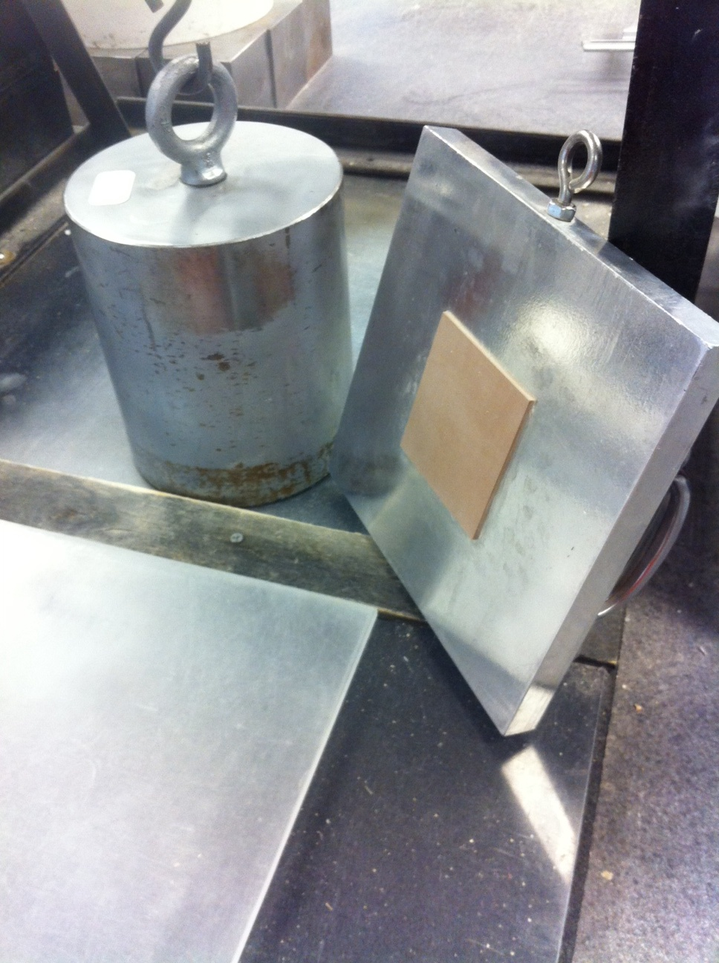
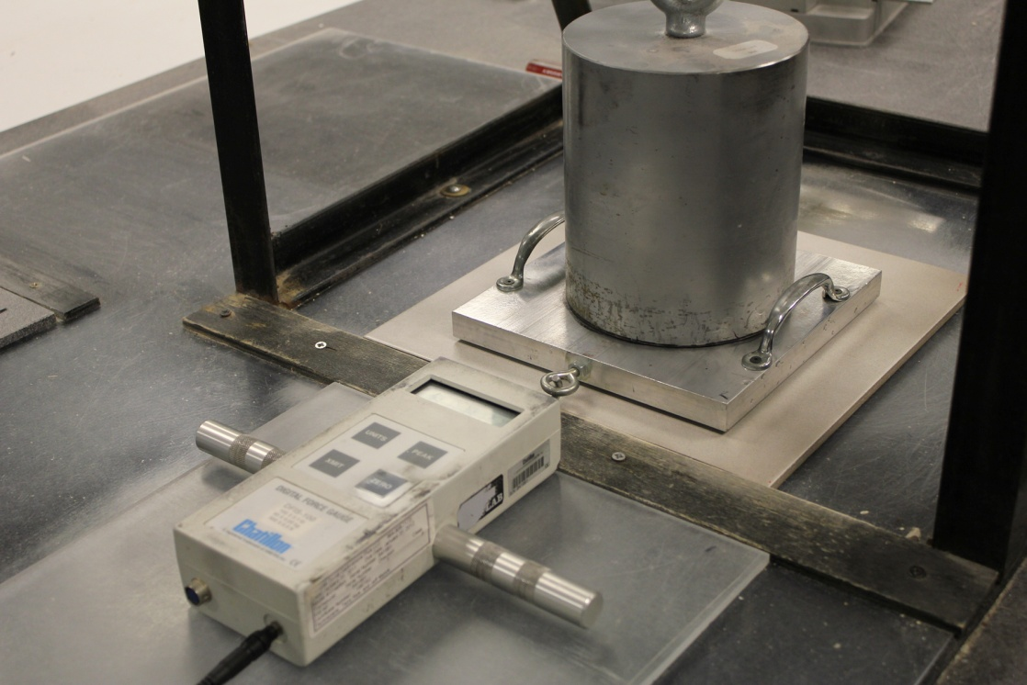
The Old Method: ASTM C1028
Static Coefficient of Friction
  Pull meter method
  Neolite (syn. rubber test foot)
  Measures wet and dry static coefficient of friction

Slide 13
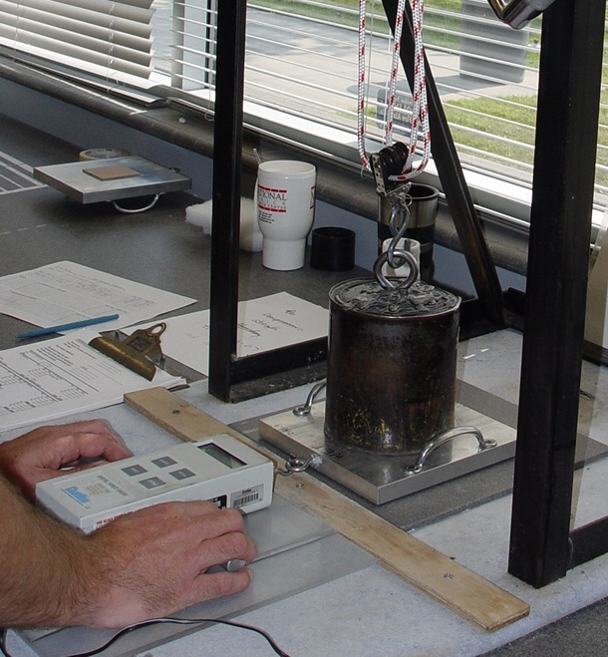
Issues with the ASTM C1028 Test Method
  Variables that can affect results
  (testing requires experienced &
  skilled technician)
      Pulling motion
      Sanding pressure
      Sanding technique
  Availability of Neolite rubber
  material
  Stiction
      Affects measurement of polished and highly smooth surfaces

Slide 14

Stiction
  May occur when measuring wet static COF of polished or very smooth surfaces
  Caused in part by the surface tension of water – similar to two wet pieces of glass sticking together
  Possible to generate higher COF results which may give a false expectation of slip resistance

Slide 15

The New Method: DCOF AcuTestSM
  The new method is included in section 9.6 of the ANSI A137.1 Standard Specifications for Ceramic Tile
  ANSI A137.1-2012 also includes:
      Definitions for SCOF and DCOF
      Threshold value for DCOF in Specification Tables
      Informational section (6.2.2.1.10)

Slide 16
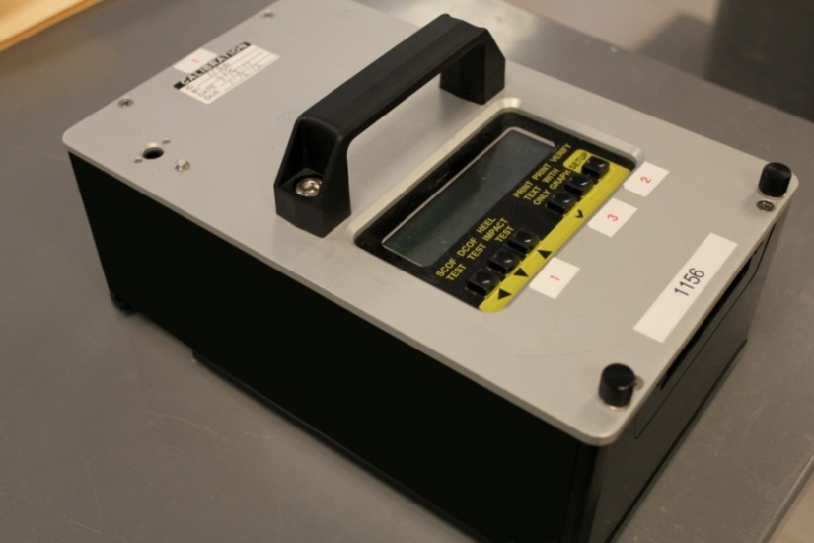
New DCOF AcuTestSM Test Method
  Dynamic COF (DCOF) testing using the BOT 3000 (or equivalent) automated and portable testing device
  Testing done with 0.05% SLS water
  SBR Sensor sanded with
  sanding device
  Four measurements on
  each tile
  Report the 4 measurements
  for each piece of tile - measure three tiles, or more if more than 3 textures are present

Slide 17
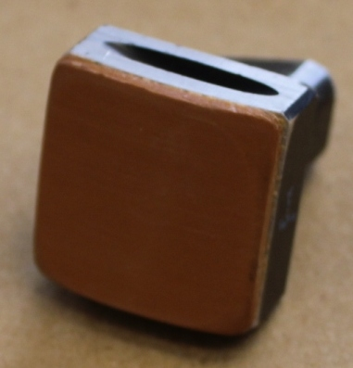
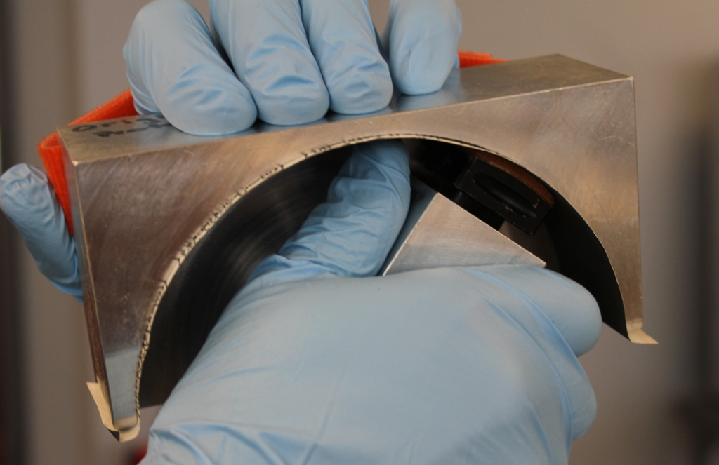
Sensor Preparation Procedure
Sensor
400 Grit Sandpaper

Slide 18
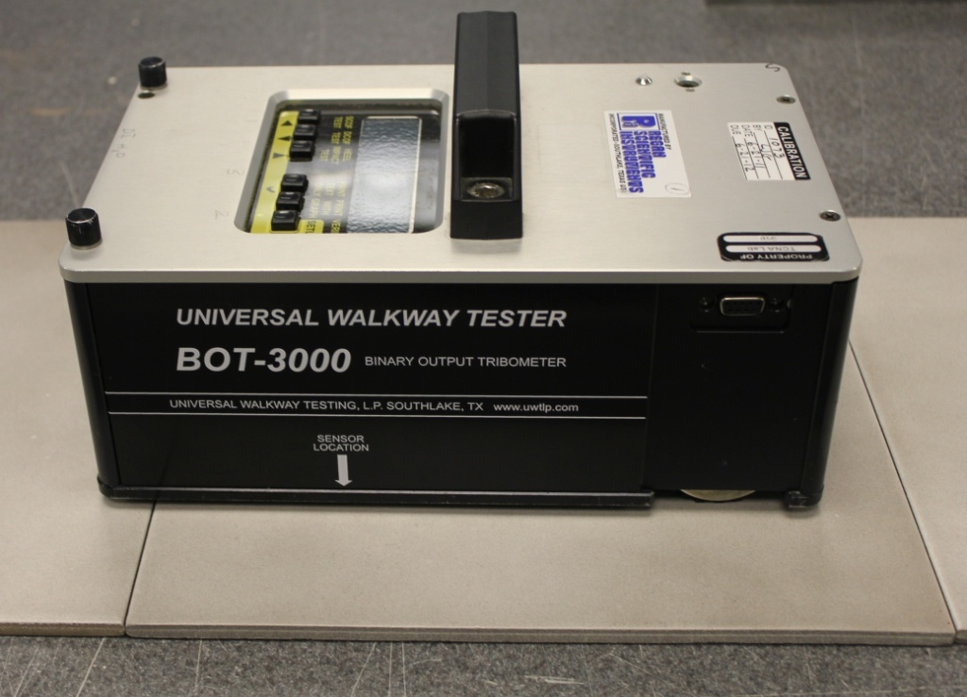
Standard Tile for Sensor Verification
Standard Tile
One measurement made on standard tile. If within appropriate range, proceed with the test.

Slide 19
What does all this mean?

Slide 20

Changing from Static to Dynamic COF
  Note that the new test method is a dynamic coefficient of friction test as opposed to static.
  Why is this important?
      They are different!

Slide 21

Static COF (Old Method) vs.
Dynamic COF (New Method)
  Static COF is higher than Dynamic COF
    From research at TCNA, on average 0.60 SCOF correlated with 0.38 DCOF (further details to be explained later).
  More force required to make an object begin sliding

Slide 22

What About the “ADA Requirement”?
  Commonly we hear that the
  SCOF of commercial floors
  is required to be 0.60 per the
  1991 Americans with
  Disabilities Act.
  ADA did not set a requirement but rather referenced accessibility guidelines in the appendix (Section A4.5) that recommended a value of 0.6 SCOF, but failed to specify a means of measurement.

Slide 23

What About the “ADA Requirement”?
  With over 10 devices in the marketplace, all measuring COF differently and providing very different values, the recommended 0.6 SCOF value was meaningless without a test method.
  When the ADA accessibility guidelines and the guidelines for access to Federal facilities covered by the Architectural
  Barriers Act (ABA) were
  updated in 2004, the 0.6 SCOF recommendation was withdrawn.

Slide 24

What About the “ADA Requirement”?
  Even though the 0.60 recommendation was removed from the ADA document, the value is still widely used by specifiers when referring to ASTM C1028 SCOF results.

Slide 25

Legal Issues with the Old Method
  People who use other devices, that are very different from ASTM C1028, reference the 0.60 “ADA” value in court.
  Many use devices that measure Dynamic COF, but still reference the 0.60 SCOF value.
  There is no published threshold value for SCOF.

Slide 26

For the first time ever…
ANSI A137.1 contains a threshold COF value!

Slide 27
There is a Dynamic COF Threshold Value included in the new ANSI A137.1 – 2012 when products are tested with the new method.
0.42 for level interior spaces expected to be walked upon when wet.
Note: Minimum threshold value is found in the specification tables for mosaic tile, quarry tile, pressed floor tile, and porcelain tiles, as well as, section 6.2.2.1.10 of ANSI A137.1-2012.

Slide 28

What About Ramps,
Exterior Applications, etc.?
  Note: The DCOF threshold value is specifically for level interior spaces expected to be walked upon when wet.
  There are no threshold values specific to ramps or exterior applications.
  Many tile manufacturers have tiles they sell for these applications. Tiles appropriate for ramps or exteriors shall be chosen for the specific properties and use of the application.

Slide 29
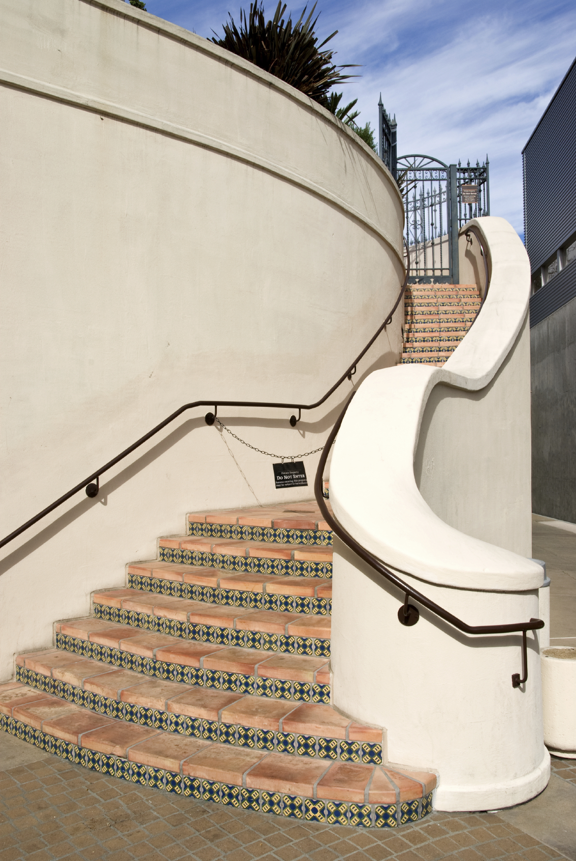
Tile in Exterior Applications
  On exterior applications, there are many factors that create slippery conditions that cannot be avoided.
  The COF of the tile surface shall not be the only factor considered when designing for these environments.
      Other factors such as drainage, number of grout joints, structure of the tile surface, etc. must also be considered.

Slide 30

Why DCOF AcuTest? You might ask…

Slide 31
So Why the Switch to DCOF AcuTest?
  Dynamic testing is done in many other countries.
  Generally more repeatable predictor of slip resistance.
  Method is a more suitable test of polished and highly smooth surfaces.
  DCOF measures COF when sensor is already in motion, which better simulates human ambulation at the time of most slips.

Slide 32

Finding the Right Test Method…
  Extensive research done at the University of Wuppertal in Germany
      Studied various devices, sensor materials, and wetting agents
      Showed BOT 3000 has good correlation to German Ramp and GMG 100/200
  Studies done in TCNA laboratory to develop the new method
      Static vs. Dynamic COF, DI water vs. SLS water, BOT 3000 vs. C1028, BOT 3000 vs. British Pendulum
      Designed a specialized sanding device for BOT 3000 sensors to eliminate variation from sanding

Slide 33
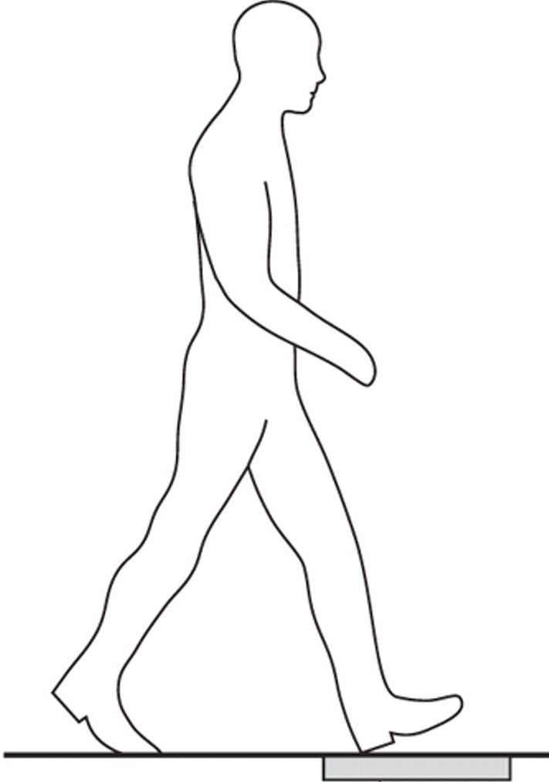
Where Did 0.42 DCOF Come From?
  0.42 value stems from the research done at the University of Wuppertal over ten years to establish threshold values used by the German Workers Compensation Board.
  TCNA comparison of over 300 tile surfaces: 0.6 SCOF correlated with 0.38 DCOF (w/SLS).

Slide 34

Where Did 0.42 DCOF Come From?
A137.1 specifies 0.42 to follow German Research and include additional
measure of safety
0.42

Slide 35


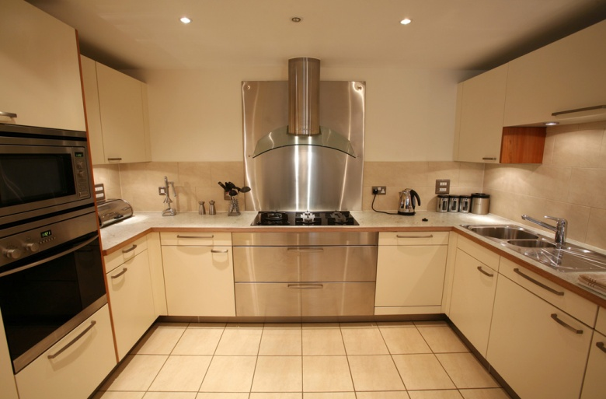
How Can the Standard be Used to Specify a Tile?
The new ANSI A137.1-2012 contains a two page section on COF (section 6.2.2.1.10) which many specifiers will find helpful in determining the right tile for the job.

Slide 36
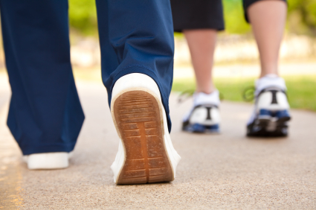
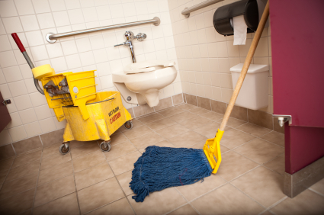

Section 6.2.2.1.10 of ANSI A137.1-2012
Specifying Tile
“Because many variables affect the risk of a slip occurring, the COF shall not be the only factor in determining the appropriateness of a tile for a particular application.”
Multiple factors that affect the possibility of a slip occurring on a tile surface are listed.

Slide 37

Also in Section 6.2.2.1.10…
“The specifier shall determine tiles appropriate for specific project conditions, considering by way of example, but not in limitation, type of use, traffic, expected contaminants, expected
maintenance, expected wear, and
manufacturers’ guidelines and
recommendations.“
Footnote: The COF of installed tiles can change
over time as a result of wear and surface
contaminants. In addition to regular cleaning, deep
cleaning and traction-enhancing maintenance may
be needed periodically to maintain DCOF values.

Slide 38

Also in Section 6.2.2.1.10…
Specifying Tile
  “The presence on installed tiles of water (including standing water as can exist on floors which are not properly sloped for drainage or on exterior tiles immediately after a rain storm or on which snow is melting), oil, grease, and any other elements which reduce traction, creates slippery conditions where the risk of a slip or fall cannot be completely eliminated.”

Slide 39

Also in Section 6.2.2.1.10…
Specifying Tile
“Tile installations with exposure to such elements require extra caution in product selection, use, and maintenance. The risk of a slip can be diminished but not eliminated in these installations by installing tiles with a structured/textured surface, mosaic tiles, or certain extruded unglazed quarry tiles. The specifier shall follow
manufacturers’ guidelines
and recommendations for
these products.”

Slide 40
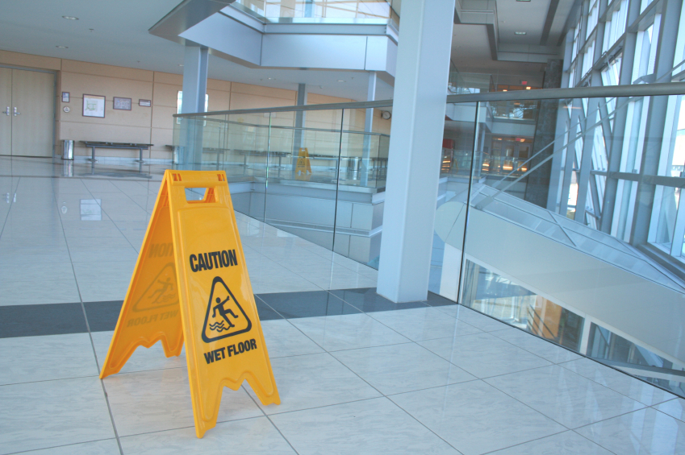
Also in Section 6.2.2.1.10…
Specifying Tile
“When tested using SLS solution as per the procedure in section 9.6.1, tiles with a wet DCOF of less than 0.42, (including by way of example, but not in limitation, polished tiles), shall only be installed when the surface will be kept dry when walked upon and proper safety procedures will be applied when cleaning the tiles.”

Slide 41

How do we transition from the old to the new?

Slide 42
Transitioning to the DCOF AcuTest
Legal Issues
Now that there is a threshold requirement and recommendations made in the ANSI A137.1 standard, any party involved in the chain of sales may be held responsible for knowing about the new 0.42 requirement.

Slide 43
Transitioning to the DCOF AcuTest
Legal Issues
  In some cases, both SCOF and DCOF may be required
      DCOF AcuTest automatically applies as an active standard
      Specifications and older documents may still reference 0.60 per ASTM C1028
  SCOF will still be used for comparing to historical data.

Slide 44
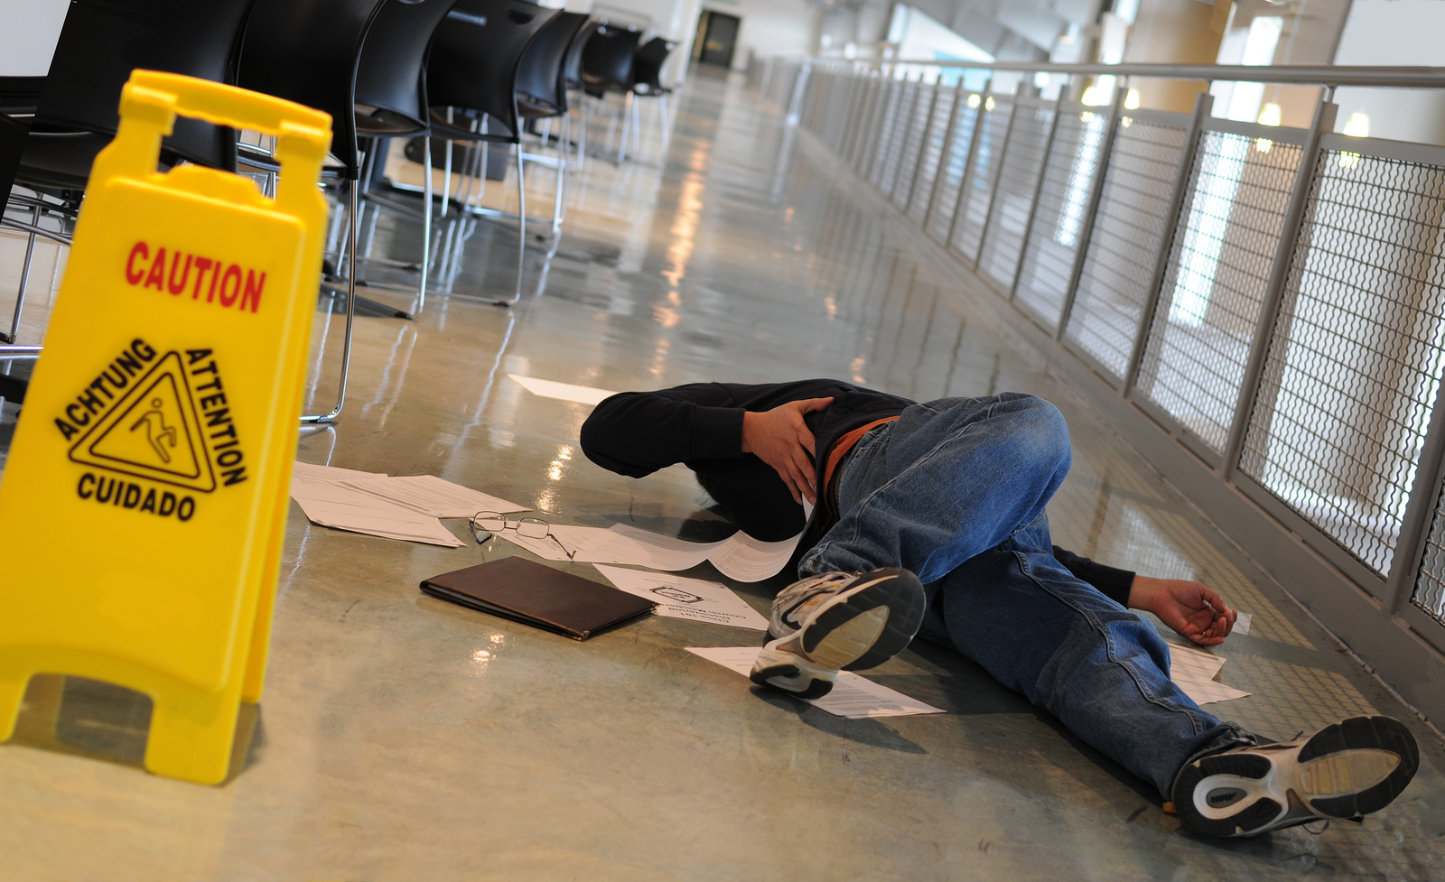
Transitioning to the DCOF AcuTest
  There will still be a need for SCOF until there is more understanding and recognition of DCOF nationwide.
  For level, interior
  tile floors
  expected to be
  walked upon
  when wet:
  know the DCOF AcuTest value…

Slide 45
Transitioning to the DCOF AcuTest
  ASTM C1028 expires in 2014
  Industry will no longer routinely provide C1028 values starting in 2014

Slide 46

Getting the Word Out…
  2012 TCNA Handbook – Tile Initiative Insert available for free download from TCNA’s website (www.tcnatile.com)
  Q&A Article in May/June 2012 issue of Tile Magazine
  TCNA’s website
  Manufacturer’s literature
  and websites

Slide 47

This new method can change the industry…

Slide 48

Game Changer Ahead…
  The BOT 3000 being a portable device now allows for more ease in testing in the field.
  This means periodic testing can be done to monitor the DCOF of the actual floor.
      Done by building owners, maintenance professionals, etc.

Slide 49
The Game Changer!
  Having a portable device that can be used onsite will help building owners identify possible maintenance and safety issues
  A log of floor measurements
  can be used to prove
  compliance in the event
  of a slip/fall claim

Slide 50
The Game Changer!
  If areas of low traction are identified, traction enhancement measures can be taken
  Accidents are prevented… the world is a safer place!

